Slide 1
Exploring the Battery Market for Electric Cars
THE 36TH INTERNATIONAL CONFERENCE OF THE SYSTEM DYNAMICS SOCIETY
REYKJAVÍK, ICELAND
Jonatan Gómez Vilchez, Joint Research Centre
The views expressed are purely those of the presenter and may not in any circumstance be regarded as stating an official position of the European Commission

Slide 2
Problem Statement
Over 3 million electric cars in use worldwide in 2017 (EVI, 2018)
Goal: 100 million electric cars globally in 2030 (COP21, 2016)
Potential supply-side constraints neglected
Resource scarcity
Supply chain bottlenecks

Slide 3
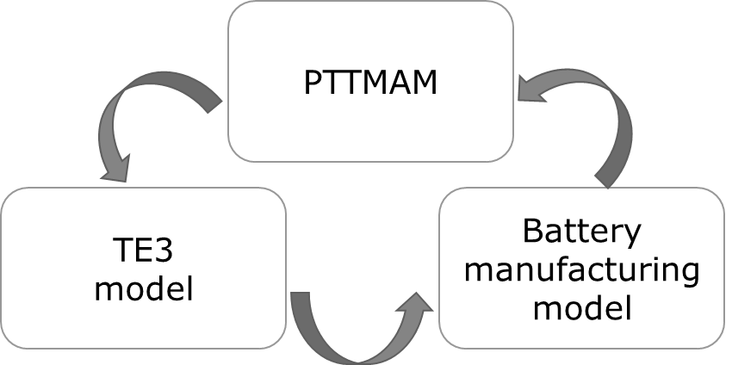
Approach or Dynamic Hypothesis

Slide 4
Progress and Insights to Share
Battery market dynamics disruptive
Source: own assumptions based on Lebedeva et al. (2016) and DB (2016)

Slide 5
References
COP21 (2016) Paris Declaration on Electro-Mobility and Climate Change and Call to Action - Electrifying Sustainable Transport, 21st Conference of the Parties (COP). Available at: http://newsroom.unfccc.int/lpaa/transport/the-paris-declaration-on-electro-mobility-and-climate-change-and-call-to-action/
DB (2016) EV battery makers. Market research. Deutsche Bank (DB)
EVI (2018) Global EV Outlook 2017. Electric Vehicles Initiative (EVI)
Lebedeva, N., Di Persio, F., Brett, L. (2016) Lithium ion battery value chain and related opportunities for Europe. Publications Office of the European Union
I thank Sebastiaan Deuten for his Causal Loop Diagram on slide #3.

