Slide 1
Dynamics of Migration: Population Growth, Food Security, and Water Resource Management in the Nile River Basin (1962-2050)
THE 36TH INTERNATIONAL CONFERENCE OF THE SYSTEM DYNAMICS SOCIETY
REYKJAVÍK, ICELAND
Bruce Keith, US Military Academy
Mary Keith, McGill University
Cody Akers, US Military Academy
Amanda Ramirez, US Military Academy
Patrick Wall, US Military Academy
0:00-0:30
Notes:
Title page: Bold the name of the presenter and display your name as you want it read by the moderator (eg Bob instead of Robert). Do not include contact information. Timing in the bottom right. Moderator will change slide following that schedule, or earlier if requested. Change if needed.

Slide 2
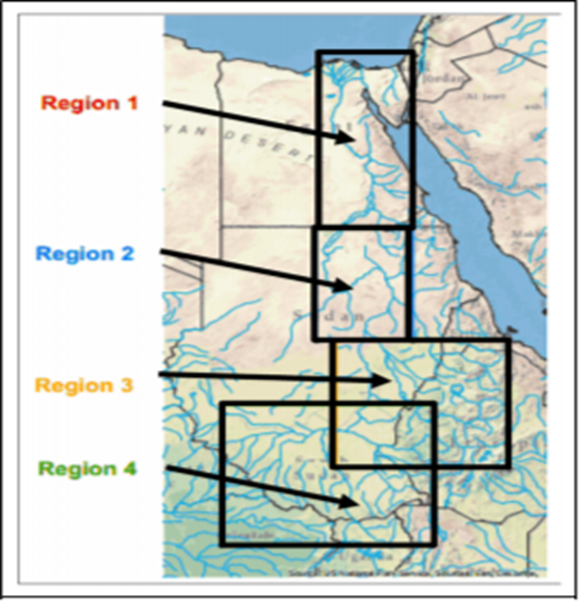
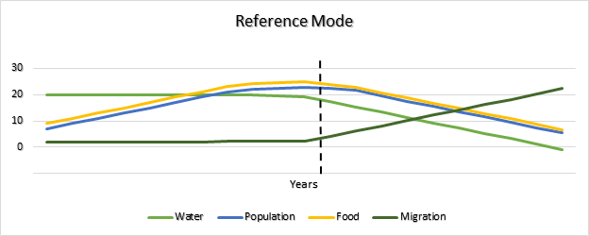
Problem Statement
The purpose of our study is to explain the effect of changes in water resources, food production, and population changes on plausible human displacement in the Nile River Basin and to understand various policy strategies available to mitigate these outcomes. Our study will focus on four regions of the Nile River Basin.
Egypt
Sudan
Ethiopia
Uganda
0:30-2:00
Notes:
Problem Statement: Do not change this title. Keep fonts big (24 pt or bigger). Indicate why the problem is important.

Slide 3
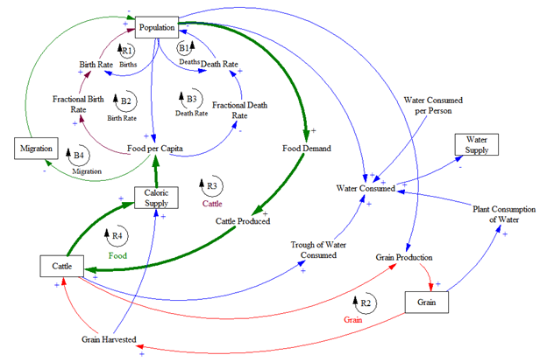
Approach or Dynamic Hypothesis
Dynamic Hypothesis: If resource levels remain constant with a growing population in the NRB, then resource adequacy will struggle to support the population. Large scale migration of people, or an increased death rate are probable results.
2:00-3:30
Notes:
Again big fonts, do not alter title

Slide 4
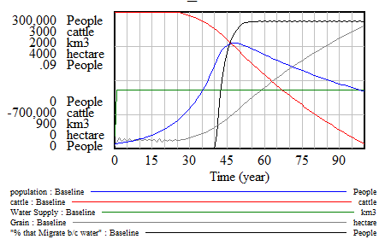
Progress and Insights to Share
Sensitivity analysis was conducted on human diet composition, water consumed per hectare of crops, water extraction, crop capacity.
Output from base model shows behavior consistent with the overshoot and collapse displayed by the reference mode. The graph shows that water and its structure acts as a carrying capacity and drives model behavior
Key findings
Volatility of resource management in NRB
Security applications
Importance of irrigation techniques
Adoption of more efficient farming
Future work
Creation of mapping output capability
Fewer assumptions leading to the formation of the model
Goodness of fit analysis of historical data and model output
Inclusion of foreign aid variable
Add additional causal loops to replace lookup functions
3:30-5:00
Notes:
Again short. Show structure or behavior – may not be room for both (some flexibility on font for these). No need to conclude, there is always more to be done. Note the timing in the bottom right.

