Slide 1
A Social Integration Case Accelerating Learning by Prototyping and Modelling Human Systems Interventions
THE 36TH INTERNATIONAL CONFERENCE OF THE SYSTEM DYNAMICS SOCIETY
REYKJAVÍK, ICELAND
Diego Luzuriaga, Buenos Aires Institute of Technology (ITBA)
Mariana Ameri, Buenos Aires Institute of Technology (ITBA)
0:00-0:30
Notes:
Title page: Bold the name of the presenter and display your name as you want it read by the moderator (eg Bob instead of Robert). Do not include contact information. Timing in the bottom right. Moderator will change slide following that schedule, or earlier if requested. Change if needed.

Slide 2
Problem Statement
Social integration of shanty towns inhabitants has proven to be an almost impossible task for Argentinian governments.
Social integration dynamics are strongly characterized by mistrust and rejection
0:30-2:00
Notes:
Problem Statement: Do not change this title. Keep fonts big (24 pt or bigger). Indicate why the problem is important.

Slide 3
Approach or Dynamic Hypothesis
Under controlled and neutral conditions it is possible to develop nurturing and integrating activities between the two groups that will foster mutual trust among them.
Prototyping + modelling can accelerate learning in human systems interventions
2:00-3:30
Notes:
Again big fonts, do not alter title

Slide 4
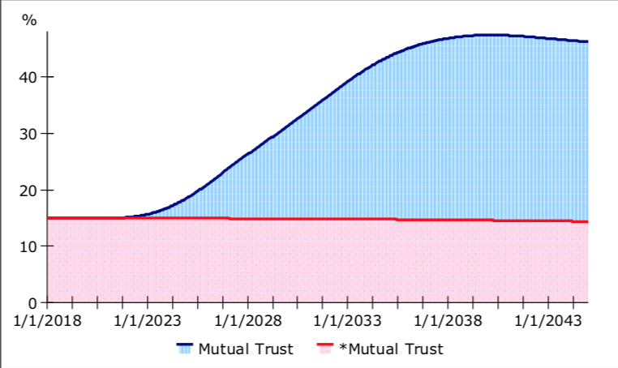
Progress and Insights to Share
Recognition of own an others’ vulnerability is the basis for the development of empathy and serves as the starting point for social integration
Long term efforts are required for changing radical mindsets.
Mutual trust after policy
Mutual trust base case
3:30-5:00
Notes:
Again short. Show structure or behavior – may not be room for both (some flexibility on font for these). No need to conclude, there is always more to be done. Note the timing in the bottom right.

