Slide 1
The curse of low human development
THE 36TH INTERNATIONAL CONFERENCE OF THE SYSTEM DYNAMICS SOCIETY
REYKJAVÍK, ICELAND
Hamilton Carvalho, University of São Paulo
José Mazzon, Joaquim Santos, Eduardo Franco
University of São Paulo
0:00-0:30

Slide 2
Introduction
In very unequal societies, poverty is a “curse” that gets transmitted from generation to generation
0:30-2:00

Slide 3
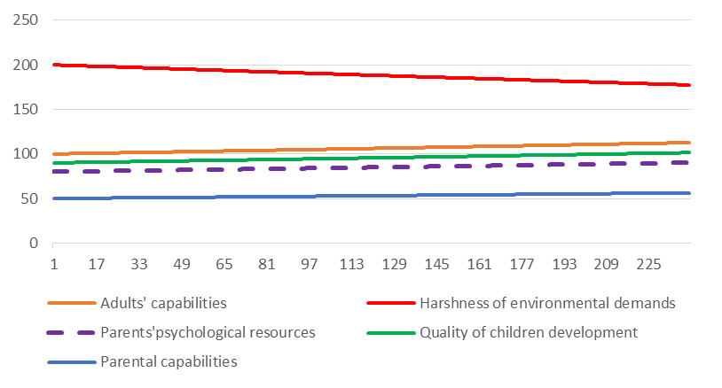
Reference mode
2:00-3:30
Notes:
Again big fonts, do not alter title

Slide 4
How the curse is transmitted
Harshness of environmental demands (typical of poverty) depletes parents’ psychological resources, channeling toxic stress to children.
Stress affects the development of key individual capabilities during the first years of life
Insufficient levels of parental capabilities also lead to poor cognitive stimulation
Low levels of children’s capabilities lead to low levels of adults’ capabilities.
3:30-5:00

Slide 5
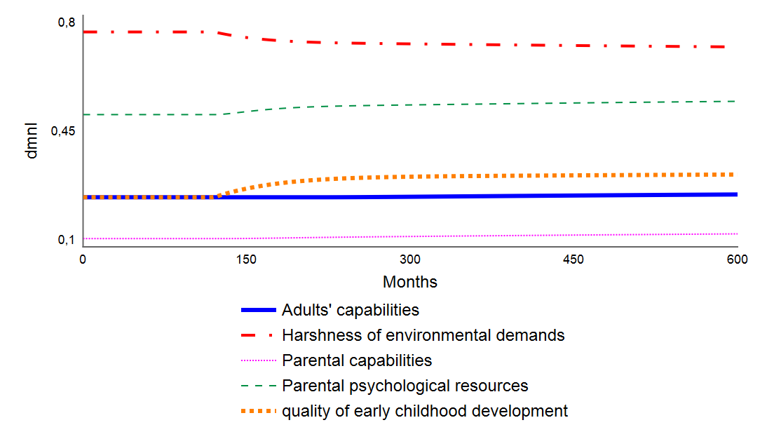
Simulation
Base run:
0:30-2:00

Slide 6
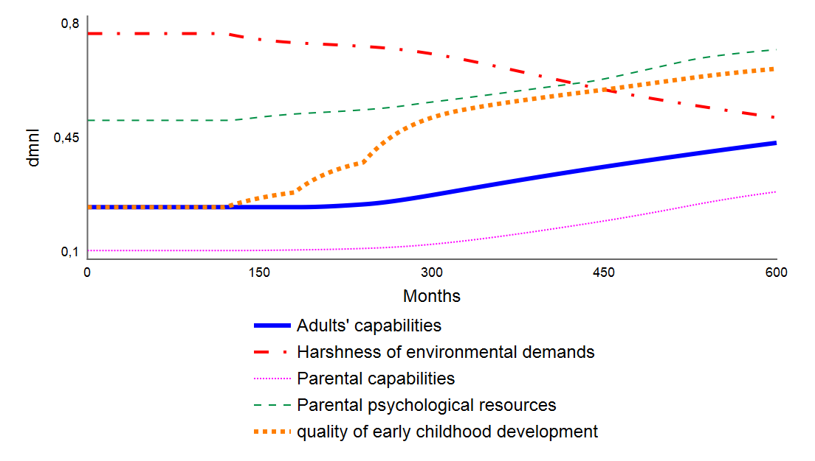
Example of a policy
High-quality childcare:
0:30-2:00

Slide 7
Conclusion
There are necessary causal drivers of full human development in early childhood: adequate prenatal care, attention, love and stimulation from caregivers, stability (structure) in the immediate environment, and moderate levels of stress combined with adequate support (buffer), preferentially from mothers.
0:30-2:00

Slide 8
Conclusion
The model suggests that comprehensive social policies, as argued by experts in the field of early childhood development, are necessary to break the curse of poverty.
0:30-2:00

