Slide 1
System Dynamics Modeling of Construction Safety Management Based on Site Corrective Actions
Shahin Dabirian¹
Mehdi Saffar²
Abstract
Safety is one of the effective factors on the operation of construction projects and plays a major role in the success of a project. According to the statistics presented from various institutions, the majority of the accidents among different industries are related to construction industry. Therefore, safety improvement in construction projects is one of the most significant issues to consider. Construction projects are naturally complex, dynamic, and include many feedback processes. Thus, construction projects can be regarded as complex dynamic systems which their management requires possession of tools to overcome their dynamic complexities. In this study, the structure governing safety management in construction workshops is regarded as one system.
Also, concerning the dynamic nature of the variables over the passage of time, system dynamic modeling is applied. In current study, it is illustrated that by applying learnings from safety scrutiny, accident investigation and corrective actions based on them, the severity and number of accidents as well as losses can be reduced significantly and improve the safety operation of construction projects. This study suggests the corrective actions as a helpful policy to prevent accidents.
PhD, Assistant Professor in Construction Engineering and Management
Art University of Isfahan
M.Sc Student in Construction Engineering and Management
Department of Civil Engineering, Khorasgan (Isfahan) Branch
Islamic Azad University
Figure A: neque dignissim, and in aliquet nisl et umis.

Slide 2
System Dynamics Modeling of Construction Safety Management Based on Site Corrective Actions
Shahin Dabirian¹, PhD, Assistant Professor in Construction Engineering and Management
Art University of Isfahan
Mehdi Saffar², M.Sc Student in Construction Engineering and Management,
Department of Civil Engineering, Khorasgan (Isfahan) Branch, Islamic Azad University
Introduction
Construction industry is one of the largest and most challenging industries in the world. Using a great portion of national resources of the countries, construction industry plays a main role in GDP. Construction industry has fundamental difference with other industries in the world. This difference includes its unique varieties and complexities which is due to uniqueness of each construction project. The goal of stockholders of construction projects is optimizing the benefits and reaching appropriate quality level in proper time by spending optimal cost. There are many factors which affect the accomplishment of this goal the most prominent of which is safety during project progress. According to statistics presented by several institutions, the most amount of loss occurs in construction industry.
For instance, based on the report of National Safety Council of America, although construction industries employ only 5% of the labor of the industries, more than 20% of fatalities and damages are related to this industry. According to the study conducted by Atrkar Roshan and Alizadeh‌(2015), average cost of each accident in construction industry of Iran in 2013 was $3600 and 4984 accidents happened in the construction industry of Iran in that year. Consequently, with regard to high statistics of accidents as well as high costs of accidents in construction industry, one of the major issues in this regard is the improvement of the safety of projects. One of the necessary measures to increase the safety of projects is recognition of affecting factors on safety in construction workshops. By recognition and control of such factors, safety can be improved in this industry.
However, these factors are scarcely independent of each other and have complex interactions to one another, the way that whether one factor is usually the cause of another and heightens its effect, or it is created by another factor. In this article the structure governing construction safety management is regarded as a system and by creating a system dynamic model it is shown that by utilizing system dynamic modeling, a better understanding of dynamics of safety management would be obtained in construction projects. In this study, the policy of corrective actions is investigated based on the learning from safety scrutiny and accident investigation. The aim of the study is to show the extent to which corrective actions are effective on continuous improvement of safety operation of construction projects.
Current research tries to improve this area of knowledge based on previous valid developed modeling structures and addition of new structures in the area of safety modeling of construction projects.
Model Structure
In order for a better description of system dynamic structure of the present model, it is classified into four sections of safety function, commitment, investigation of occurred accidents, and safety scrutiny. Different sections have interactions due to common variables. Commitment is both effective on all other sections and is affected by them. It is also true for safety function. It affects and is affected by all other sections.
Figure A: neque dignissim, and in aliquet nisl et umis.

Slide 3
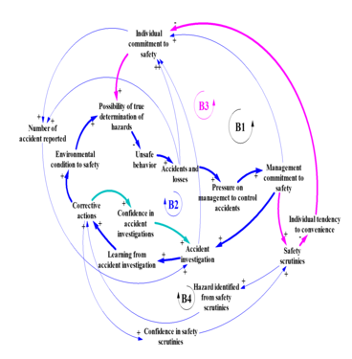
System Dynamics Modeling of Construction Safety Management Based on Site Corrective Actions
Shahin Dabirian¹, PhD, Assistant Professor in Construction Engineering and Management
Art University of Isfahan
Mehdi Saffar², M.Sc Student in Construction Engineering and Management,
Department of Civil Engineering, Khorasgan (Isfahan) Branch, Islamic Azad University
Structure of Safety Scrutiny
As the illustration of the presented model, with increase of management commitment to safety, it will be regarded as a prominent issue and by emphasizing safety and developing safety policies, management will increase individual commitment to safety. Consequently, fewer unsafe behavior will occur. Following a reduction in unsafe behavior, accident rate falls. However, with the reduction of accident rate, pressure on management to reduce and control the accident rate decreases and as a result, management commitment to safety reduces. In fact, B1 balancing loop will be created.
Lessons learned from accidents rise with the rate of learning from accidents and reduce due to the forgetting of the organization. Corrective actions which are performed in the project depend on four variables. The greater the number and quality of safety scrutiny and accident investigation, the more will be learned from them and therefore, it is expected that more corrective actions be performed. However, performance of corrective actions in project relies on management commitment to safety.
Figure A: neque dignissim, and in aliquet nisl et umis.
In the structure of this figure the interactions of the following variables are obvious: the interaction of management commitment with individual commitment, the interaction of management commitment and individual commitment with accident rate, the effects of affective variables on individual commitment and management commitment.
Structure of Accident Investigation and its Learning

Slide 4
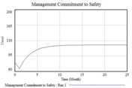
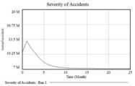
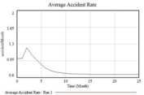
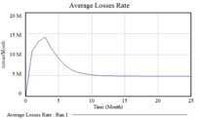
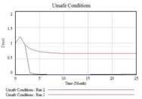
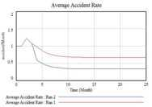
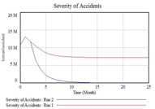
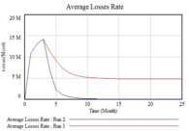
System Dynamics Modeling of Construction Safety Management Based on Site Corrective Actions
Shahin Dabirian¹, PhD, Assistant Professor in Construction Engineering and Management
Art University of Isfahan
Mehdi Saffar², M.Sc Student in Construction Engineering and Management,
Department of Civil Engineering, Khorasgan (Isfahan) Branch, Islamic Azad University
Results
Model operation without performance of corrective actions
Also with the reduction of management commitment to safety, individual commitment to safety reduces as well and risky behaviors increase in the project. Consequently, number of accidents and their severity increase in the project and accident losses increase dramatically. Following the increase of accidents and their relative losses, pressure on management rises to control the accidents. With more pressure to control the accidents, managers are committed themselves to safety.
As it is shown, unsafe conditions are sharply reduced by performing corrective actions in site. According to the reduction of unsafe conditions, number and severity of accidents are considerably reduced. Therefore, accident losses are significantly reduced. Thus, it can be concluded that the policy of performing corrective actions in site is a highly successful policy to improve safety conditions and reduce accident losses.
As it is obvious in the presented model, management commitment affects many effective variables in the safety of construction projects. Indeed, if project managers be committed to safety, it is expected that the project be in great safety condition, and vice versa. Also it was presented in this study that the performance of corrective actions in site is highly effective on the reduction of the number and severity of accidents and their relative losses. If project managers apply the learnings of safety scrutiny and accident investigations to perform corrective actions, they can significantly improve the safety of construction projects. Performance of corrective actions not only prevents accidents with high losses, but also prevents accidents which are assumed to be part of the job.
Figure A: neque dignissim, and in aliquet nisl et umis.
Conclusion
Model operation with performance of corrective actions
We believe that the presented model in this study is a fruitful model to understand the behavior of a complex safety system in construction projects. Applying the presented model in this study, it is concluded that management commitment to safety, compared to other factors, is highly effective on the safety operation of construction projects.
At the start of the project due to low accident losses, complacency of safety rises in managers and management commitment to safety reduces. According to this reduction, unsafe conditions escalate.

