Slide 1
Operator confidence in models: comparing two business examples
July 22, 2015
Paul Newton, Rod MacDonald, Suzanne Riney, Frank Rasor, Mary Rita Roux-Zink, Neil Roberts, Rich Bierlein, Eric Garday

Slide 2
Agenda
Introduction to the two projects.
Why more interest in one of the models?
Can modeling approach influence operator confidence? (an open research question)
The atypical modeling approach we used on one of the two projects.
Can models influence organizational culture?

Slide 3
Initial and current purposes of each model
 | MMRSP model (Mental Models Relating Safety & Productivity) | HOS model (Hazardous Operations Safety)
Initial Purpose | To explore the meaning of a “safety system” as part of a team working to define an enterprise SMS (safety management system) | To test proposed mitigations to improve the safety of a specific type of repetitive hazardous operation.
Current Purpose | To be the core of an online course to inspire people to improve their mental models of system structure relating safety & productivity | To inspire reflection on how varying the hazardous operation project’s start date can affect both safety and schedule dynamics.

Slide 4
Sponsorship & initiation of each model
 | MMRSP model (Mental Models Relating Safety & Productivity) | HOS model (Hazardous Operations Safety)
Sponsor | Riney initially, with Roux-Zink joining later | Riney initially, with Rasor joining later
Initiation | SD was peripheral. Riney engaged modeler Newton to participate on the SMS team. The purpose of the team’s SMS project did not clearly require SD. Newton saw relevance in Cooke’s (2006) model, but the team never adopted it. | SD was a primary approach used to address the problem. Riney & Roberts engaged modeler Newton, and later MacDonald at Newton’s request, to facilitate the modeling process.

Slide 5
Why more interest in the MMRSP model?
Learning that a project model is a good foundation
Traditional modeling by MacDonald with SMEs Bierlein/Garday/Roberts. Periodic reviews with other SMEs, business managers, Riney & Rasor
Rasor & Newton presented work to the Service Org VP & his Leadership Team (LT). It was quite well received.
HOS
Model
2nd Qtr. 2013
3rd Qtr. 2013
4th Qtr. 2013
1st Qtr. 2014
2nd Qtr. 2014
3rd Qtr. 2014
4th Qtr. 2014
1st Qtr. 2015
2nd Qtr. 2015
3rd Qtr. 2015
Reorganization & occasional use of Cooke’s model with G4Z SMS team. Periodic demos to other organizations.
Adapting Cooke’s model to aerospace for Roux-Zink BTJ paper
Blind BTJ Tech Fellow review of paper
Simplify story told by model & paper
Referred presentations to many Orgs’ VPs & their LTs.
MMRSP Model
Roux-Zink is developing an online course using model
Presentation given
Presentation to be given

Slide 6
Our paper hypothesizes many potential reasons why the MMRSP model has attracted more interest.
One potential reason is relevant to the subject of this session: “model validation in business.”
Traditional SD models compare alternative policies (CAP). Following Senge (1990, 2006), the MMRSP model instead compares alternative mental models of system structure (CAMMSS).
Our paper hypothesizes why the CAMMSS approach may provide operators more non-discrepant contacts with their perception of reality than the CAP approach, thus creating conditions for more operator confidence (Forrester, 1973)
To illustrate the CAMMSS approach, the remainder of this presentation is how we present the MMRSP model.
We hope to inspire research into the CAMMSS approach.

Slide 7
Mental Models Relating Safety and Productivity
Paul Newton and Mary Rita Roux-Zink

Slide 8
Agenda
Introduction
  Project focus
  Safety viewed thru the systems thinking iceberg lens
  Definition & attributes of mental models of system structure
Mental models of system structure significantly influence business performance dynamics (safety & productivity patterns over time)
Alternative mental models of system structure
Online education to inspire people to discover, challenge & improve their mental models relating safety & productivity
Notes:
The introduction
briefly describes the history and context of this work,
Uses a true story in which a safety risk was taken for productivity reasons. This story will be used throughout for illustration.
States the guiding question for the project, and how this question leads to the project’s focus
Illustrates with an example the kind of deep reflection we hope this course inspires,
Introduces the systems thinking iceberg as a useful framework for thinking about the safety system and the safety and productivity patterns-over-time (dynamics) that it creates
Defines how we are using the term “mental models,” including four generic attributes of mental models.
2) We then simulate a STim (Systems Thinking aided by simulation) model to illustrate how different mental models relating safety and productivity can significantly influence Lost Workday Case Rate (LWDC rate: a commonly used safety measure) and Productivity patterns-over-time, both of which are important business performance dynamics.
3) Next we describe the two mental models used in the STim model. In these two mental models, it is easy to see three of the four previously reviewed attributes of mental models. We then quickly revisit the simulations of the two mental models (#2 on this slide). These simulations provide an example of the fourth previously introduced attribute of mental models.
4) Finally, we give a brief overview of the course that LTD is developing. The course purpose is to inspire people to challenge and improve their mental models relating safety and productivity.

Slide 9
History & context
Grew out of a G4Z Safety Management System (SMS) project led by Suzanne Riney
Adaptation to aerospace of a simulation from Ph.D. research (Cooke, 2003, 2006)
The company’s learning, training and development organization is funding development of an online course based on the simulation.
Notes:
This work grew out of my experience as part of an enterprise G4Z project focused on Safety Management Systems. The project was led by Suzanne Riney, head of safety for both BT&E and BR&T.
Being a STim (Systems Thinking aided by simulation: same as “system dynamics”) modeler, I searched for STim models on safety. My search led me to David Cooke’s work (2003, 2004 and 2006). Cooke developed both generic and specific business case simulation models (based on chemical plants, coal mining and cancer treatment centers) that explicitly represent social systems that plausibly inter-relate workforce safety and productivity. Using aircraft production data from Benkard (2000), I adapted Cooke's 2006 simulation model to aerospace, and added structure representative of safety and productivity habit formation from the Alcoa safety story as presented in Duhigg (2012: Ch. 4).
In November of 2013, I presented Cooke’s model to the then director of Manufacturing, Quality and Safety in LTD. He brought along Mary Rita Roux-Zink, who leads LTD’s G4Z initiatives. She was very interested in the work, and when the Boeing Technical Journal invited her to prepare a paper for an upcoming special issue on safety, she suggested we publish this work. The special issue was published in in February of 2014.
Late in 2013 as we were wrapping up the paper LTD ALTI (Applied Learning, Training and Innovation) became interested in developing a course based on this work, and it became part of their 2015 work statement. You can see here the core team developing the course.

Slide 10
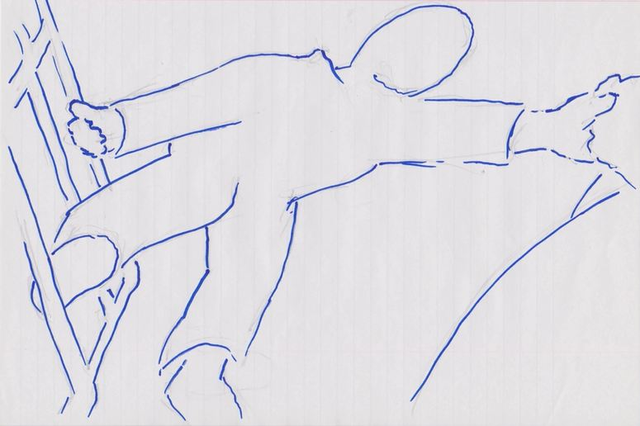
Why do we take safety risks for productivity reasons?
Notes:
Over the course of the year working on the Enterprise G4Z Safety Management System team I mentioned earlier, one of the other members of the team used this tale repeatedly in response to various discussions the team was having. This true story provides a good illustration of taking a safety risk for a productivity (schedule) reason.

Slide 11
Project focus
Guiding Question for Project: “Why do we take safety risks for productivity reasons?
Usual Answer: We think it unlikely that someone will get hurt in this one instance. But…
  The more often we succeed, the more often we take such risks
  If this attitude is repeated across a large workforce, then safety incidents, and patterns over time of safety incidents, will occur
Why the Usual Answer? Insufficient realism in our mental models relating safety and productivity.
Project focus: transformative learning for the purpose of inspiring us to challenge our mental models relating safety and productivity.
Notes:
So, the guiding question for the project is “Why do we take safety risks for productivity reasons?”
The Usual Answer is that people think it very unlikely that someone will get hurt “in this one instance.” However, the more often people succeed in taking such risks, the more often they actually take such risks. And if this attitude is repeated across a large workforce, then accidents will happen, lost workdays will happen, and some people will be permanently injured or die. People don’t tend to think about this in the moment, and they think that meeting schedule (being productive, for now), just this one time, justifies taking the safety risk.
We believe that another, and hidden, reason for our Usual Answer could be that our understanding (our mental model) of the relationship between safety and productivity is not realistic, and that, with a little more realism in our mental model, we would not take safety risks for productivity reasons.
The Project Focus then, is to inspire individuals and teams to challenge their mental models relating safety and productivity. We will first illustrate what we believe to be a mental model that could be a significant cause of stories like that of the dirty windshield on the previous slide. Second, we will add a little bit of structure to create a more realistic mental model that would reduce the probability of individuals and teams taking safety risks for productivity reasons. Some will adopt this more realistic mental model, but our real purpose is to use these two mental model examples to inspire individuals and teams to think about, discuss, challenge, and thereby hopefully improve, their mental models relating safety and productivity.

Slide 12

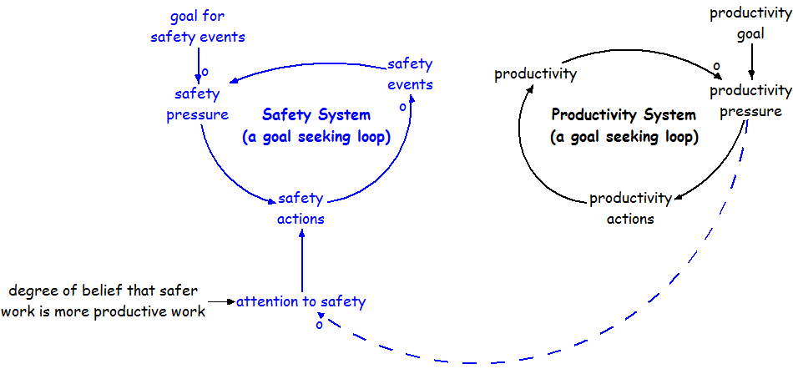
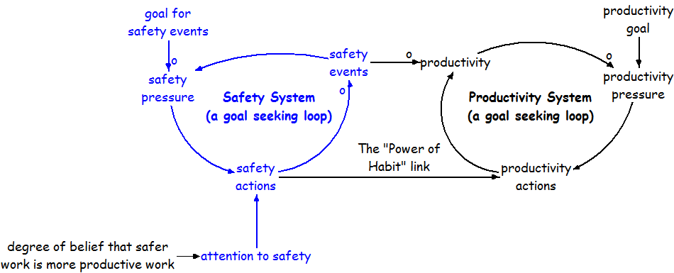
Safety through the systems thinking iceberg lens
Each accident, incident, near-miss, etc. is an event
Events
Proprietary graph omitted.
Graph shows
actual company safety performance 2008 - 2013, and desired safety performance 2014 - 2018.
Patterns Over Time
Our Mental Models of System Structure are part of the real System Structure & act thru that real structure to create the Patterns Over Time that we observe.
System Structure
A mental model
that can explain
our current decisions
A mental model
that can improve
our decisions
Mental Model of System Structure
Notes:
Each numbered item below is a step in a PowerPoint animation sequence:
Each accident, safety incident, near-miss, etc., is a visible (above the waterline) event.
Events form Patterns Over Time. A good safety-related example is this chart that shows Lost Work Day Case Injuries Per 100 Employees Per Year (LWDC rate). This particular chart, which was shown to the Enterprise G4Z Safety Management System team in 2013, shows the actual historical Pattern Over Time of LWDC rate data for various Boeing organizations (including the whole Enterprise in blue) from 2008 through 2013. The Patterns Over Time from 2014 through 2018 was the desired future pattern into the future.
2a) (no animation) Note in the iceberg at left that Below Patterns Over Time is the notion of a “System Structure.” The System Structure is the cause of the Patterns Over Time. A very important part of System Structure is our Mental Models of the System Structure that we believe relevant to creating the Patterns Over Time. We know that the decisions we make using our decision rules work through the full System Structure to create the Patterns Over Time that we experience. Therefore we use our mental models of system structure as the basis for our decision rules for improving Patterns Over Time, in this case LWDC rate Patterns Over Time. To the degree that our Mental Models of System Structure differ from the actual System Structure, our decisions will not produce the Patterns Over Time that we desire.
3) Our Mental Models of System Structure are so important that, in the systems thinking iceberg, we differentiate them as a separate layer of the iceberg.
4) Studying our aerospace-adapted version of Cooke’s model, I asked myself if, hidden in that structure there exists a mental model of the system structure that aligns with the taking of safety risks for productivity reasons, as in the dirty airplane windshield story. And I found such a structure. Do not try to read it here on this slide (it is too small); we will delve into the detail of this mental model in a later slide.
5) After finding this mental model structure in our aerospace-adapted version of Cooke’s model, it was relatively easy to also find there a slightly improved (more realistic to the real system – per Cooke’s research) mental model that, if held, would inspire in the holder an innate resistance to taking safety risks for productivity reasons. The more people who hold this mental model, the lower the LWDC rate their organizations will experience over time. And an additional benefit is that their organization will also experience more Productivity over time!
6) Our Mental Models of System Structure are part of the real System Structure & act thru that real structure to create the Patterns Over Time that we observe.

Slide 13
Mental models at the bottom of the systems thinking iceberg
Definition: To systems thinkers. the term “mental model” includes:
  “our beliefs about the networks of causes and effects that describe how a system operates, along with
  the boundary of the system (which variables are included and which are excluded) and
  the time horizon we consider relevant.” ^{1,} ^{page 16}
System Structure!
Attributes of mental models:
  “Very often, we are not consciously aware of our mental models or the effects they have on our [decisions and] behavior.”^{2, page 8}
  There are often “fundamental mismatches between our mental models and actual reality… structures of which we are unaware hold us prisoner.”^{2, pages 48 & 93}
  “Structure in human systems includes the ‘operating policies’ of the decision makers in the system.”^{2, page 53}
  We need to “shift from mental models dominated by events to mental models that recognize longer-term patterns of change and the underlying structures producing those patterns.”^{2, page} ¹⁹⁰
¹ Sterman (2000), Business Dynamics: Systems Thinking and Modeling for a Complex World. Irwin McGraw-Hill.
² Senge, Peter (2006), The Fifth Discipline: The Art & Practice of the Learning Organization. Doubleday.
Notes:
Each numbered item below is a step in a PowerPoint animation sequence.
First, note the two references at the bottom. John Sterman is the head of the System Dynamics Group at the Sloan School of Management at M.I.T. His book referenced here is used in the majority of the system dynamics courses around the world. Peter Senge is world renowned for his organizational learning work and has written several best sellers, one of them the book referenced here. He also earned his Ph.D. with the System Dynamics Group at the Sloan School of Management at M.I.T.
Note that this systems thinker definition of “mental models” is all about system structure:
a) …the networks of causes and effects…
b) …the boundary of the system – variables relevant, and irrelevant…
c) …the relevant time horizon. How long has it taken for this problem to develop, and how long will it take for us to address this problem? What is the relevant system structure over this full time scale?
2) Emphasize that these three components of the definition are about system structure.
3) These are a few important attributes of mental models. Later in this presentation we will illustrate each of these with examples from the mental models we’ll be describing and simulating. For now, just briefly reflect on each of them.

Slide 14
Mental models of system structure significantly influence safety & productivity patterns over time
A mental model
that can explain our current decisions
1.30
1.29
1.26
1.23
1.24
1.20
1.17
LWDC injuries per
100 employees per year
1.13
1.10
1.10
1.07
Simulated safety patterns over time
1.00
2015
2016
2017
2018
A more realistic mental model
that can improve our decisions
Current Mental Model
Better Mental Model
1.8
Note: numerical values produced by simulations are fictitious.
1.6
Simulated productivity patterns over time
Planes per week
1.4
1.2
1
2015
2016
2017
2018
Productivity : Better Mental Model
Productivity : Current Mental Model
Notes:
Each numbered item below is a step in a PowerPoint animation sequence.
First though, the purpose of this slide is to illustrate that our mental models of system structure, in this case mental models relating safety and productivity, significantly influence business performance dynamics, in this case safety & productivity patterns over time.
Again, for now, don’t try to read the mental model in the red box (or the one that will shortly show in a blue box). What is important here is that you notice that in the simulation at right (the red bars) of the red box mental model at left, LWDC rate is getting worse (increasing). Note that this simulation runs over four years.
This blue box mental model is more realistic than the red box mental model. However, note that in the top right simulation of the mental model in the blue box (the blue bars), the LWDC rate is getting better (decreasing) over the four year duration of the simulation. These two simulations, red and blue, illustrate improved safety patterns over time (safety performance!) from a more realistic mental model, leading those who have the mental model to make better decisions – better because they result in improved safety performance over time.
A probably surprising result at this stage is that not only does the more realistic blue box mental model achieve better safety performance, but it also achieves better productivity performance. This simulation model assumes an airplane assembly facility with a 10,000 person workforce, and the productivity shown here are the planes per week produced by this stylized factory. The LWDC rate in the upper chart is likewise for this stylized 10,000 person airplane production facility. The data for the simulation model came from Benkard, C. Lanier (2000) Learning and Forgetting: The Dynamics of Aircraft Production. The American Economic Review. Vol. 90 No. 4. [Available for download from The Boeing Library].

Slide 15
The Way It Is: Safety Influences Productivity
goal for
productivity
safety events
goal
safety
O
productivity
O
events
O
safety
O
productivity
pressure
Safety System
Productivity System
pressure
(a goal-seeking loop)
(a goal-seeking loop)
The "Power of
safety actions
Habit" link
productivity
actions
Key research from which I derived the simulation:
Benkard, C. Lanier (2000) Learning and Forgetting: The Dynamics of Aircraft Production. The American Economic Review. Vol. 90 No. 4.
Cooke, David L. (2003) A system dynamics analysis of the Westray mine disaster. System Dynamics Review Vol. 19, No. 2 (Summer 2003): 139-166
Cooke, David L. (2004) The Dynamics and Control of Operational Risk. Ph.D. Dissertation. Haskayne School of Business, The University of Calgary, Calgary, Alberta, Canada. (Cooke was Head of Safety for Nova Chemical. I believe he got his Ph.D. after retiring.)
Cooke, David L. (2006) Learning from incidents: from normal accidents to high reliability. System Dynamics Review Vol.2, No. 3, (Fall 2006): 213-239.
Duhigg, Charles (2012) The Power of Habit: Why We Do What We Do In Life And Business. Random House, New York, NY.
Notes:
Each numbered item below is a step in a PowerPoint animation sequence.
Before getting started, note the key sources from which I derived the structure of this mental model. I adapted Cooke’s (2006) model to aircraft production using data from Benkard (2000), as well as added structure described in Chapter 4 of Duhigg (2012).
At any point in time we have a certain degree of productivity. As well, most of the time we likely have a productivity goal that is probably greater than our current productivity. To the degree that our productivity goal exceeds our productivity, we feel productivity pressure. The pressure we feel causes us to undertake productivity actions. Over time our efforts result in greater productivity, bringing it closer to our productivity goal. Of course then, we likely set a higher goal, a “stretch” goal. However the essence of this very basic representation of a Productivity System is that the system acts to cause our productivity to achieve our productivity goal.
The safety system is exactly the same kind of goal-seeking system as the productivity system. The only difference is that we wish to reduce safety events over time, but to increase our productivity over time. So the two systems move in opposite directions, but otherwise their structures are identical.
Safety events reduce productivity. We all understand that if the event is an accident in which someone gets injured, we lose the productivity of that person. But there are many more safety events than there are accidents. In the case of the dirty airplane windshield story, the team stood around, looking up at that dirty windshield, talking together trying to figure out how they could clean it when the proper and safe equipment was not available to them. During this time, perhaps ten people were not doing the other work on the airplane they had to be done before delivery later in the day. My guess is the sum of these sorts of productivity losses when people and teams are thinking about how to take an “acceptable” (to them, with their mental model) safety risk to meet schedule (productivity) far outweigh the sum of the productivity losses from actual accidents. In any case, safety events, such as in the dirty airplane windshield story, decrease productivity.
Also when we are thoughtful and systemic in executing the safety actions we take, we are also improving our productivity. Again, the dirty airplane windshield example will serve to explain a piece of this. This event should have set off process improvement activity to ensure either that airplanes never arrive at the final preparation stall with a dirty windshield, or that such teams always have equipment immediately available to them to clean dirty windshields. The resulting process improvement would improve not only safety, but also productivity; the team would not be standing around, hands in pockets, looking up at the dirty windshield and thinking together about how they would clean it. And the habits that people develop in improving the process for safety reasons, also serve well as process improvement habits. This is what is meant by the “Power of Habit” link in the system.

Slide 16
Our all-too-common Mental Model of the System
goal for
productivity
safety events
goal
safety
O
productivity
O
events
O
safety
O
productivity
pressure
Safety System
Productivity System
pressure
(a goal-seeking loop)
(a goal-seeking loop)
The "Power of
safety actions
Habit" link
productivity
actions
small or zero…
…at least in the moment
degree of belief that
attention to
safer work is more
safety
productive work
Notes:
Each numbered item below is a step in a PowerPoint animation sequence.
An all-too-common mental model in the moment, while we’re making a decision related to both safety and productivity, does not see either the “Power of Habit” link, or that “productivity” is influenced by “safety events.” These links are not in our “networks of causes and effects that describe how [the] system operates” (quote from the earlier definition of mental models). Our mental model’s blindness to these links means that our “degree of belief that safer work is more productive work” is, at that time, small or zero.
Because our “degree of belief that safer work is more productive work” is small or zero, we pay less “attention to safety,” and take fewer “safety actions,” than we otherwise would.
Also, because our “degree of belief that safer work is more productive work” is small or zero, we allow our “attention to safety” to be further reduced in response to any “productivity pressure” we are feeling. Like the team in the dirty aircraft windshield story, we then take safety risks for productivity reasons.

Slide 17
Our all-too-common Mental Model creates two vicious cycles that REDUCE BOTH PRODUCTIVITY & SAFETY
goal for
productivity
safety events
goal
safety
O
productivity
O
events
O
safety
O
productivity
pressure
Safety System
Productivity System
pressure
(a goal-seeking loop)
(a goal-seeking loop)
The "Power of
safety actions
Habit" link
productivity
actions
Two Vicious Cycles
REDUCING BOTH
degree of belief that
PRODUCTIVITY & SAFETY
safer work is more
attention to
(two reinforcing loops)
productive work
safety
Notes:
Each numbered item below is a step in a PowerPoint animation sequence.
But in fact, those two links are present.
They create two vicious cycles that actually reduce both safety and productivity! Let’s now walk through one of these vicious cycles.
Imagine that “productivity goal” is increased, say by management edict. Because “productivity” is less than “productivity goal,” “productivity pressure” increases.
Increased “productivity pressure” causes our “attention to safety” to decrease.
Decreased “attention to safety” causes us to reduce our emphasis on “safety actions.”
A decrease in our “safety actions” makes it more probable that we will have “safety events”.
Any “safety event” will reduce our “productivity” to less than it otherwise would have been.
Reduced “productivity” causes the “productivity pressure” we feel to increase still further! Thus, in response to an initial increase in “productivity pressure,” the feedback loop we just worked our way around has the effect of further increasing “productivity pressure,” along the way reducing both safety and productivity. This is why we call it a “vicious cycle.” All else equal, both safety and productivity get worse and worse over time.
Starting again… Again increasing the “productivity goal” and therefore “productivity pressure”…
…we trace the other vicious cycle…which also further increases “productivity pressure,”’ and along the way cause both safety and productivity to get worse and worse over time.
So, our all-too-common mental model contains a goal-seeking safety system working to align the safety events we experience with a goal for safety events, a goal-seeking productivity system working to align our productivity with our productivity goal, and two vicious cycles acting against both of these goal-seeking loops. We have a system that is working against itself to try to thwart our efforts to achieve our goals for both safety and productivity!

Slide 18
A Better Mental Model that reflects “the Way It Is”
goal for
productivity
safety events
goal
safety
O
productivity
O
events
O
safety
O
productivity
pressure
Safety System
Productivity System
pressure
(a goal-seeking loop)
(a goal-seeking loop)
The "Power of
safety actions
Habit" link
productivity
actions
Two Vicious Cycles
large (1, or close to 1)
REDUCING BOTH
degree of belief that
PRODUCTIVITY & SAFETY
safer work is more
attention to
(two reinforcing loops)
productive work
safety
Notes:
Each numbered item below is a step in a PowerPoint animation sequence.
Of course, a better mental model is one that recognizes both of the ways that more safety causes more productivity. Such recognition means that our “degree of belief that safer work is more productive work” is large, that is, equal to 1, or at least close to 1. Therefore, because we value being as productive as possible, we pay great “attention to safety,” and continually work hard to take actions that will improve safety – and productivity! When we see a safety risk, whether a unsafe behavior or an unsafe condition (a hazard, as in the dirty airplane windshield story), we undertake and complete a process improvement initiative intended to ensure that the behavior or condition never recurs again.
This mental model also motivates us not to allow “productivity pressure” to influence our “attention to safety.” If we become involved in a safety event while under productivity pressure, our mental model drives us to proactively undertake and complete process improvement activity to ensure that safety event never recurs again. By ensuring that such an event doesn’t happen again, we are both more safe and more productive than we would have been otherwise (had we not proactively undertaken the process improvement).
Because we no longer allow “productivity pressure” to influence our “attention to safety,” both vicious cycles have disappeared... The system we see will result in our being both more safe, and more productive, than we otherwise would have been.

Slide 19
Mental models at the bottom of the systems thinking iceberg
Definition: To systems thinkers. the term “mental model” includes:
  our beliefs about the networks of causes and effects that describe how a system operates, along with
  the boundary of the system (which variables are included and which are excluded) and
  the time horizon we consider relevant – our framing or articulation of a problem.” ^{1,} ^{page 16}
Attributes of mental models:
  “Very often, we are not consciously aware of our mental models or the effects they have on our [decisions and] behavior.”^{2, page 8}
  There are often “fundamental mismatches between our mental models and actual reality… structures of which we are unaware hold us prisoner.”^{2, pages 48 & 93}
  “Structure in human systems includes the ‘operating policies’ of the decision makers in the system.”^{2, page 53}
  We need to “shift from mental models dominated by events to mental models that recognize longer-term patterns of change and the underlying structures producing those patterns.”^{2, page} ¹⁹⁰
¹ Sterman (2000), Business Dynamics: Systems Thinking and Modeling for a Complex World. Irwin McGraw-Hill.
² Senge, Peter (2006), The Fifth Discipline: The Art & Practice of the Learning Organization. Doubleday.
Notes:
Each numbered item below is a step in a PowerPoint animation sequence.
The two mental models just discussed illustrate three of the four previously mentioned attributes of mental models:
There are often “fundamental mismatches between our mental models and actual reality… structures of which we are unaware hold us prisoner.”
“Very often, we are not consciously aware of our mental models or the effects they have on our [decisions and] behavior.”
“Structure in human systems includes the "operating policies“ of the decision makers in the system.”
If there is time, host a discussion on these three attributes in relation to the dirty airplane windshield story.

Slide 20
Mental models of system structure significantly influence safety & productivity patterns over time
A mental model
that can explain our current decisions
1.30
1.29
1.26
1.23
1.24
1.20
1.17
LWDC injuries per
100 employees per year
1.13
1.10
1.10
1.07
Simulated safety patterns over time
1.00
2015
2016
2017
2018
A more realistic mental model
that can improve our decisions
Current Mental Model
Better Mental Model
1.8
Note: numerical values produced by simulations are fictitious.
1.6
Simulated productivity patterns over time
Planes per week
1.4
1.2
1
2015
2016
2017
2018
We need to “shift from mental models dominated by events to mental models that recognize longer-term patterns of change and the underlying structures producing those patterns.”
Productivity : Better Mental Model
Productivity : Current Mental Model
Notes:
Each numbered item below is a step in a PowerPoint animation sequence.
Earlier, you saw these simulations of the two mental models, and their results on safety and productivity, repeated here. Note that, unlike the windshield story in which the team was concerned only about delivering on time this afternoon, these simulations show safety and productivity not for this afternoon, but over a four year period.
1) We need to “shift from mental models dominated by events to mental models that recognize longer-term patterns of change and the underlying structures producing those patterns.”

Slide 21
Mental models at the bottom of the systems thinking iceberg
Definition: To systems thinkers. the term “mental model” includes:
  our beliefs about the networks of causes and effects that describe how a system operates, along with
  the boundary of the system (which variables are included and which are excluded) and
  the time horizon we consider relevant – our framing or articulation of a problem.” ^{1,} ^{page 16}
Attributes of mental models:
  “Very often, we are not consciously aware of our mental models or the effects they have on our [decisions and] behavior.”^{2, page 8}
  There are often “fundamental mismatches between our mental models and actual reality… structures of which we are unaware hold us prisoner.”^{2, pages 48 & 93}
  “Structure in human systems includes the ‘operating policies’ of the decision makers in the system.”^{2, page 53}
  We need to “shift from mental models dominated by events to mental models that recognize longer-term patterns of change and the underlying structures producing those patterns.”^{2, page} ¹⁹⁰
¹ Sterman (2000), Business Dynamics: Systems Thinking and Modeling for a Complex World. Irwin McGraw-Hill.
² Senge, Peter (2006), The Fifth Discipline: The Art & Practice of the Learning Organization. Doubleday.
Notes:
This is a fourth attribute of mental models of systems from Peter Senge. Or perhaps, as Barry Richmond, an eminent systems thinker once said, “we need to see the forest AND the trees.” In this, the dirty windshield case, the short term (this afternoon’s delivery) is the “tree,” AND the long term impact on both safety and productivity is the “forest.”

Slide 22
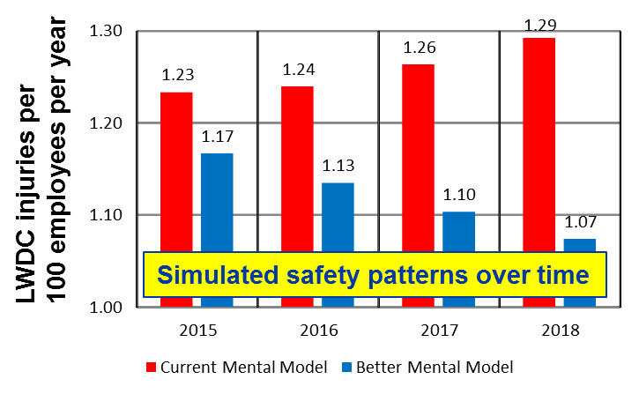
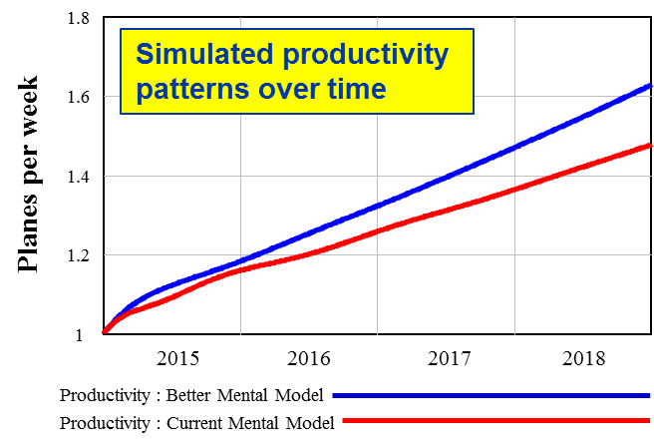
Summary: Safety thru the systems thinking iceberg lens
Each accident, incident, near-miss, etc. is an event
Events
Patterns Over Time
Our Mental Models of System Structure are part of the real System Structure & act thru that real structure to create the Patterns Over Time that we observe.
System Structure
A mental model
that can explain
our current decisions
A mental model
that can improve
our decisions
Mental Model of System Structure
Notes:
Summarizing, we have discussed two mental models:
one that can explain the decisions of the delivery preparation team that faced cleaning a dirty windshield unsafely in order to meet a productivity objective, and
another mental model that can improve such decisions when we are tempted to take a safety risk for productivity reasons.
Our Mental Models of System Structure are part of the real System Structure & act thru that real structure to create the Patterns Over Time that we observe.
The full system structure (that includes our mental models of it) creates the Patterns Over time that we experience. Here are shown the simulation results of these two mental models, the bottom left red one producing the red bars and lines (reduced safety performance and increasing productivity), and the bottom right one producing the blue bars and lines (improving safety performance and even better productivity growth over time).
And of course the Patterns Over Time are aggregations of safety events over time.

Slide 23
Summary: Safety thru the systems thinking iceberg lens
Each accident, incident, near-miss, etc. is an event
Events
Proprietary graph omitted.
Graph shows
actual company safety performance 2008 - 2013, and desired safety performance 2014 - 2018.
Patterns Over Time
Our Mental Models of System Structure are part of the real System Structure & act thru that real structure to create the Patterns Over Time that we observe.
DEEPENING UNDERSTANDING
System Structure
CREATING NEW POSSIBILITIES
A mental model
that can explain
our current decisions
A mental model
that can improve
our decisions
Mental Model of System Structure
HIGHEST-LEVERAGE CHANGE
Notes:
Continuing the summary… Of course our real interest is to achieve the reductions over time in LWDC Injuries Per 100 Employees Per Year that we desire. I hope this presentation has shown that improved mental models can help us achieve that goal.
This presentation started with a safety event – the dirty windshield story. It continued with understanding such events as part of a Pattern Over Time, caused by a System Structure chosen as relevant to that Pattern Over Time. And it emphasized that a very important part of the System Structure is our Mental Model of System Structure, recognizing that these Mental Models are the basis of our decision-making rules and decisions. The Highest Leverage Change is in our Mental Models. By going beyond events, to patterns over time, to relevant system structure, and then to our mental models of that system structure, we are deepening our understanding of how to create meaningful improvements in our lives and work.
Discovering our mental models of system structure, reflecting on them, sharing them, discussing them, and improving them creates new high leverage possibilities for system performance over time, both safety and productivity!
We are not advocating for the mental models used in this presentation, but rather hope that these examples will motivate you and your team to discover your mental models of system structure, reflect on them, share them, discuss them, and improve them.

Slide 24
Developing LTD Online Course
Project Goal: To inspire people who make safety-related decisions to reflect on their mental models relating safety and productivity, both personal and collective, and short and long term.
Online Virtual Education Storytelling Simulation (OVESS)
  Seeking a transformative learning experience.
  Via their own simulations, users will play with altering mental models in the OVESS, making the learning more real and visceral than more traditional education. As they play, they will see resultant patterns over time of productivity and safety.
  Planned to include video, audio, pictures, etc., that tell relevant true real-life stories in concert with the simulation. We intend to make this material customizable for organizations.
  This project is a path-breaker for similar online virtual education storytelling simulation deployments, e.g., improve program management, shift the product validation paradigm, reduce cost on airplane development programs, increase quality.
This project is a start on trying to discover “the system” causing Boeing’s safety performance. It addresses only a small part of “the system,” but hopefully an important part – our mental models and how they can make us less safe and less productive that we could be.
Project Timeline: Late in 2015, the online course will be available on request.
ECCN: EAR99
Notes:
Self explanatory…

Slide 25
LTD Online Course
This course will avoid giving the impression that
“this is the way you think now,
but you should think this way instead.”
Rather, this course will encourage people to,
and show them that they can,
discover,
think about,
share,
challenge, and
improve
their own mental models relating safety and productivity.
Notes:
Self explanatory.

Slide 26

Can organizational culture be changed?
At the surface, yes.
Artifacts can be redesigned
Espoused values can be rewritten
At the deepest level, that of assumptions, beliefs, values and mental models, culture change cannot be mandated, or “driven.”
Assumptions are often so embedded and implicit that it is difficult to even surface this level to begin to shift it.
Notes:
Organizational Culture can be defined as:
“the group norms of behavior and the underlying shared values that help keep those norms in place,”
John Kotter The Key to Changing Organizational Culture
Edgar Schein (3 Levels of Organizational Culture:
Artifacts - Tangible, identifiable elements in an organization
Espoused values - Organization's stated values and rules of behavior.
Assumptions - The deeply embedded, taken-for-granted behaviors, actual values, and mental models which are usually unconscious, but constitute the essence of culture

Slide 28


Causal Loop Diagram of Full System Structure
personal degree of belief that
management degree of belief
safer work is more productive
that safer work is more
work
productive work
safety stretch
goal for weekly
O
factor
LWDC rate injuries
Take A Chance
O
Safety Goal
O
safety pressure
Finish This Today Or Else!
management
weekly LWDC rate
attention to safety
injuries
O
safety
productivity
improvements
The "Power of
improvements
personal attention
Habit" link
to safety
O
Safe Conditions
Unsafe
Productivity Pressure
Conditions
productivity
productivity
Safe Behavior
incidents
losses
Productivity
pressure
O
O
O
risky behavior
Productivity Goal
productivity stretch
productivity
factor
goal
Notes:
Note that this diagram includes the following system structures that are not part of the mental model system structures on the previous slides:
Floating goals for productivity and safety (the “Productivity Goal” loop and the “Safety Goal” loop)
Differentiation between safe conditions and safe behavior (the “Safe Conditions” loop and the “Safe Behavior” loop)
Differentiation between personal and management “attention to safety”
All three present opportunities for investigating strategic trades, e.g. relative goal stretch factors, relative focus on personal or management attention to safety, and relative focus on safe conditions or safe behavior.
The full model in Vensim format, and a paper with full model documentation, are available from Paul Newton.
One thought is that this model might relate to the “Model of Controlled Process,” “Model of Context,” and “Environmental Inputs” boxes in the following books by Nancy Leveson:
Figure 8.8 on page 228 of Nancy Leveson’s “Engineering a Safer World,” (http://mitpress.mit.edu/books/engineering-safer-world) and
Figure 1.8 on page 19 of “STPA Primer” (STPA-Primer-v0.pdf) at http://sunnyday.mit.edu/STPA-Primer-v0.pdf.

