Slide 1
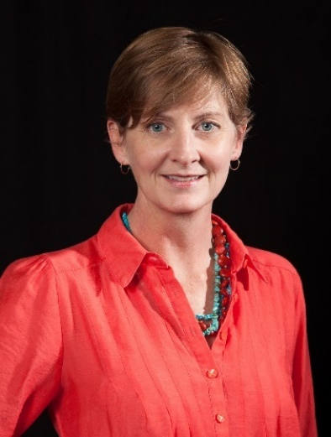
Report, Chair, ad hoc committee advising PhD Colloquium, Laura Black
Main events and achievements of 2016
Continued PhD Colloquium focus on acknowledging and supporting doctoral students doing SD with varying degrees of local institutional support
Surveyed Colloquium participants; 40+% identified as self-taught in SD
Repeated pilot of Angel Advisors, experienced SD-ists interacting with specific Colloquium participants during the PhD Colloquium Poster Session
Note related report from Student Chapter: Established several peer-mentoring groups to increase interaction and support among graduate students during non-conference months
Main aims for 2017
Alter format Colloquium, including World Café and Open Space style events, to increase substantive interactions between senior system dynamicists and graduate students
Explore enhanced coordination among Summer School, PhD Colloquium, conference
Support, cooperation, resources needed &potential obstacles/issues.
Support from experienced SD-ists in serving as Angel Advisors and in participating in forums with graduate students such as World Café and Open Space conversations

