Slide 1
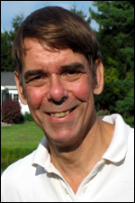
Report, VP of Finance, David Andersen
The Society Performed Poorly in Financial Terms during 2016
The Delft Conference was smaller.
The journal is underperforming and the exchange rate between UK and US works against us.
We had expensive unplanned turnover in Home Office staff during the fall.
Our Assets have performed well.
We will post an overall loss, but still have a strong asset base to support the transition of the Home Office.
Plans for the Transition are going well.
I plan to step down as VP Finance in January 1, 2018.

