Slide 1
Design and Evaluation of interventions for Preventing HIV Drug Resistance in Dar es Salaam, Tanzania
WIP Presentation
Beatrice Aiko, KU Leuven
Nico Vandaele & Catherine Decouttere, Access-To-Medicines Research Centre, KU Leuven
https://feb.kuleuven.be/research/decision-sciences-and-information-management/om/access-to-medicines-research-centre/home
0:00-0:30
@systemdynamics_
THE 41st INTERNATIONAL SYSTEM DYNAMICS CONFERENCE
Chicago, USA and Virtually
#isdc2023
Notes:
Title page: Change title to submission name. Bold the name of the presenter and display your name as you want it read by the moderator (eg Bob instead of Robert). Note the suggested timing in the bottom right. Slide timing may be adjusted, but not the number of slides. The session chair will change slide following the timing indicated, or earlier if requested.

Slide 2
Problem Statement
HIV drug resistance(HIVDR) situation worsening
15% in 2008 and 23% in 2017
Threat to success of HIV treatment programs
Possible rebound in HIV incidence and mortality
Spread of resistant strains
Interventions not adequately curbing HIVDR
Expenses and time(new medication)
Implementation issues(supply chain)
Uptake issues(ART home delivery)
Ineffective(long term vs short term)
Upscale challenges(economic interventions)
0:30-2:00
@systemdynamics_
THE 41st INTERNATIONAL SYSTEM DYNAMICS CONFERENCE
Chicago, USA and Virtually
#isdc2022
THE 40TH INTERNATIONAL SYSTEM DYNAMICS CONFERENCE
Virtually everywhere!
#isdc2023
Notes:
Problem Statement: Do not change the slide title. Keep fonts big (24 pt or bigger). Indicate why the problem is important. Note the timing in the bottom right.

Slide 3
Approach or Dynamic Hypothesis
Human-centered and transdisciplinary
Systems dynamics
Study setting
Dar es Salaam Urban Cohort Study (DUCS)
Ukonga and Gongolamboto wards of Ilala district
Under surveillance for HIVDR since 2011
Data collection
Group Model Building (GMB)
Stakeholder interviews
2:00-3:30
@systemdynamics_
THE 41st INTERNATIONAL SYSTEM DYNAMICS CONFERENCE
Chicago, USA and Virtually
#isdc2022
THE 40TH INTERNATIONAL SYSTEM DYNAMICS CONFERENCE
Virtually everywhere!
#isdc2023
Notes:
Approach or Dynamic Hypothesis: Do not change the slide title. Keep fonts big (24 pt or bigger). Note the timing in the bottom right.

Slide 4
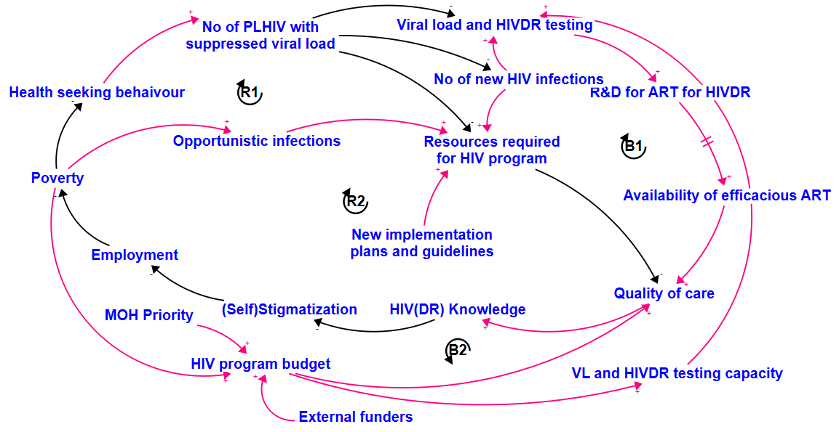
Progress, Insights, and Questions
On-going progress
Development of systems map
Identification of leverage points
Next steps
Building quantitative model
Design and evaluation of interventions
Questions
SD vs mixed methods?
GIS?
3:30-5:00
@systemdynamics_
THE 41st INTERNATIONAL SYSTEM DYNAMICS CONFERENCE
Chicago, USA and Virtually
#isdc2022
THE 40TH INTERNATIONAL SYSTEM DYNAMICS CONFERENCE
Virtually everywhere!
#isdc2023
Notes:
Progress, Insights, and Questions: Do not change the slide title. Again, keep the text short and fonts big. Show structure or behavior – may not be room for both (some flexibility on font for images). No need to conclude, there is always more to be done. Any questions you want to pose to the audience can go here. Note the timing in the bottom right.

