Slide 1
The Capability Frontier: Factors Influencing Capability Development Decisions
WIP Presentation
Paulo Gonçalves, University of Lugano
Mariya Andreeva, University of Lugano
0:00-0:30
@systemdynamics_
THE 41st INTERNATIONAL SYSTEM DYNAMICS CONFERENCE
Chicago, USA and Virtually
#isdc2023
Notes:
Title page: Change title to submission name. Bold the name of the presenter and display your name as you want it read by the moderator (eg Bob instead of Robert). Note the suggested timing in the bottom right. Slide timing may be adjusted, but not the number of slides. The session chair will change slide following the timing indicated, or earlier if requested.

Slide 2
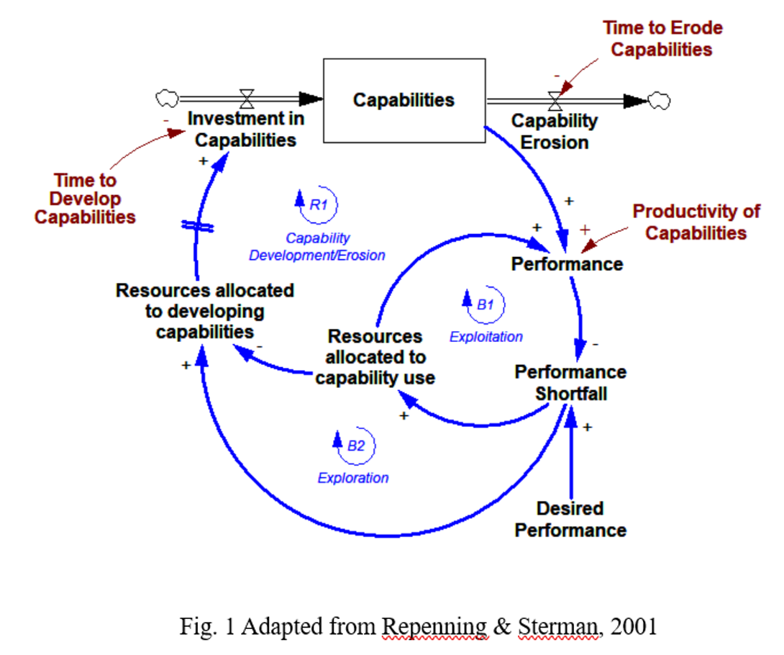
Problem Statement
Managers make resource allocation decisions between new and existing capabilities to enable effective short- and long-term competitive advantage.
Yet, many organizations fall into capability traps – “better-before-worse” performance scenarios.
Factors that impact resource-allocation decisions on capability development:
exogenous to the capability: environmental, organizational, and individual (e.g., Cohen & Levinthal, 1990; March, 1991; Lavie et al., 2010);
endogenous to the capability under consideration (Repenning & Sterman, 2001; 2002):
development time,
erosion time,
Productivity factor.
0:30-2:00
@systemdynamics_
THE 41st INTERNATIONAL SYSTEM DYNAMICS CONFERENCE
Chicago, USA and Virtually
#isdc2022
THE 40TH INTERNATIONAL SYSTEM DYNAMICS CONFERENCE
Virtually everywhere!
#isdc2023
Notes:
Problem Statement: Do not change the slide title. Keep fonts big (24 pt or bigger). Indicate why the problem is important. Note the timing in the bottom right.

Slide 3
Dynamic Hypothesis
Focus on the individual and joint influence of these 3 factors on resource allocation decisions through a formal theoretical model.
RQs:
How do the critical capability factors affect capability development attractiveness individually and in combinations?
Is there a threshold beyond which investments in capabilities become unattractive?
Can we formally characterize such a threshold?
2:00-3:30
@systemdynamics_
THE 41st INTERNATIONAL SYSTEM DYNAMICS CONFERENCE
Chicago, USA and Virtually
#isdc2022
THE 40TH INTERNATIONAL SYSTEM DYNAMICS CONFERENCE
Virtually everywhere!
#isdc2023
Notes:
Approach or Dynamic Hypothesis: Do not change the slide title. Keep fonts big (24 pt or bigger). Note the timing in the bottom right.

Slide 4
Progress, Insights, and Questions
Productivity
Time to develop capabilities
Short times are more attractive:
“Quick Wins” (Landry & Sterman, 2017)
Low
Capability Frontier
Time to erode capabilities:
Long times are more attractive
High
Time to Erode
Productivity of capabilities:
High productivity is more attractive
Short
Long
Short
Long
Attractive zone for developing capabilities: Short time to build
Long time to erode
High productivity
Time to Build
2:00-3:30
@systemdynamics_
THE 41st INTERNATIONAL SYSTEM DYNAMICS CONFERENCE
Chicago, USA and Virtually
#isdc2022
THE 40TH INTERNATIONAL SYSTEM DYNAMICS CONFERENCE
Virtually everywhere!
#isdc2023
Notes:
Approach or Dynamic Hypothesis: Do not change the slide title. Keep fonts big (24 pt or bigger). Note the timing in the bottom right.
We define a “capability frontier” characterized by a favorable combination of the three key attributes determining an attractive area for investment in capability development

Slide 5
THE INTERNATIONAL SYSTEM DYNAMICS CONFERENCE
Instructions: Please do this!!!
1) Prepare your Work in Progress (WIP) presentation using a copy of this template.
Change the presentation title and author information to match your submission.
Do NOT change the titles of the other slides. Do NOT change the number of slides with content.
Change the body of the slides to present your work, following the instructions in the slide notes.
2) Submit your WIP presentation slides at https://webportal.systemdynamics.org by June 20
Click on the title of your submission
Select “Upload new or updated paper files”
Upload the Powerpoint presentation file for your WIP slides
3) Follow the format and timing listed below:
You have exactly 5:00 minutes to present, followed by up to 5:00 minutes of discussion.
Keep within the time limits noted at the lower right of each slide.
The session chair will combine your slides with other presentations and will control the screen.
4) You may record your presentation in advance
If you are not able to attend the session, the recording will be used instead
If you do attend, you can ask the chair to play the recording, or present live
Add the YouTube Video ID to the Web Portal under “Review or update paper information”
5) If you make updates or change plans after June 20, send the session chair a note
Use the contact information at https://isdc.systemdynamics.org
Notes:
This slide will be hidden from presentation. You may delete this instruction slide once your slides are ready.

