Slide 1
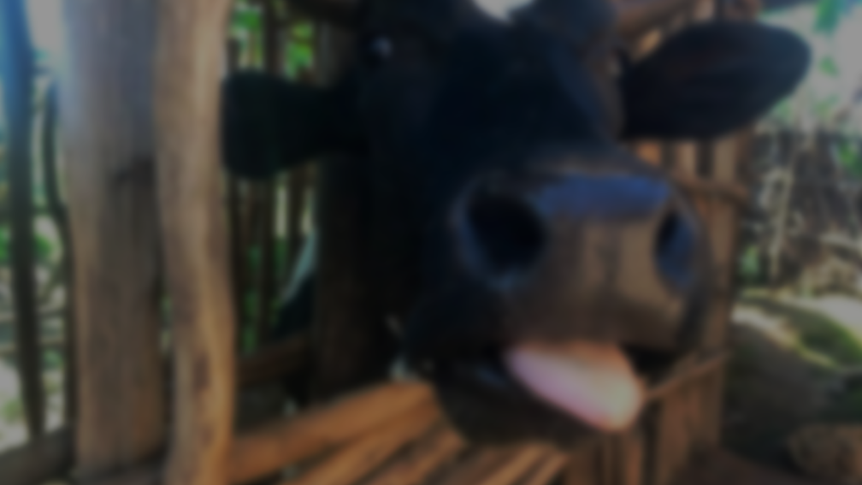
Understanding Dynamic Drivers of Beef Consumption in the U.S.
WIP Presentation
Sydney Pryor, MPH
PhD Candidate, Health Policy and Management
Milken Institute School of Public Health at George Washington University
Sumner M. Redstone Global Center for Prevention and Wellness, Doctoral Fellow
0:00-0:30
@systemdynamics_
THE 41st INTERNATIONAL SYSTEM DYNAMICS CONFERENCE
Chicago, USA and Virtually
#isdc2023

Slide 2
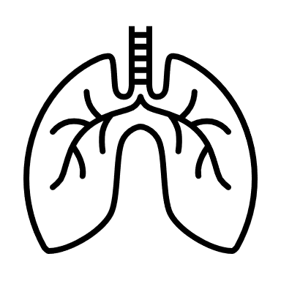
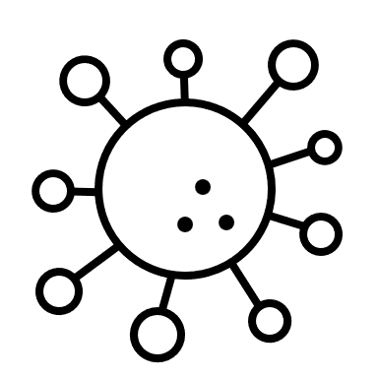
THE HIDDEN COSTS OF BEEF
Problem Statement
0:30-2:00
@systemdynamics_
THE 41st INTERNATIONAL SYSTEM DYNAMICS CONFERENCE
Chicago, USA and Virtually
#isdc2023

Slide 3
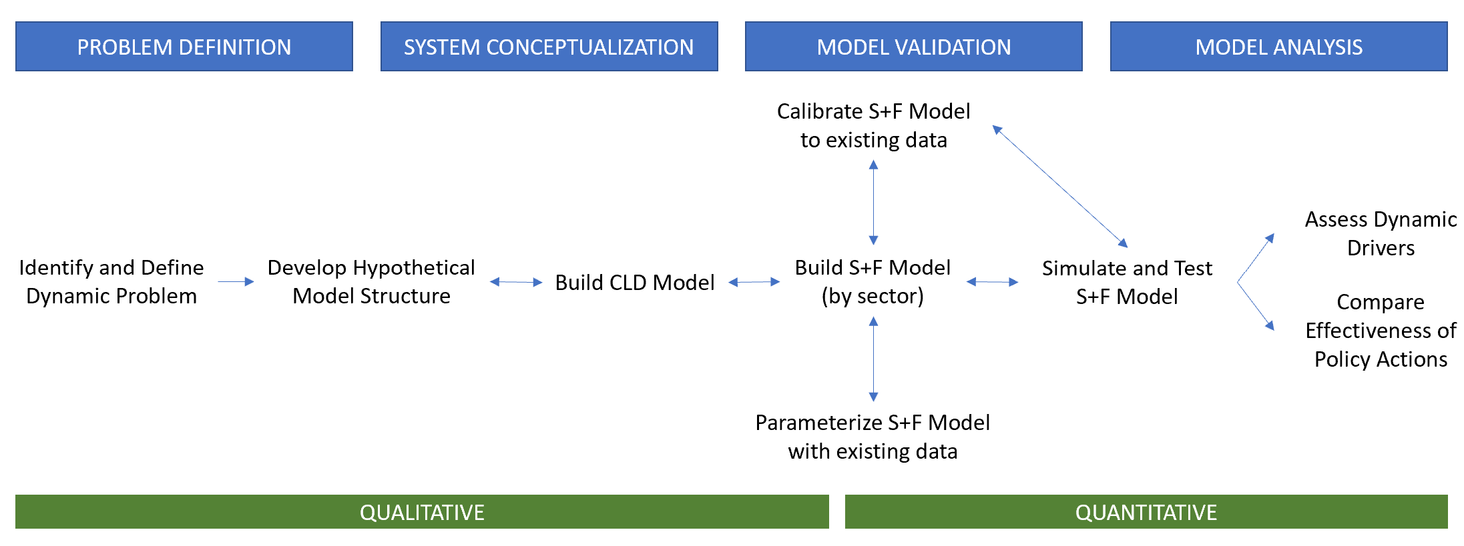
Approach or Dynamic Hypothesis
System Dynamics Approach and Model-Building Process
Adapted from Walters et al. 2016 and building on the work of Stave and Kopainsky, Sterman, and Richardson and Pugh
Walters J, Archer D, Sassenrath G, et al. Exploring agricultural production systems and their fundamental components with system dynamics modelling. Ecological Modelling. 2016;333:51-65.
Stave KA, Kopainsky B. A system dynamics approach for examining mechanisms and pathways of food supply vulnerability. Journal of Environmental Studies and Sciences. 2015;5(3):321-336.
2:00-3:30
@systemdynamics_
THE 41st INTERNATIONAL SYSTEM DYNAMICS CONFERENCE
Chicago, USA and Virtually
#isdc2023

Slide 4
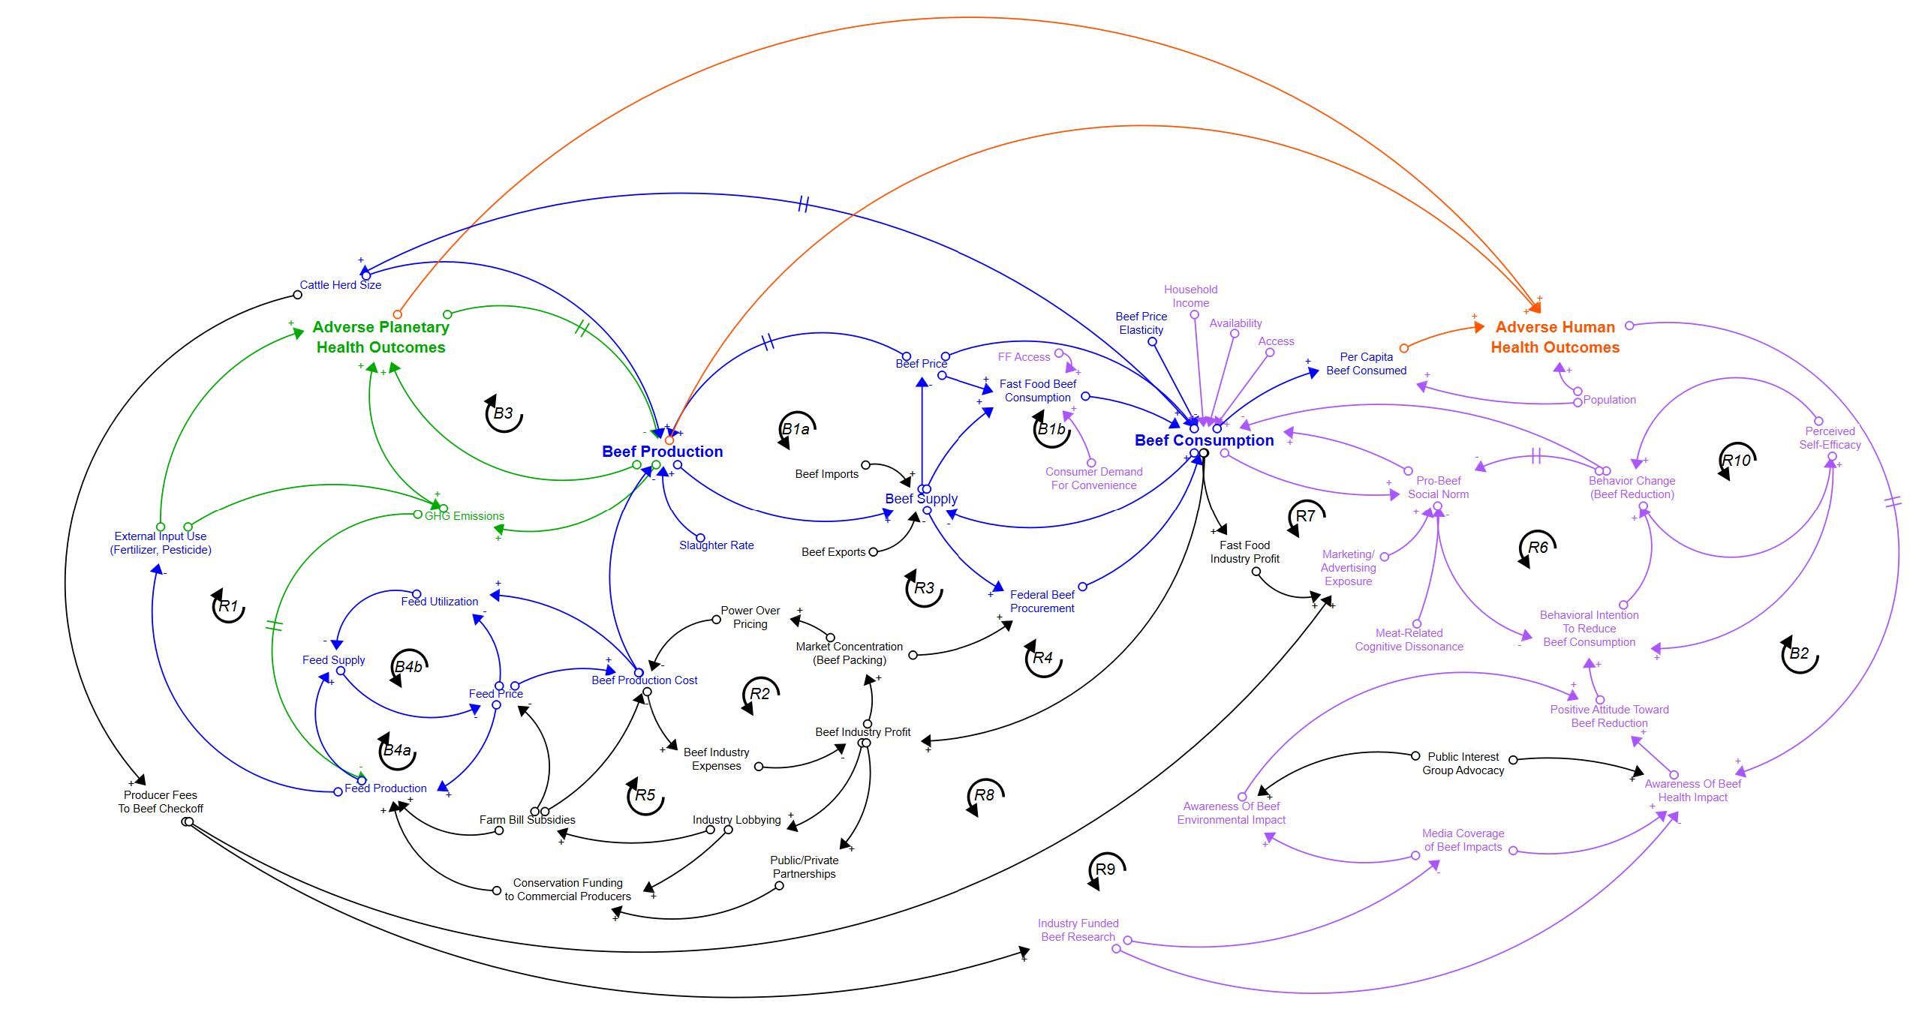
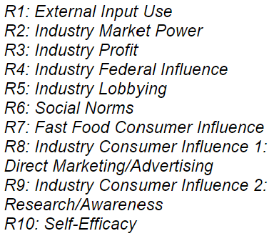
Progress, Insights, and Questions
Reinforcing Loops
Balancing Loops
Hypothesized Dynamic Drivers
Industry Power & Influence
Social Norms & Information Asymmetry
Access and Availability of Beef/Alternatives
U.S. Beef Consumption Causal Loop Diagram
3:30-5:00
@systemdynamics_
THE 41st INTERNATIONAL SYSTEM DYNAMICS CONFERENCE
Chicago, USA and Virtually
#isdc2023

