Slide 1
A System Dynamics Model of Child Maltreatment and Adolescent Suicide Risk
WIP Presentation
Erinn Duprey, Ph.D., Children’s Institute, University of Rochester
Ann Marie White, Ed.D., Children’s Institute, University of Rochester
0:00-0:30
@systemdynamics_
THE 41st INTERNATIONAL SYSTEM DYNAMICS CONFERENCE
Chicago, USA and Virtually
#isdc2023

Slide 2
Problem Statement
Youth who experience child abuse and neglect are more at risk for suicide
But there are no current upstream, school-based suicide prevention programs for this group
Problems: (1) What causes maltreated adolescents to gain social and emotional protective factors within the school context? (2) What causes a school-wide reduction in levels of suicidal thoughts and behaviors for maltreatment-exposed adolescents?
0:30-2:00
@systemdynamics_
THE 41st INTERNATIONAL SYSTEM DYNAMICS CONFERENCE
Chicago, USA and Virtually
#isdc2022
THE 40TH INTERNATIONAL SYSTEM DYNAMICS CONFERENCE
Virtually everywhere!
#isdc2023
Notes:
Research and epidemiological show that adolescents who have experienced .child abuse or neglect are at a much higher risk for suicidal thoughs and behaviors.
Not only that, but youth suicide is a critical public health issue, with rates going up particularly in communities of color.
This work serves as a conceptual foundation for a suicide prevention intervention for adolescents with maltreatment exposure/involvement with child protective services.
The two problems we were aiming to address include: (LIST)
Consequently, we developed a conceptual model with system dynamics modeling to answer the following two interrelated problem statements: (1) What causes maltreated adolescents to gain social and emotional protective factors within the school context? (2) What causes a school-wide reduction in levels of suicidal thoughts and behaviors for maltreatment-exposed adolescents?

Slide 3
Approach or Dynamic Hypothesis
We conducted a literature review previously and developed a conceptual model (Duprey et al., 2022)
Based on this previous work, we built a preliminary stock and flow model
We focused the system within the school context
The system model will inform a school-based suicide prevention program
2:00-3:30
@systemdynamics_
THE 41st INTERNATIONAL SYSTEM DYNAMICS CONFERENCE
Chicago, USA and Virtually
#isdc2022
THE 40TH INTERNATIONAL SYSTEM DYNAMICS CONFERENCE
Virtually everywhere!
#isdc2023
Notes:
I published a paper in 2022 that was a systematic review of the literature on child maltreatment and suicide, including potential mediators or mechanisms.
We use this literature review to build a preliminary model, with the school as the primary system.
Based on the relationships we think are an important, we boudn the system in one school setting – so one school for example

Slide 4
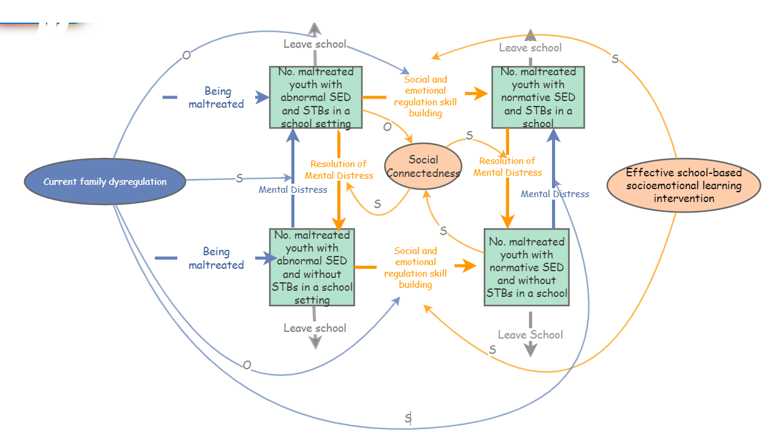
Progress, Insights, and Questions
See Figure for preliminary model.
Thoughts, feedback, and questions welcome STBs = Suicidal Thoughts and Behaviors SED = Social emotional development
3:30-5:00
@systemdynamics_
THE 41st INTERNATIONAL SYSTEM DYNAMICS CONFERENCE
Chicago, USA and Virtually
#isdc2022
THE 40TH INTERNATIONAL SYSTEM DYNAMICS CONFERENCE
Virtually everywhere!
#isdc2023
Notes:
This slide shows our preliminary figure.
This is a core stock and flow model that we would expect based on the literature
Remind people that this was built on research – but these were all linear models – ‘excited abou this
There are four main stocks- give a quick geography first OR use the clicker
Being maltreated refers to history of maltreatment
Then talk about flows
Then talk about reinforcing loops
Define social emotional learning intervention – would be tailored in a way to help adolescents with skill enhancement but also to resolve social emotional skills that are particularly affected by maltreatment
Then concluding sentence – and next steps
Mention that my next step is a K01 and talking about it from a system perspective – importance of system methods to solve this critical issue

Slide 5
THE INTERNATIONAL SYSTEM DYNAMICS CONFERENCE
Instructions: Please do this!!!
1) Prepare your Work in Progress (WIP) presentation using a copy of this template.
Change the presentation title and author information to match your submission.
Do NOT change the titles of the other slides. Do NOT change the number of slides with content.
Change the body of the slides to present your work, following the instructions in the slide notes.
2) Submit your WIP presentation slides at https://webportal.systemdynamics.org by June 20
Click on the title of your submission
Select “Upload new or updated paper files”
Upload the Powerpoint presentation file for your WIP slides
3) Follow the format and timing listed below:
You have exactly 5:00 minutes to present, followed by up to 5:00 minutes of discussion.
Keep within the time limits noted at the lower right of each slide.
The session chair will combine your slides with other presentations and will control the screen.
4) You may record your presentation in advance
If you are not able to attend the session, the recording will be used instead
If you do attend, you can ask the chair to play the recording, or present live
Add the YouTube Video ID to the Web Portal under “Review or update paper information”
5) If you make updates or change plans after June 20, send the session chair a note
Use the contact information at https://isdc.systemdynamics.org
Notes:
This slide will be hidden from presentation. You may delete this instruction slide once your slides are ready.

