Slide 1
Systems Thinking in Psychological Counseling: A Pilot Study in a Middle School
WIP Presentation
Meltem Ceylan Alibeyoglu, Darüşşafaka Schools
Ebru Arabul Torun, Darüşşafaka Schools
Nesibe Gönül Durak, Darüşşafaka Schools
Emre Göktepe, Systems Thinking Associaton in Türkiye
Ulkem Yararbas, Ege University, Medical Faculty, Department of Nuclear Medicine
Phil Ramsey, Massey University
Tim Joy, De La Salle North Catholic High School
0:00-0:30
@systemdynamics_
THE 41st INTERNATIONAL SYSTEM DYNAMICS CONFERENCE
Chicago, USA and Virtually
#isdc2023
Notes:
Good [morning/afternoon/evening], everyone. Today, I'm excited to discuss our pilot study focusing on "Systems Thinking in Psychological Counseling" within a middle school setting.

Slide 2
Problem Statement
Bonfrenbrenner's Ecological Systems Theory explains how environmental factors impact individuals, especially children.
Adolescence is a period in which the processes for which the frontal lobe is responsible (decision-making, problem solving, metacognition, social relations, etc.) are still in the process of development.
School counselors play a crucial role in influencing student behavior within these systems.
Counseling interventions have shown mixed or ineffective results, indicating the need for further development in psychological counseling.
0:30-2:00
@systemdynamics_
THE 41st INTERNATIONAL SYSTEM DYNAMICS CONFERENCE
Chicago, USA and Virtually
#isdc2023
THE 40TH INTERNATIONAL SYSTEM DYNAMICS CONFERENCE
Virtually everywhere!
#isdc2022
Notes:
As you may know, the ecological systems theory developed by Bronfenbrenner highlights five systems influencing individuals, particularly children. School counselors play a crucial role in engaging with these systems, such as students, parents, teachers, and the broader community, to influence student behavior positively.
However, while previous research indicates that counseling interventions can have a positive impact on academic success, there are also studies with mixed or ineffective results. Therefore, we believe there is a valuable opportunity for further development in the field of psychological counseling, particularly in the context of academic success for students facing difficulties in 7th grade.

Slide 3
Approach or Dynamic Hypothesis
A pilot study is planned to increase self-awareness in students using mental models and systems thinking.
Mental models and stock-flow diagrams will be used as visualization tools to facilitate counseling activities.
The approach aims to improve the effectiveness of counseling interventions and contribute to the field of psychological counseling.
2:00-3:30
@systemdynamics_
THE 41st INTERNATIONAL SYSTEM DYNAMICS CONFERENCE
Chicago, USA and Virtually
#isdc2022
THE 40TH INTERNATIONAL SYSTEM DYNAMICS CONFERENCE
Virtually everywhere!
#isdc2023
Notes:
Our pilot study aims to address this opportunity by exploring the use of systems thinking as a tool in guidance and counseling to increase self-awareness and improve counseling interventions.
-We strongly believe that systems thinking, with its holistic view of complex systems and the use of mental models and stock-flow diagrams, can effectively facilitate counseling activities.
-Our methodology involves several essential steps. First, we identify students in 7th grade who are experiencing academic difficulties. Then, through brainstorming sessions, we determine the key elements that impact learning and academic success. This information is used to create a conceptual stock-flow diagram, capturing the interrelationships and dynamics affecting the students' academic journey.
-To ensure the model's accuracy and effectiveness, we actively seek input from 7th-grade teachers who interact closely with the students. Their valuable insights help refine and adjust the model as needed.
-Additionally, we organize meetings with the students to introduce them to systems thinking and identify those willing to participate as volunteers in the pilot study. Now, let's explore the ongoing progress, insights gained, and some important questions arising from our study in the next slide.

Slide 4
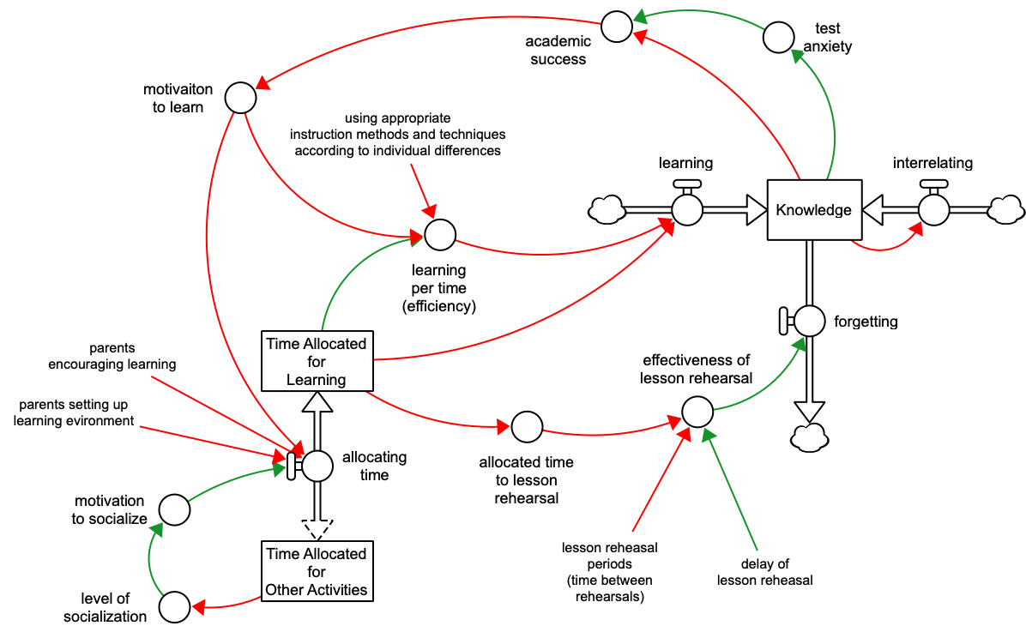
Progress, Insights, and Questions
Identification of students experiencing academic difficulties in 7th grade.
Creation of a conceptual model (stock-flow diagram) through brainstorming and input from teachers.
Meetings with students to explain systems thinking and identify volunteer participants.
Weekly activities conducted with volunteer students: relating experiences to the model, analyzing stories, writing stories, interpreting Behavior Over Time Graphs (BOTG), and reflecting on factors influencing academic success.
3:30-5:00
@systemdynamics_
THE 41st INTERNATIONAL SYSTEM DYNAMICS CONFERENCE
Chicago, USA and Virtually
#isdc2022
THE 40TH INTERNATIONAL SYSTEM DYNAMICS CONFERENCE
Virtually everywhere!
#isdc2023
Notes:
-Here, we'll delve into the progress we've made, some exciting insights we've gained, and the important questions that have emerged during our pilot study on "Systems Thinking in Psychological Counseling."
-We've been conducting weekly studies with volunteer students to explore the effectiveness of systems thinking tools in increasing their self-awareness. The activities include relating personal experiences to the model, analyzing stories with causal loops, writing their own stories, interpreting Behavior Over Time Graphs (BOTGs) related to the model's elements, and understanding the factors influencing their motivation for learning.
-Through these activities, we've gained valuable insights into how students respond to systems thinking as a means of self-exploration and understanding. The students have shown enthusiasm and engagement in the counseling process, indicating a promising direction for the application of systems thinking in counseling interventions.
-As we move forward, we face some intriguing questions. For instance, how can we further refine and integrate systems thinking into counseling practices to optimize its impact on academic success? Moreover, are there other areas within counseling that could also benefit from adopting a systems thinking approach? Lastly, we ponder on how to measure the long-term impact of our intervention on the students' academic success.
-These questions will guide our future research and development efforts as we strive to contribute to the advancement of psychological counseling in educational settings.
-Thank you for your attention, and I'm now open to any questions you may have.

