Slide 1
Connecting Whole of Nation Systems Archetypes to a Global Perspective Using Artificial Intelligence Driven Simulation
Jyotirmay Gadewadikar, Jeremy Marshall, Zachary Bilodeau
©2023 The MITRE Corporation. ALL RIGHTS RESERVED Approved for public release. Distribution unlimited 23-00792-1

Slide 2
Whole of Nation Initiatives using AI driven Simulation
Objective
The whole of nation approach involves identifying the prevalence of system archetypes on a national level using system dynamics
This approach makes use of the AI driven Simulation capabilities involving InsightMaker and PySD to aid in parameter identification and simulation
Approach
AI/ML model training using real world data to aid in parameter identification and quantitative relationships
Simplification of workflows
Creation of an intuitive Graphic User Interface
MITRE Role
Construct dynamical systems which occur on a national level
Identify common dynamical themes amongst these models which correlate to defined system archetypes
Quantitatively identify parameters and relationships using AI/ML with reliable historical data
Status of MITRE Task
Previous initiatives show the capabilities of AI/ML to aid in system dynamics
Current tasks have identified common themes on a national level as well as evidence to aid in their correlation to system archetypes
Structures of more archetypes are being constructed based on the scenarios that have been identified

Slide 3
Outline
Whole of Nation Archetypes
AI/ML Graphic User Interface and Simulation
Systems Archetype Example
Conclusion

Slide 4
Whole of Nation Archetypes

Slide 5
Model with system archetypes (Whole of Nation)
We as a nation are most concerned about
growth
fixing problems
reinforcing loop: viscous and virtuous spiral
balancing loop
but fixes come back to haunt us..
but our fix is other’s nightmare
We form a partnership for growth but end up feeling betrayed..
but nothing grows forever..
but our growth seem to lead to others decline..
while waiting for the fix to take hold, to relieve the tension, we become satisfied with less….
Fixes that fail
Escalation
Success to the successful
…by making our partners into adversaries…
Eroding goals
Limits to growth
.. because we are not getting at the real underlaying cause…
Nation’s capacity is the limit and is not large enough
eroding goals undermine long-term growth
.. so we are all up against same limit…
Accidental adversaries
Shifting the burden
Growth and underinvestment (fixed standards)
Tragedy of the commons
We have more than one limit and cannot address all of them equally
Growth and underinvestment (drifting standards)
…but there is temptation to let standards slip instead
Attractiveness principle
MITRE’s customization of System Archetypes from Fifth Discipline, by Peter Senge et. al, and Systems Archetypes I (thesystemsthinker.com)

Slide 6
Artificial Intelligence/ Machine Learning Graphic User Interface

Slide 7
AI/ML GUI – AI Algorithms
GUI created that allows user to load in data an apply different AI/ML Algorithms to their data
GUI also allows for user to learn from examples via a description tab and a visual representation of the algorithm
CSV data to help identify/calculate parameters to simulate
Notes:
Kmeans, logistic regression, decision trees, svm, neural network
Linear regression

Slide 8
AI/ML GUI – Systems Dynamics
GUI allows users to understand AI and Systems Dynamics so that they can apply AI to Systems Dynamics
Integrated with GitLab
Interactive, users can input their own CSV data and apply AI as well as change the parameter values through different formats (xmile, insightmaker, Stella, VenSim)
Steps: Load archetype, then upload CSV data that corresponds to archetype, train the archetype as a model with the CSV data to make predictions (Flow Regression)

Slide 9
System Archetype Exemplar

Slide 10
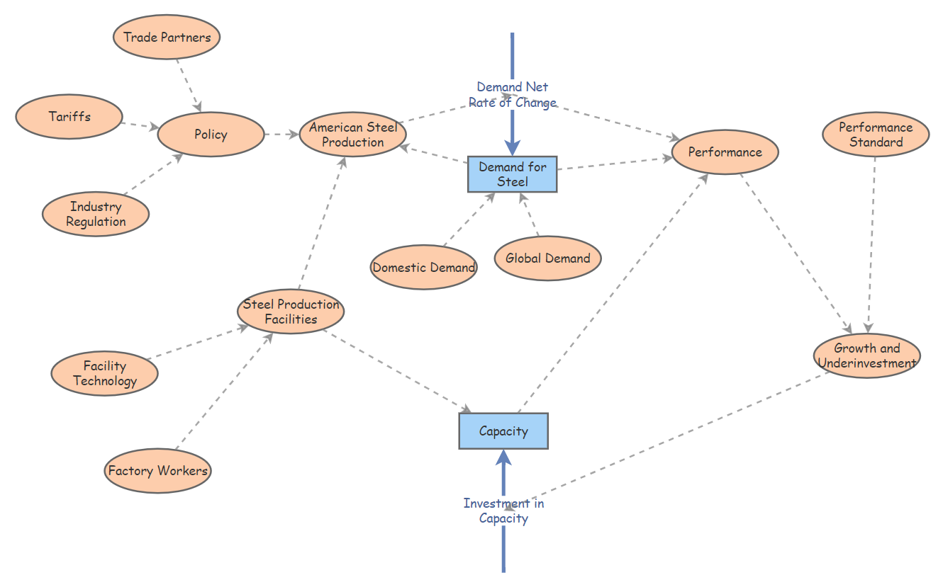
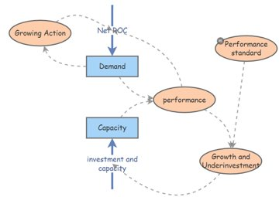
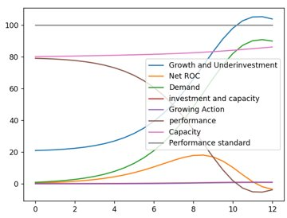
Growth and Underinvestment
A system is growing, however once it reaches its limit performance begins to deteriorate. Growth can be restored, and deterioration can be reversed if investments in capacity are made. However, if the investments are not made before the growth limit is reached, the system will continue to deteriorate.
In 1970, USA led the World in steel production (115 million metric tons). However, the major US steel companies refused to invest in more modern technologies, while place like Japan and the European Union adapted. This caused the collapse of the US steel industry due to the availability, and increased production of foreign steel and the increased worldwide demand of steel. The American Steel Industry has gone from 700,000 employees to 83,000 and fallen to 4th place behind China, the EU, India and Japan
Notes:
Demand for steel --> American Steel Production(policy, trade partners, tarrifs, industry regulation)
Demand for steel --> Domestic Demand, foreign demand
Capacities --> steel production facilities (technology, workers)
In 1970, USA led the World in steel production (115 million metric tons), above the Soviet Union (96.9 million metric tons). However, the major US steel companies refused to invest in more modern technologies, while place like Japan and the European Union adapted. This caused the collapse of the US steel industry due to the availability, and increased production of foreign steel and the increased worldwide demand of steel. The American Steel Industry has gone from 700,000 employees to 83,000 and fallen to 4th place behind China, the EU, India and Japan
This is growth and underinvestment because the growing action is American Steel production, and the demand is steel. As the worldwide demand for steel increases, the American Steel companies perceived need is modern technology with advanced production capabilities. However, the companies don't want to spend their profit causing a delay in investment causing their production to fall below demand, losing market share, money and employees. Now other countries' have taken over and the USA still lags
Total American Steel Production per year: Year
2019
2015
2010
2008
2000
1990
Million Metric Tons
87.8
78.9
80.6
91.4
101.8
89.7
When American steel was king (cnn.com)

Slide 11
Conclusion
Constructed whole of Nation Dynamical System Models
Identified common dynamical themes amongst these models which correspond to defined system archetypes
Quantitatively identified parameters and relationships using AI/ML with available historical data
Demonstrated the feasibility of implementing AI/ML with Systems Dynamics using PySD and Insight Maker
Next Steps
Create fully functional UI with ability to train a model with user-input archetypal data
Use trained model to help identify/predict the behavior of current global system trends that correspond to archetypes

Slide 12
Closing Slide
Questions
Jyotirmay Gadewadikar, Chief Scientist – AI Integration and Systems Engineering
jgadewadikar@mitre.org
@JyoGadewadikar
https://www.linkedin.com/in/JyoMIT

Slide 13
References (Primary)
Gadewadikar, J., Marshall, J. AI-Driven System Simulation for Decision Support - Methodology to integrate AI with System Dynamics workflows in Python, Systems Dynamics Conference, Frankfurt, July 2022
Kim, D. (2016, April 1). Systems archetype basics: From story to structure. The Systems Thinker. Retrieved September 8, 2022, from https://thesystemsthinker.com/systems-archetype-basics-from-story-to-structure/
Fifth Discipline, by Peter Senge et. al, and Systems Archetypes I (thesystemsthinker.com)
Bourget-Diaz, R. E., & Perez-Salazar, G. (2003, February). On Mathematical Structures for Systems Archetypes. Retrieved 2022.
Kube, C. (2022, June 27). Why is the U.S. military struggling to recruit Young Americans? NBCNews.com. Retrieved September 8, 2022, from https://www.nbcnews.com/news/military/every-branch-us-military-struggling-meet-2022-recruiting-goals-officia-rcna35078
Isidore, C. (n.d.). When American Steel was king. CNNMoney. Retrieved September 8, 2022, from https://money.cnn.com/2018/03/09/news/companies/american-steel-history/index.html
Overholt, M. (2016, August 17). The importance of oil and gas in today's economy. Tiger General. Retrieved September 8, 2022, from https://www.tigergeneral.com/the-importance-of-oil-and-gas-in-today-s-economy/#:~:text=Oil%20and%20gas%20is%20incredibly%20important%20not%20only,combined%20provide%20over%20half%20of%20the%20world%E2%80%99s%20energy.

Slide 14
References (Secondary)
World Proved Reserves of Oil and Natural Gas, Most Recent Estimates. Wayback Machine. (n.d.). Retrieved September 8, 2022, from https://web.archive.org/web/20120217151346/http:/www.eia.gov/international/reserves.html
Wikimedia Foundation. (2022, August 2). World Energy Resources. Wikipedia. Retrieved September 8, 2022, from https://en.wikipedia.org/wiki/World_energy_resources
Yamin, S. E. (2018, October 22). How can a country join NATO? NATO. Retrieved September 8, 2022, from https://natoassociates.wordpress.com/2018/10/13/references/#:~:text=In%20order%20to%20be%20eligible%20to%20be%20invited,to%20contribute%20the%20security%20of%20the%20Euro-Atlantic%20area.
Wikimedia Foundation. (2022, September 4). Russia–NATO relations. Wikipedia. Retrieved September 8, 2022, from https://en.wikipedia.org/wiki/Russia%E2%80%93NATO_relations
Dvorkin, M. (n.d.). Who are the U.S.'s largest trade partners? TalkMarkets. Retrieved September 8, 2022, from https://talkmarkets.com/content/us-markets/who-are-the-uss-largest-trade-partners?post=199733#:~:text=It%20is%20interesting%20to%20note%20that%20the%20largest,in%20the%20trade%20deficit%20has%20been%20steadily%20growing.
STAFF, N. A. T. O. (n.d.). Key facts and figures - NATO. Retrieved September 8, 2022, from https://www.nato.int/nato_static_fl2014/assets/pdf/pdf_2019_06/20190625_2019-06-KFOR-Placemat.pdf

