Slide 1
What is the effect of charging infrastructure availability on electric truck adoption? An egg-chicken dynamics problem
WIP Presentation
Zeinab Raoofi, KTH University
Morteza Mahmoudi, Sharif University of technology
Anna Pernestål, KTH University
0:00-0:30
@systemdynamics_
THE 41st INTERNATIONAL SYSTEM DYNAMICS CONFERENCE
Chicago, USA and Virtually
#isdc2023
Notes:
Title page: Change title to submission name. Bold the name of the presenter and display your name as you want it read by the moderator (eg Bob instead of Robert). Note the suggested timing in the bottom right. Slide timing may be adjusted, but not the number of slides. The session chair will change slide following the timing indicated, or earlier if requested.

Slide 2
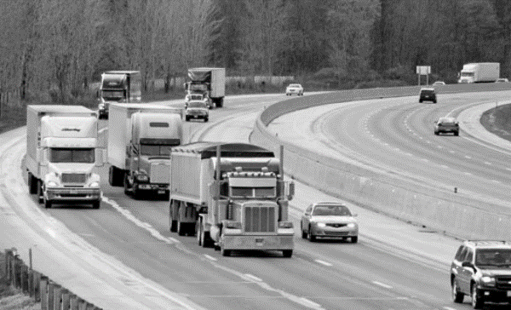
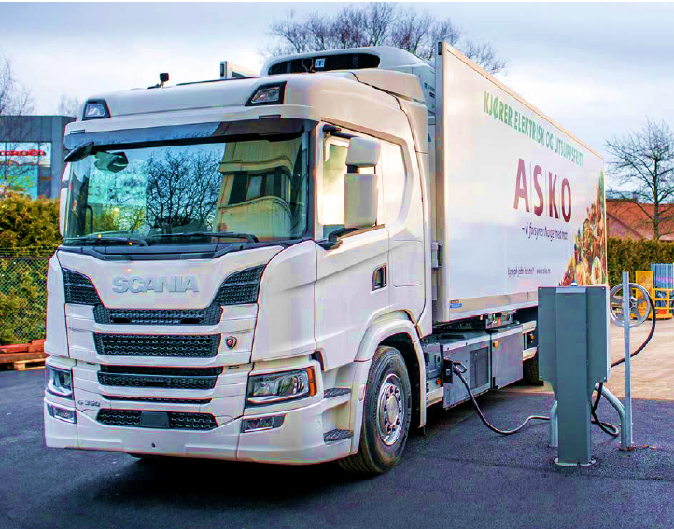
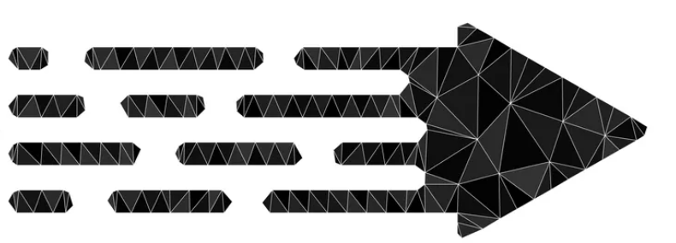
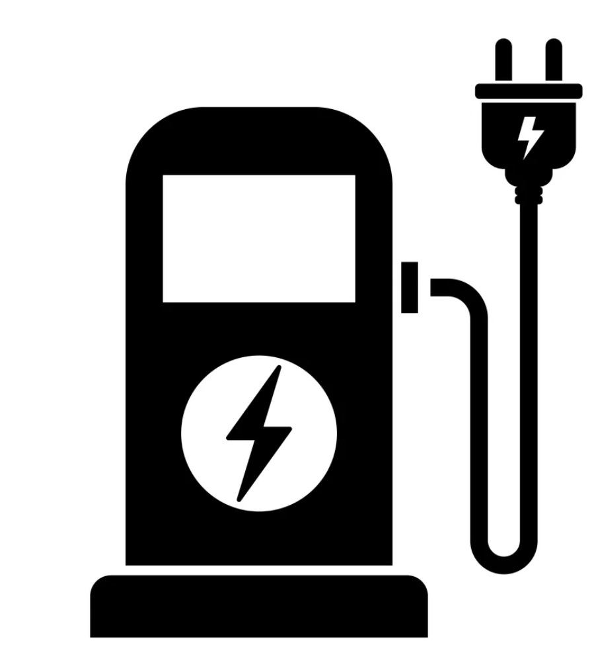
The transition of the road freight transport system
7%
Transition to
sustainable system
Q1: How and to what extent will the availability of charging infrastructure affect the market adoption of heavy electric trucks?
Q2: How can public and private sector investment in charging infrastructure development be optimized to accelerate the adoption of heavy electric trucks?
Q3: What role can policy interventions play in the development and adoption of heavy electric trucks?
Electrification
@systemdynamics_
THE 41st INTERNATIONAL SYSTEM DYNAMICS CONFERENCE
Chicago, USA and Virtually
#isdc2022
THE 40TH INTERNATIONAL SYSTEM DYNAMICS CONFERENCE
Virtually everywhere!
#isdc2023
Notes:
Problem Statement: Do not change the slide title. Keep fonts big (24 pt or bigger). Indicate why the problem is important. Note the timing in the bottom right.

Slide 3
Storytelling
+
Charging Demand
E-truck Fleet
for E-trucks
Size
+
+
+
+
+
Demand of E-truck
Installed E-truck
Charging Stations
Charging Stations
R1
Technology
Technology
Building Charging
E-truck Sale
Awareness
Maturity
B1
Station
Awareness
Availability of
+
R2
Charging Stations
+
-
B2
Maturity
<E-truck
Fleet Size>
Public Investment in
-
+
Charging Stations
+
Market Gap of
+
E-truck Attractiveness
-
Emission Goal Gap for
(Utility Function)
Charging Stations
Charging Stations
-
(demand minus supply)
E-truck total
+
Governmental Funds for
Cost
Gap of Number of
+
Building Charging Stations
+
-
Charging Stations based
+
E-truck Purchase
on Regulation
+
+
Cost
B3
E-truck
Private Investmant in
Operational Cost
+
Charging Stations
Profitability of Building
Private Funds for Building
Charging Station (IRR)
Charging Stations
+
Notes:
Approach or Dynamic Hypothesis: Do not change the slide title. Keep fonts big (24 pt or bigger). Note the timing in the bottom right.

Slide 4
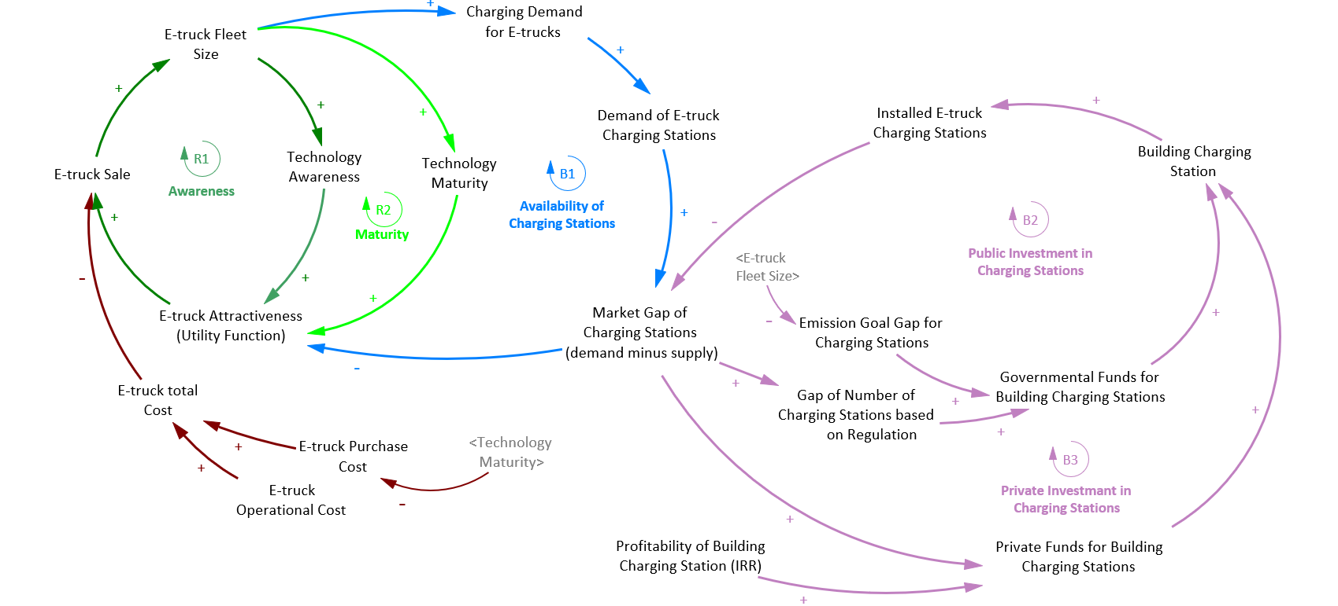
Policy intervene
Fund for vehicle tech
Charging subsidy
electric vehicle subsidy
Subsidy in price of electricity
Tax in price of diesel
@systemdynamics_
THE 41st INTERNATIONAL SYSTEM DYNAMICS CONFERENCE
Chicago, USA and Virtually
#isdc2022
THE 40TH INTERNATIONAL SYSTEM DYNAMICS CONFERENCE
Virtually everywhere!
#isdc2023
Notes:
Progress, Insights, and Questions: Do not change the slide title. Again, keep the text short and fonts big. Show structure or behavior – may not be room for both (some flexibility on font for images). No need to conclude, there is always more to be done. Any questions you want to pose to the audience can go here. Note the timing in the bottom right.

Slide 5
THE INTERNATIONAL SYSTEM DYNAMICS CONFERENCE
Instructions: Please do this!!!
1) Prepare your Work in Progress (WIP) presentation using a copy of this template.
Change the presentation title and author information to match your submission.
Do NOT change the titles of the other slides. Do NOT change the number of slides with content.
Change the body of the slides to present your work, following the instructions in the slide notes.
2) Submit your WIP presentation slides at https://webportal.systemdynamics.org by June 20
Click on the title of your submission
Select “Upload new or updated paper files”
Upload the Powerpoint presentation file for your WIP slides
3) Follow the format and timing listed below:
You have exactly 5:00 minutes to present, followed by up to 5:00 minutes of discussion.
Keep within the time limits noted at the lower right of each slide.
The session chair will combine your slides with other presentations and will control the screen.
4) You may record your presentation in advance
If you are not able to attend the session, the recording will be used instead
If you do attend, you can ask the chair to play the recording, or present live
Add the YouTube Video ID to the Web Portal under “Review or update paper information”
5) If you make updates or change plans after June 20, send the session chair a note
Use the contact information at https://isdc.systemdynamics.org
Notes:
This slide will be hidden from presentation. You may delete this instruction slide once your slides are ready.

Slide 6
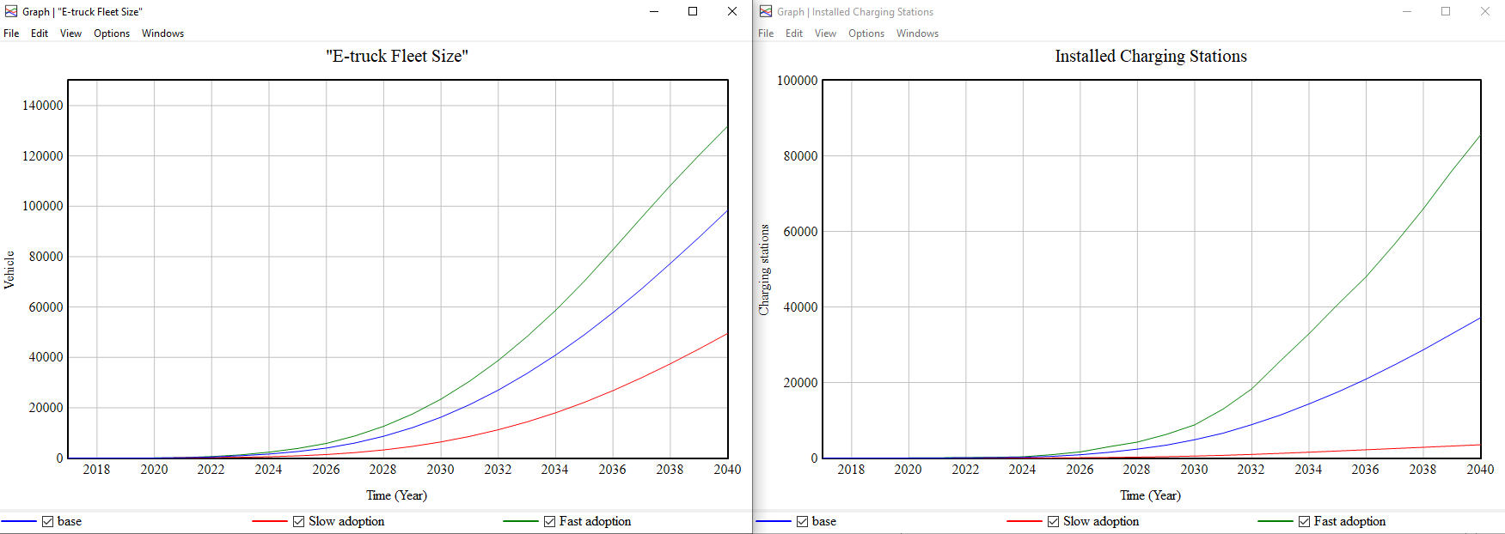
Scenario results
Slow adoption
Business as usual
Fast adoption
@systemdynamics_
THE 41st INTERNATIONAL SYSTEM DYNAMICS CONFERENCE
Chicago, USA and Virtually
#isdc2022
THE 40TH INTERNATIONAL SYSTEM DYNAMICS CONFERENCE
Virtually everywhere!
#isdc2023
Notes:
Progress, Insights, and Questions: Do not change the slide title. Again, keep the text short and fonts big. Show structure or behavior – may not be room for both (some flexibility on font for images). No need to conclude, there is always more to be done. Any questions you want to pose to the audience can go here. Note the timing in the bottom right.

Slide 7
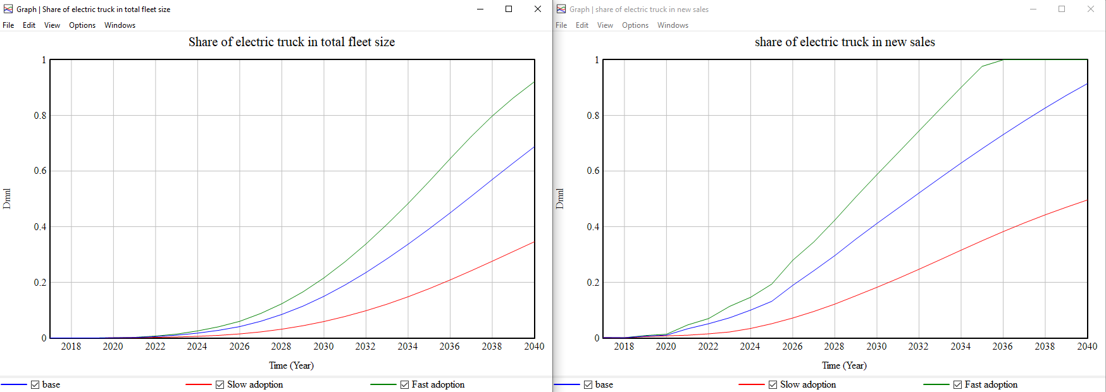
Scenario results
Slow adoption
Business as usual
Fast adoption
@systemdynamics_
THE 41st INTERNATIONAL SYSTEM DYNAMICS CONFERENCE
Chicago, USA and Virtually
#isdc2022
THE 40TH INTERNATIONAL SYSTEM DYNAMICS CONFERENCE
Virtually everywhere!
#isdc2023
Notes:
Progress, Insights, and Questions: Do not change the slide title. Again, keep the text short and fonts big. Show structure or behavior – may not be room for both (some flexibility on font for images). No need to conclude, there is always more to be done. Any questions you want to pose to the audience can go here. Note the timing in the bottom right.

Slide 8
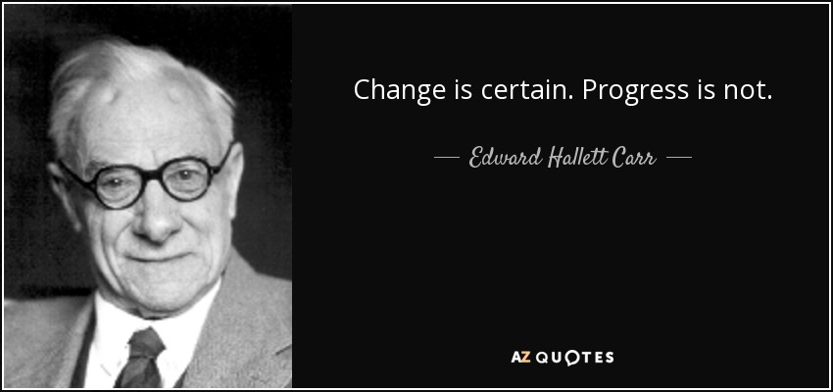
Thank you!
Please contact:
Zeinab Raoofi
Zeinabr@kth.se

