Slide 1
System dynamics modeling for predicting socio-economic-environmental evolution in highly anthropized Mar Menor coastal areas – a group model building approach
WIP Presentation
Mahla Rashidian, NIVA
Norwegian Institute for Water Research, Water & Society section
Oslo, Norway
H2020 European project
https://www.smartlagoon.eu/
0:00-0:30
@systemdynamics_
THE 41st INTERNATIONAL SYSTEM DYNAMICS CONFERENCE
Chicago, USA and Virtually
#isdc2023

Slide 2
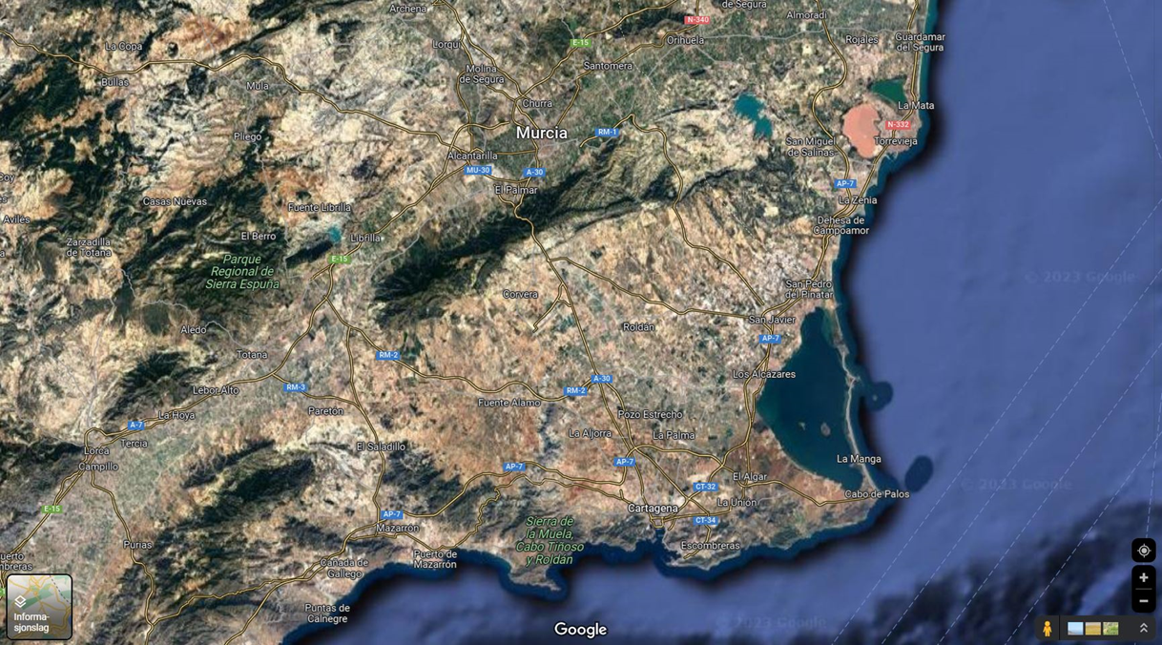
Background
The Mar Menor is one of the biggest hypersaline lagoons in the Mediterranean, with a surface area of 135 km². It is in South-East Spain.
Over the last decades, the lagoon ecosystem has undergone drastic changes. It went from oligotrophic in 1970 to eutrophic (Pérez-Ruzafa et al., 2005).
Origen: Google map
0:30-2:00
@systemdynamics_
THE 41st INTERNATIONAL SYSTEM DYNAMICS CONFERENCE
Chicago, USA and Virtually
#isdc2022
THE 40TH INTERNATIONAL SYSTEM DYNAMICS CONFERENCE
Virtually everywhere!
#isdc2023

Slide 3
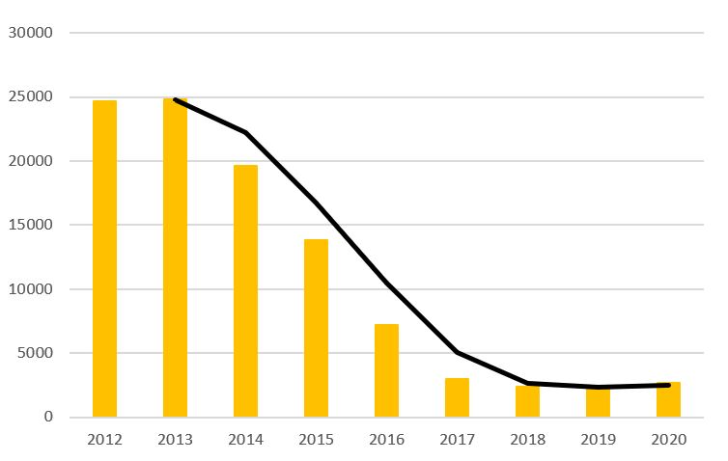
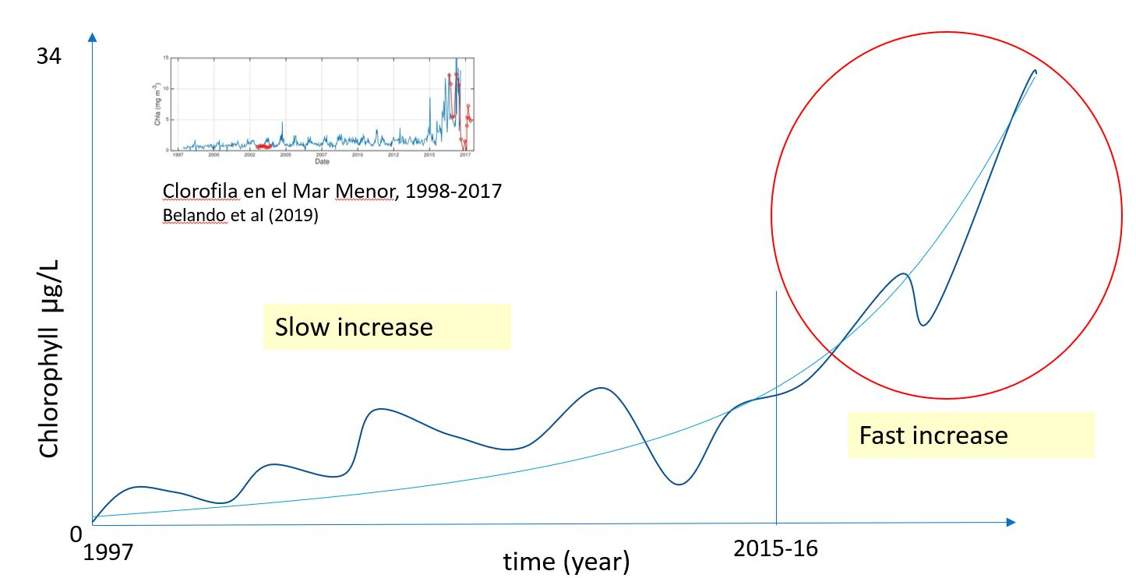
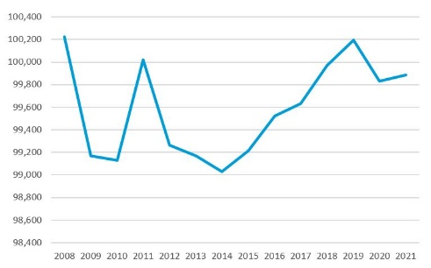
Problem statement
Area of rainfed agriculture
(Mar Menor, Campo de Cartegena)
Hectares
Origen: CARM
Life quality in Murcia region
Indicator
Belando et al., 2019
Origen: INE
0:30-2:00
@systemdynamics_
THE 41st INTERNATIONAL SYSTEM DYNAMICS CONFERENCE
Chicago, USA and Virtually
#isdc2022
THE 40TH INTERNATIONAL SYSTEM DYNAMICS CONFERENCE
Virtually everywhere!
#isdc2023

Slide 4
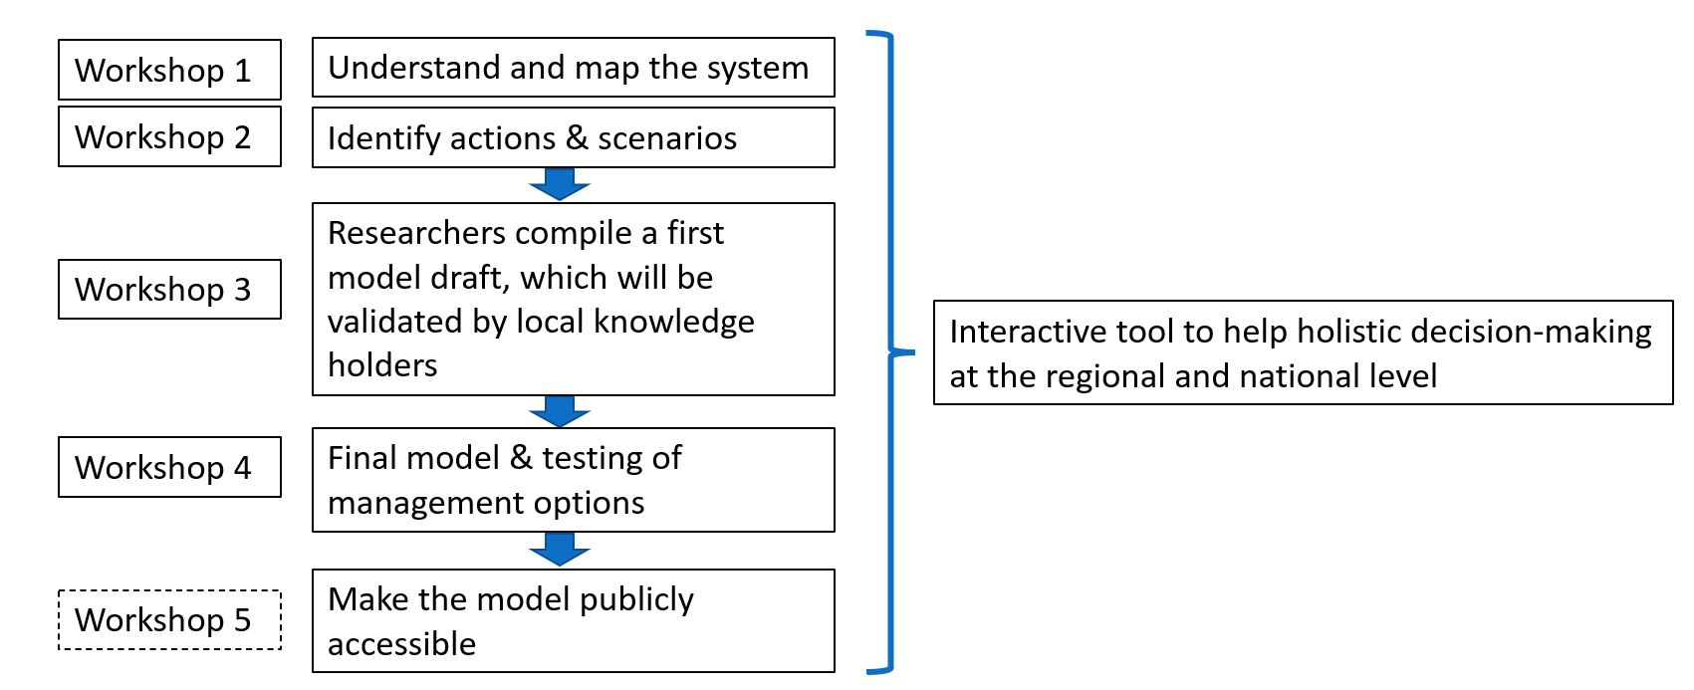
Approach & Methodology
Understand what has led to the environmental degradation of the lagoon ecosystem
How the degradation influences the economic activities and living conditions of the people in the region.
What must be done to have economic activities and good living conditions and allow the recovery of the lagoon ecosystem in the future?
2:00-3:30
@systemdynamics_
THE 41st INTERNATIONAL SYSTEM DYNAMICS CONFERENCE
Chicago, USA and Virtually
#isdc2022
THE 40TH INTERNATIONAL SYSTEM DYNAMICS CONFERENCE
Virtually everywhere!
#isdc2023

Slide 5
Insights and the way forward
Intensive agriculture is widely recognized as the primary sector accountable for significant environmental impact.
The tourism industry has experienced the most profound repercussions due to the prevailing circumstances.
The absence of coordination between local, regional, and national policies has hindered synergy and collaboration.
Transitioning to stock and flow diagrams (SFDs)
Integration with soil and water assessment tool (SWAT) and quantitative water-energy transport (QWET) models
Cross-sectoral CLD – overall overview with subsystems
3:30-5:00
@systemdynamics_
THE 41st INTERNATIONAL SYSTEM DYNAMICS CONFERENCE
Chicago, USA and Virtually
#isdc2022
THE 40TH INTERNATIONAL SYSTEM DYNAMICS CONFERENCE
Virtually everywhere!
#isdc2023

Slide 6
Questions / Comments
Contact us :
Mahla.Rashidian@niva.no
@systemdynamics_
THE 41st INTERNATIONAL SYSTEM DYNAMICS CONFERENCE
Chicago, USA and Virtually
#isdc2022
THE 40TH INTERNATIONAL SYSTEM DYNAMICS CONFERENCE
Virtually everywhere!
#isdc2023

Slide 7
THE INTERNATIONAL SYSTEM DYNAMICS CONFERENCE
Instructions: Please do this!!!
1) Prepare your Work in Progress (WIP) presentation using a copy of this template.
Change the presentation title and author information to match your submission.
Do NOT change the titles of the other slides. Do NOT change the number of slides with content.
Change the body of the slides to present your work, following the instructions in the slide notes.
2) Submit your WIP presentation slides at https://webportal.systemdynamics.org by June 20
Click on the title of your submission
Select “Upload new or updated paper files”
Upload the Powerpoint presentation file for your WIP slides
3) Follow the format and timing listed below:
You have exactly 5:00 minutes to present, followed by up to 5:00 minutes of discussion.
Keep within the time limits noted at the lower right of each slide.
The session chair will combine your slides with other presentations and will control the screen.
4) You may record your presentation in advance
If you are not able to attend the session, the recording will be used instead
If you do attend, you can ask the chair to play the recording, or present live
Add the YouTube Video ID to the Web Portal under “Review or update paper information”
5) If you make updates or change plans after June 20, send the session chair a note
Use the contact information at https://isdc.systemdynamics.org
Notes:
This slide will be hidden from presentation. You may delete this instruction slide once your slides are ready.

