Slide 1
Systems Thinking and System Dynamics Modelling to Facilitate Interdisciplinary Learning through an Undergraduate Course
Online Poster Presentation
Sreenivas
(Bellam Sreenivasulu)
Residential College 4
National University of Singapore
0:00-0:30
@systemdynamics_
THE 41ST INTERNATIONAL SYSTEM DYNAMICS CONFERENCE
Chicago, USA and Virtually
#isdc2023

Slide 2
Problem Statement
Would application of systems thinking tools and system dynamics modeling for modelling ‘Energy Systems’ facilitate interdisciplinary learning?
Systems thinking and system dynamics modeling to facilitate undergraduates’ interdisciplinary learning
Project-based learning in small groups to improve interdisciplinary learning outcomes.
Rationale for formal systems thinking and system dynamics modeling curriculum for interdisciplinary learning.
0:30-2:00
@ systemdynamics_
THE 41ST INTERNATIONAL SYSTEM DYNAMICS CONFERENCE
Chicago, USA and Virtually
#isdc2022
THE 40TH INTERNATIONAL SYSTEM DYNAMICS CONFERENCE
Virtually everywhere!
#isdc2023

Slide 3
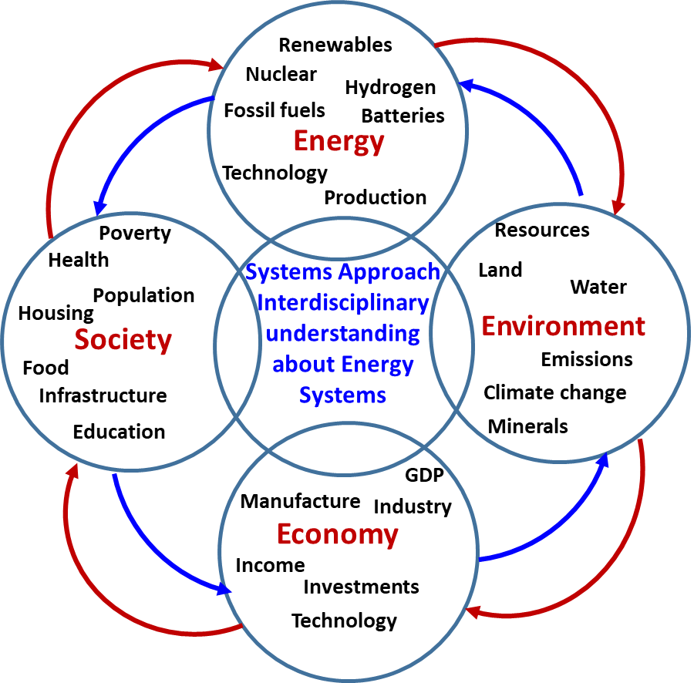
Approach or Dynamic Hypothesis
ST and SD modeling framework to model complex real-world problems to gain interdisciplinary knowledge through project-based Learning. It offers a common platform for students from different disciplines to model complex real-world problems to gain interdisciplinary perspectives/knowledge.
The role of systems science/theory for interdisciplinary studies (Newell, 2001; Repko 2012).
Systems thinking and system dynamics curriculum supports students’ ability to see the interconnections among different disciplines (Flynn et al., 2019; Mathews & Jones, 2008).
Flynn, A. B., Orgill, M., Ho, F. M., York, S., Matlin, S. A., Constable, D. J. C. and Mahaffy, P. G., (2019). Future directions for systems thinking in chemistry education: putting the pieces together, J. Chem. Educ., 96(12), 3000–300.
Mathews, L. G., Jones, A. (2008). Using Systems Thinking to Improve Interdisciplinary Learning Outcomes: Reflections on a Pilot Study in Land Economics. Issues in Integrative Studies, 26, 73-104.
Newell, W.H. (2001). A theory of interdisciplinary studies. Issues in Integrative Studies, 19, 1-25.
Repko, A. F. (2012). Interdisciplinary research: Process and theory (2nd Ed.). Los Angeles, CA: Sage.
2:00-3:30
@systemdynamics_
THE 41ST INTERNATIONAL SYSTEM DYNAMICS CONFERENCE
Chicago, USA and Virtually
#isdc2022
THE 40TH INTERNATIONAL SYSTEM DYNAMICS CONFERENCE
Virtually everywhere!
#isdc2023

Slide 4
Results: Sample Students’ Responses
3:30-5:00
@systemdynamics_
THE 41ST INTERNATIONAL SYSTEM DYNAMICS CONFERENCE
Chicago, USA and Virtually
#isdc2022
THE 40TH INTERNATIONAL SYSTEM DYNAMICS CONFERENCE
Virtually everywhere!
#isdc2023

Slide 5
Main Conclusions
ST & SD framework and pedagogy can foster the development of the four cognitive abilities associated with interdisciplinary learning (Repko (2008a, p.172):
Perspective-taking ; Structuring; Integrating; Producing a cognitive advancement or interdisciplinary understanding
Interdisciplinary approaches draw on disciplinary perspectives and students are able to integrates their insights through modelling to construct a more comprehensive perspective about energy systems.
Implications: What instructors can do (role of instructors and pedagogy)?
Interdisciplinary teaching and learning through systems thinking and system dynamics modelling and Project-based learning
Learner-centred teaching
Collaborative learning in small groups
3:30-5:00
@systemdynamics_
THE 41ST INTERNATIONAL SYSTEM DYNAMICS CONFERENCE
Chicago, USA and Virtually
#isdc2022
THE 40TH INTERNATIONAL SYSTEM DYNAMICS CONFERENCE
Virtually everywhere!
#isdc2023

