Slide 1
Impact of Singapore Green Plan 2030 Initiatives on Electricity Consumption and Generation – a System Dynamics Approach
Online Poster Presentation
Li Kaiyuan, Kevin, National University of Singapore
Dr. Bellam Sreenivasulu, National University of Singapore
0:00-0:30
@systemdynamics_
THE 41ST INTERNATIONAL SYSTEM DYNAMICS CONFERENCE
Chicago, USA and Virtually
#isdc2023
Notes:
Title page: Change title to submission name. Bold the name of the presenter and display your name as you want it read by the moderator (eg Bob instead of Robert). Note the suggested timing in the bottom right. Slide timing may be adjusted, but not the number of slides. The session chair will change slide following the timing indicated, or earlier if requested.

Slide 2
Problem Statement
Understanding the Green Plan
Singapore’s commitments to sustainability
Policies and initiatives that affect aspects of daily life
15% reduction in annual household electricity consumption
Expand and facilitate the use of the electrical vehicle charging network
Increase solar capacity to 2 GWp
Increase efficiency of natural gas power plants
How will Singapore’s energy system react?
Goals and targets of the Green Plan
Behavior of electricity consumption and generation, and CO2 emissions
0:30-2:00
@systemdynamics_
THE 41ST INTERNATIONAL SYSTEM DYNAMICS CONFERENCE
Chicago, USA and Virtually
#isdc2022
THE 40TH INTERNATIONAL SYSTEM DYNAMICS CONFERENCE
Virtually everywhere!
#isdc2023
Notes:
Problem Statement: Do not change the slide title. Keep fonts big (24 pt or bigger). Indicate why the problem is important. Note the timing in the bottom right.

Slide 3
Approach or Dynamic Hypothesis
5 subsystems:
Household electricity consumption
Transport-related electricity consumption
Solar photovoltaic (PV) electricity generation
Natural gas electricity generation
CO2 emissions
2:00-4:00
@systemdynamics_
THE 41ST INTERNATIONAL SYSTEM DYNAMICS CONFERENCE
Chicago, USA and Virtually
#isdc2022
THE 40TH INTERNATIONAL SYSTEM DYNAMICS CONFERENCE
Virtually everywhere!
#isdc2023
Notes:
Approach or Dynamic Hypothesis: Do not change the slide title. Keep fonts big (24 pt or bigger). Note the timing in the bottom right.

Slide 4
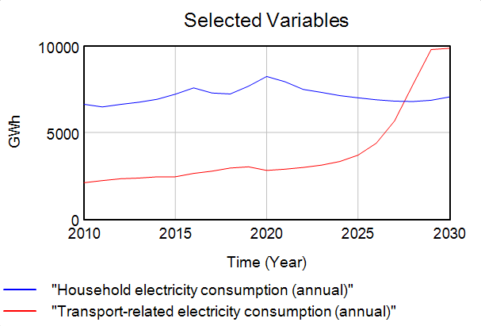
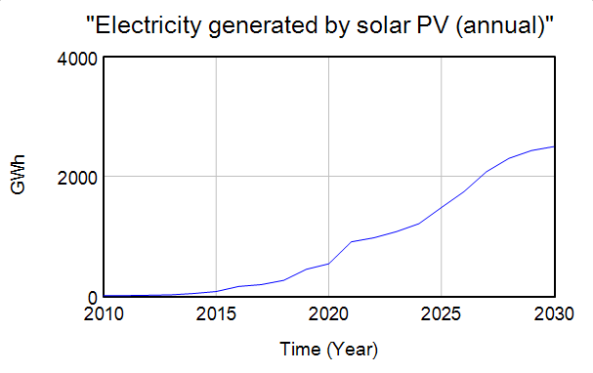
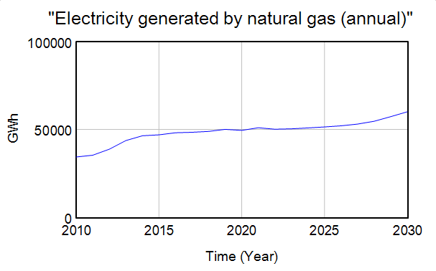
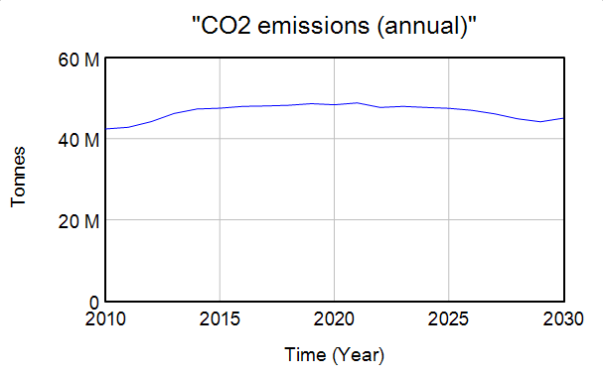
Results
Targets can mostly be achieved by 2030
Reinforcing loops involving economic growth drive up consumption and desired electricity generation in long run
4:00-5:00
@systemdynamics_
THE 41ST INTERNATIONAL SYSTEM DYNAMICS CONFERENCE
Chicago, USA and Virtually
#isdc2022
THE 40TH INTERNATIONAL SYSTEM DYNAMICS CONFERENCE
Virtually everywhere!
#isdc2023
Notes:
Results: Do not change the slide title. Again, keep the text short and fonts big. Show structure or behavior – may not be room for both (some flexibility on font for images). Any questions you want to pose to the audience can go here. Note the timing in the bottom right.

Slide 5
INTERNATIONAL SYSTEM DYNAMICS CONFERENCE
Instructions: Please do this!!!
1) Prepare your Online Poster presentation using a copy of this template.
Change the presentation title and author information to match your submission.
Do NOT change the titles of the other slides. Do NOT change the number of slides with content.
Change the body of the slides to present your work, following the instructions in the slide notes.
2) Submit your Online Poster presentation slides at https://webportal.systemdynamics.org by June 20
Click on the title of your submission
Select “Upload new or updated paper files”
Upload the Powerpoint presentation file for your Online Poster slides
3) Follow the format and timing listed below:
You have exactly 5:00 minutes to present, followed by up to 5:00 minutes of discussion.
Keep within the time limits noted at the lower right of each slide.
The session chair will combine your slides with other presentations and will control the screen.
4) You may record your presentation in advance
If you are not able to attend the session, the recording will be used instead
If you do attend, you can ask the chair to play the recording, or present live
Add the YouTube Video ID to the Web Portal under “Review or update paper information”
5) If you make updates or change plans after June 20, send the session chair a note
Use the contact information at https://isdc.systemdynamics.org
Notes:
This slide will be hidden from presentation. You may delete this instruction slide once your slides are ready.

