Slide 1
Delayed discharges among inpatients with learning disabilities Exploratory system dynamics study with policymakers
Online Poster Presentation
Shreya Sonthalia
MRC/CSO Social and Public Health Sciences Unit,
University of Glasgow
0:00-0:30
@systemdynamics_
THE 41ST INTERNATIONAL SYSTEM DYNAMICS CONFERENCE
Chicago, USA and Virtually
#isdc2023
Notes:
Good morning, I’m Shreya a PhD student in Public Health at the University of Glasgow. Today, I’m presenting about a 3-month internship I did at the Scottish govt looking at delayed discharges among patients with learning disabilities.

Slide 2
Problem Statement
Discharge delayed by up to 5 years
Restricted opportunities to lead a meaningful life
Service congestion; operate at full capacity
Costs £150,000 per year
How to reduce delayed discharges?
Number affected increasing
Reduce bed occupancy
0:30-2:00
@ systemdynamics_
THE 41ST INTERNATIONAL SYSTEM DYNAMICS CONFERENCE
Chicago, USA and Virtually
#isdc2022
THE 40TH INTERNATIONAL SYSTEM DYNAMICS CONFERENCE
Virtually everywhere!
#isdc2023
Notes:
DD is when a person is in hospital when there is no clinical need for assessment or treatment. This generally happens when there is no suitable placement for a person to return to in the community. Some people come into hospital due to challenging behaviour, resulting in placement breakdowns. Some people have long periods of treatment which can result in placement loss.
DD has significant consequences for the individual, the services and for others needing the services
The aim to eliminate DD and the focus on this work was how to reduce DD in the context of rising DD. The aim was also to look at reducing bed occupancy to prevent people needing the service to be put on waiting lists.

Slide 3
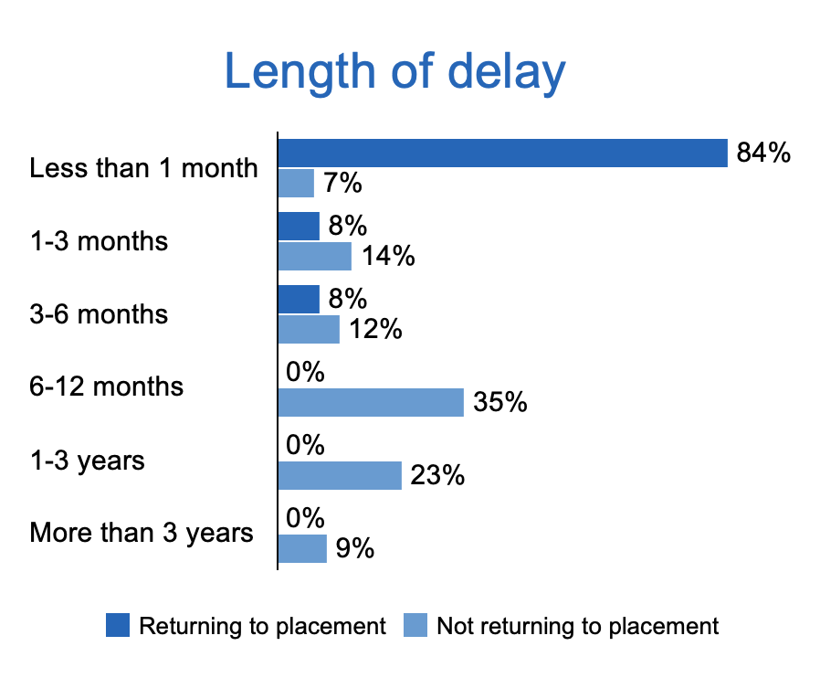
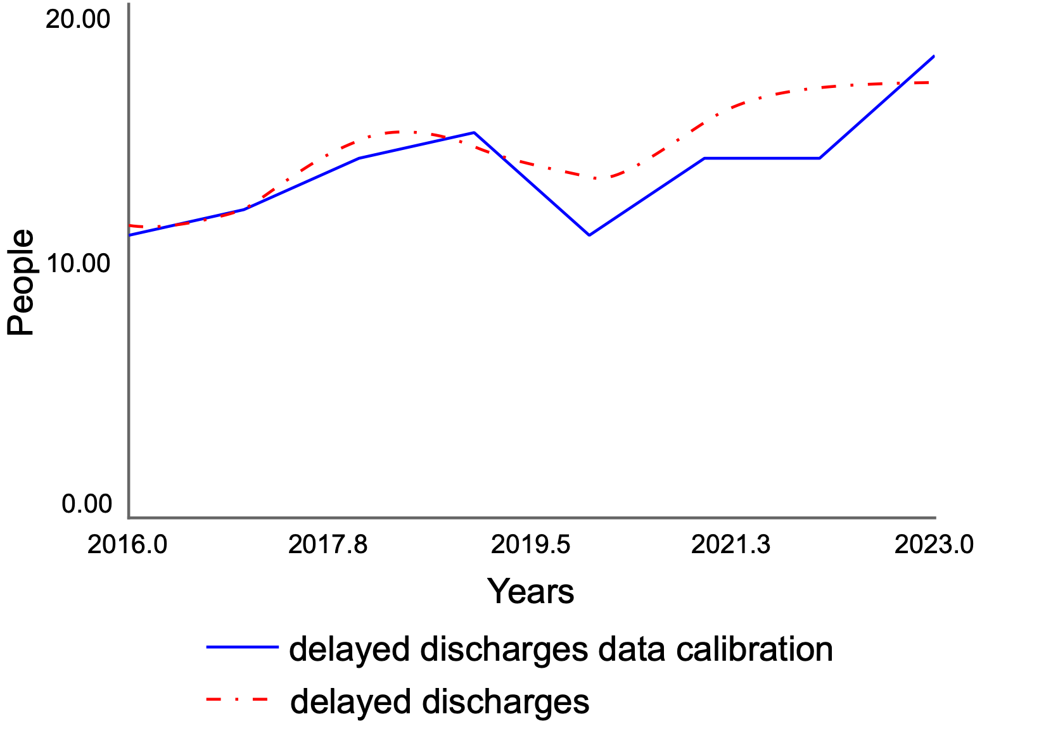
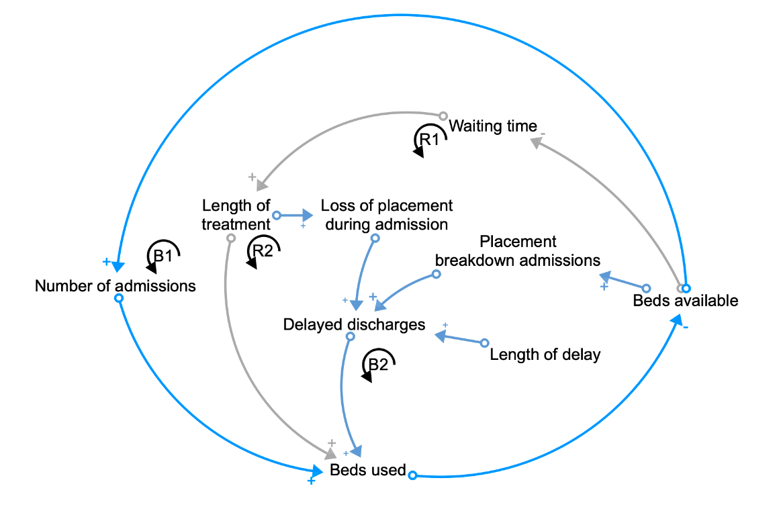
Approach or Dynamic Hypothesis
Developed in collaboration with the lead clinician at the health board
Individual level data
Delay length data problematic
Some effects built in as assumptions
@systemdynamics_
THE 41ST INTERNATIONAL SYSTEM DYNAMICS CONFERENCE
Chicago, USA and Virtually
#isdc2022
THE 40TH INTERNATIONAL SYSTEM DYNAMICS CONFERENCE
Virtually everywhere!
#isdc2023
Notes:
I took a case study approach – looking at one health board which will be kept anonymous
Worked with the lead clinician, meeting every 10 days or so over 2 months to understand the system, what’s worked, what hasn’t.
Data at the individual level for 2-3 years, and some aggregate data from reports for about 8 years.
Data was incomplete, but the main challenge was the lack of data on the length of delay. Often absent or calculated based on those discharged, or excluding outliners (those with long lengths of delay) which was problematic. Developed different assumptions into the simulation model, including a random function (with a specified range) – this is plausible given this delay is considered exogenous – something the hospital has no control over, and also fluctuating based on things like new housing projects being completed.

Slide 4
Results
Delayed discharge inflow is determined by placement breakdowns, and the outflow is determined by the length of delay (the additional time to find a new placement).
Both of these are determined by actors outside the “system” - social care & housing
Bed capacity is unlikely to impact delayed discharges: considered helpful by stakeholders
Feedback mechanisms keeping bed availability at zero
Reducing proportions needing a new placement could impact on delayed discharges but doesn’t impact bed availability much
Changing length of delay will make the biggest impact on bed availability and delayed discharges
3:30-5:00
@systemdynamics_
THE 41ST INTERNATIONAL SYSTEM DYNAMICS CONFERENCE
Chicago, USA and Virtually
#isdc2022
THE 40TH INTERNATIONAL SYSTEM DYNAMICS CONFERENCE
Virtually everywhere!
#isdc2023
Notes:
I think there were 2 important learnings for the stakeholders.
The first emerged from the applying the concepts of stocks and flows. Helped understand that the it can only change by modifying the inflow or outflow, and that these are largely controlled by actors outside the system. The project was initially framed as a bed modelling project.
Second was around understanding some of the feedback mechanisms. What they found helpful was seeing that the length of delay is important. They were aware that placement breakdown admissions were problematic but had limited leverage over it as they are obliged to accommodate people.
If you attended yesterday’s plenary, you would have heard Douglas speak more about this issue. I’d also like to thank him for the support he provided during the project.

Slide 5
INTERNATIONAL SYSTEM DYNAMICS CONFERENCE
Instructions: Please do this!!!
1) Prepare your Online Poster presentation using a copy of this template.
Change the presentation title and author information to match your submission.
Do NOT change the titles of the other slides. Do NOT change the number of slides with content.
Change the body of the slides to present your work, following the instructions in the slide notes.
2) Submit your Online Poster presentation slides at https://webportal.systemdynamics.org by June 20
Click on the title of your submission
Select “Upload new or updated paper files”
Upload the Powerpoint presentation file for your Online Poster slides
3) Follow the format and timing listed below:
You have exactly 5:00 minutes to present, followed by up to 5:00 minutes of discussion.
Keep within the time limits noted at the lower right of each slide.
The session chair will combine your slides with other presentations and will control the screen.
4) You may record your presentation in advance
If you are not able to attend the session, the recording will be used instead
If you do attend, you can ask the chair to play the recording, or present live
Add the YouTube Video ID to the Web Portal under “Review or update paper information”
5) If you make updates or change plans after June 20, send the session chair a note
Use the contact information at https://isdc.systemdynamics.org
Notes:
This slide will be hidden from presentation. You may delete this instruction slide once your slides are ready.

