Slide 1
System Dynamics Society Annual Conference 2023 Tackling multi-sectoral problems with System Dynamics – exploring whole systems solutions to support health and social care Palmer House Hilton Hotel, Chicago Monday 24 July 2023
Prof Eric Wolstenholme
Douglas McKelvie
Symmetric Scenarios
Notes:
1

Slide 2
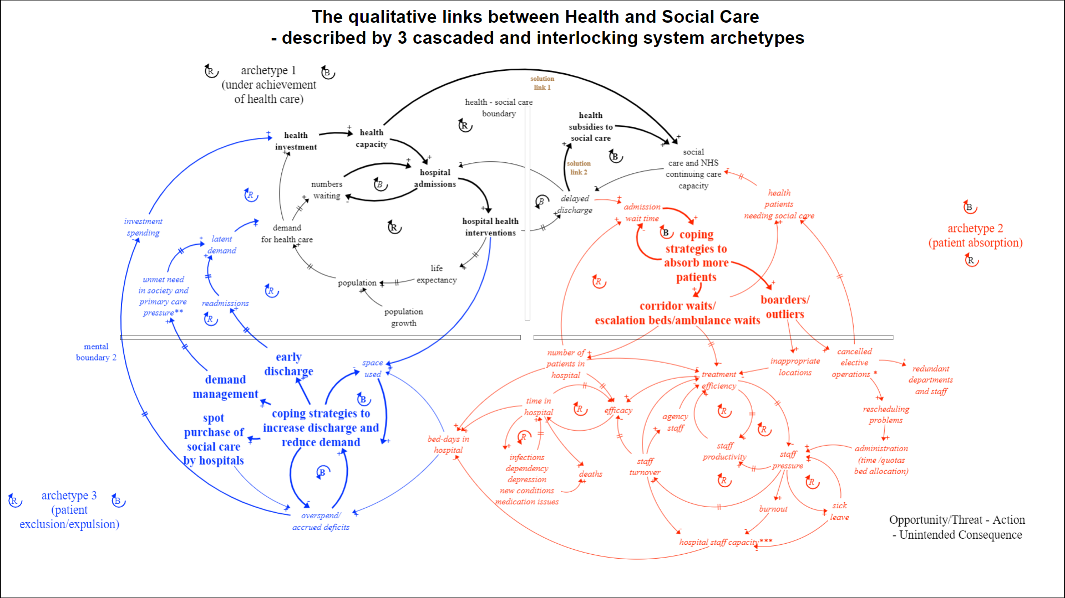
Published in Systems 2022, 10, 135
https://bit.ly/EricArchetype
NHS England video available at
https://bit.ly/EricArchetypeVideo

Slide 3
I am often asked by prospective clients, ‘What’s so great about System Dynamics? What will my organisation get that we can’t get from other, more familiar, methods of strategic planning and analysis?’
I tell them that System Dynamics is the one method that will allow them to make all of their assumptions explicit, integrate them in a logical and testable way, challenge the assumptions, provide a broader perspective and put clients in a better position to make decisions that will stand the test of time.
Jack Homer (1996) Why we iterate…. SDR, 12, 1

Slide 4
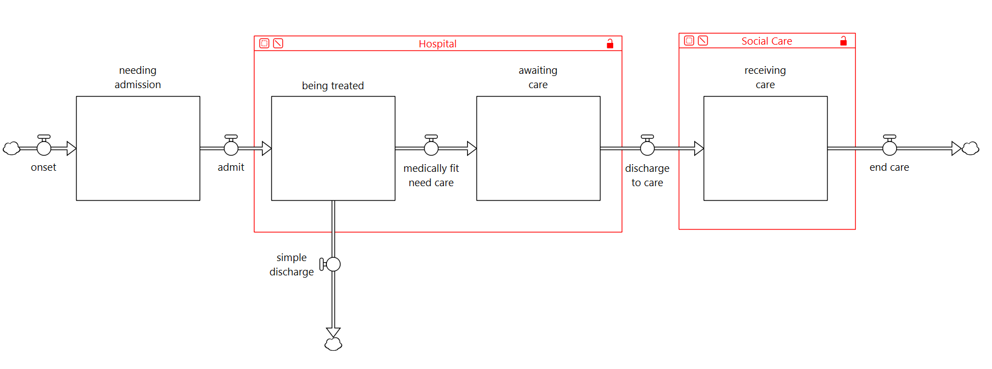
Delayed Discharge Problem
(The Lancet, September 2022)

Slide 5
Integrated Care Model
Population by Age
18
45
65
75
85+
General Hospital
wait
lists
elective
CH
Support
A&E
acute
delayed
Dependency States
reable- ment
self manage
care at home
care home
CH
delayed
Community Hosp
Int
delayed
Intermediate Care
£

Slide 6
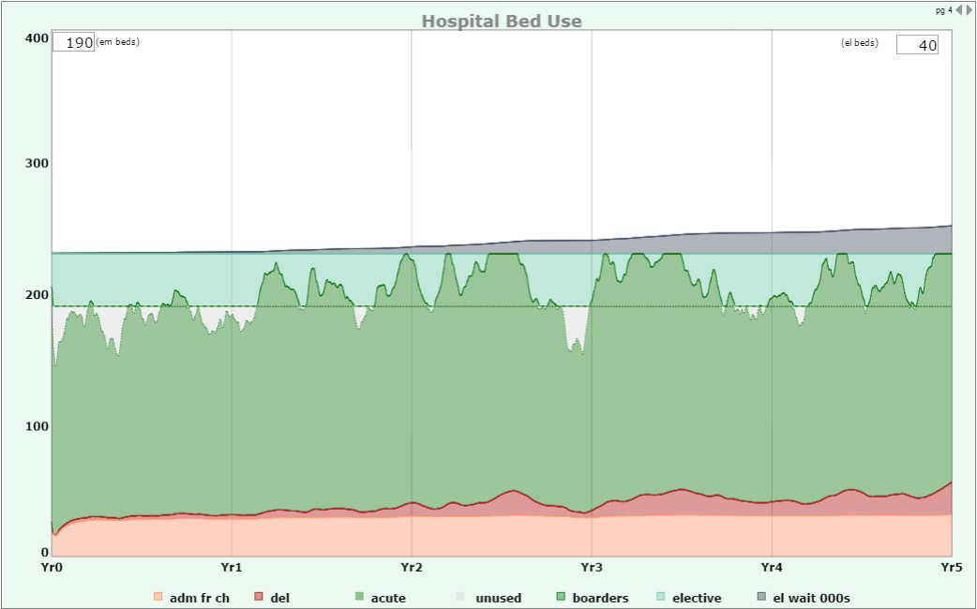
Integrated Care Model on One Graph
More about this model in The Dynamics of Care
Chapter 8 – Integrated Care
Elective Wait List (000s)
Emergency (Unscheduled Care) Bed Occupancy
Emergency Patients who are in the Right Place
Waiting for Social Care
Admitted from care homes (avoidable?)

Slide 7
Domiciliary Care – The Changing Population

Slide 8
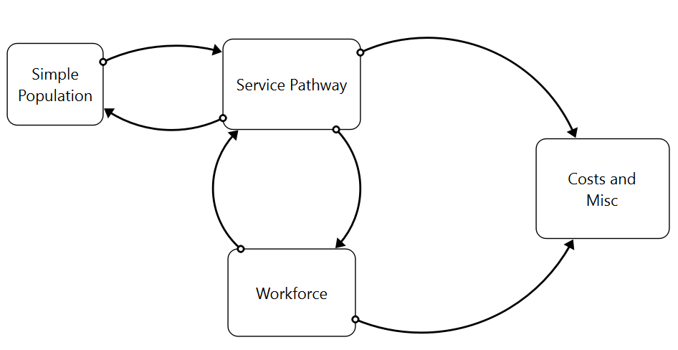
Approaches in Health Policy Modelling

Slide 9
Domiciliary Care – Model Structure

Slide 10
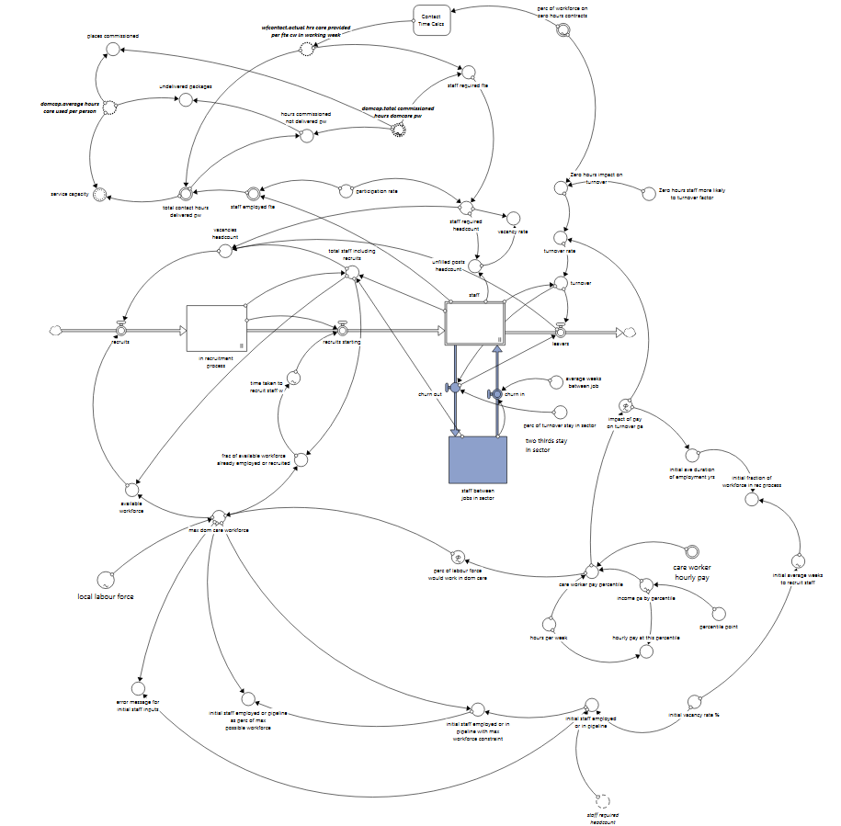
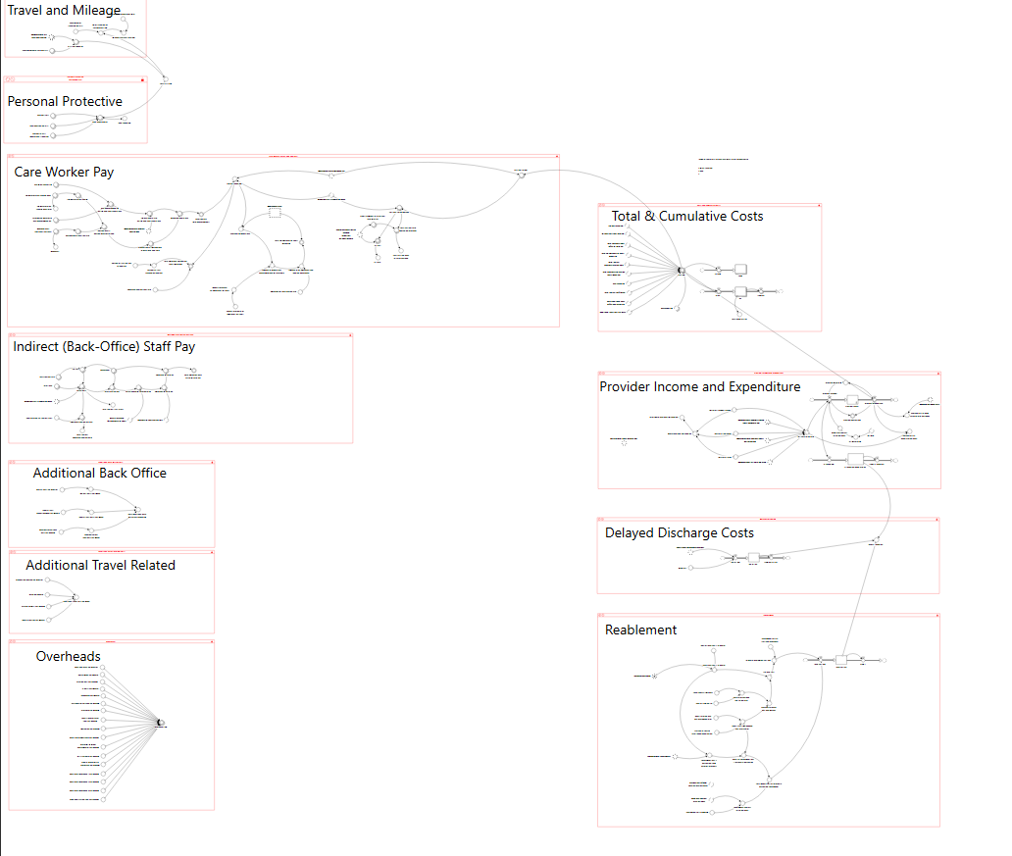
Domiciliary Care – Model Structure

Slide 12
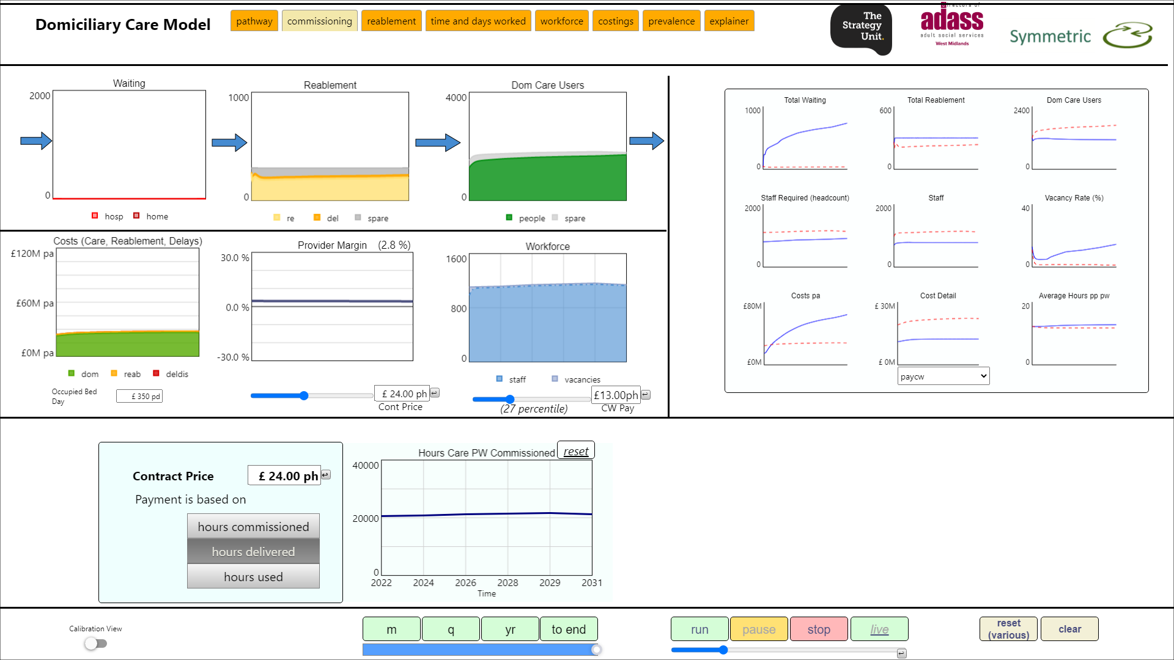
Costs Up
Provider Margin OK

Slide 13
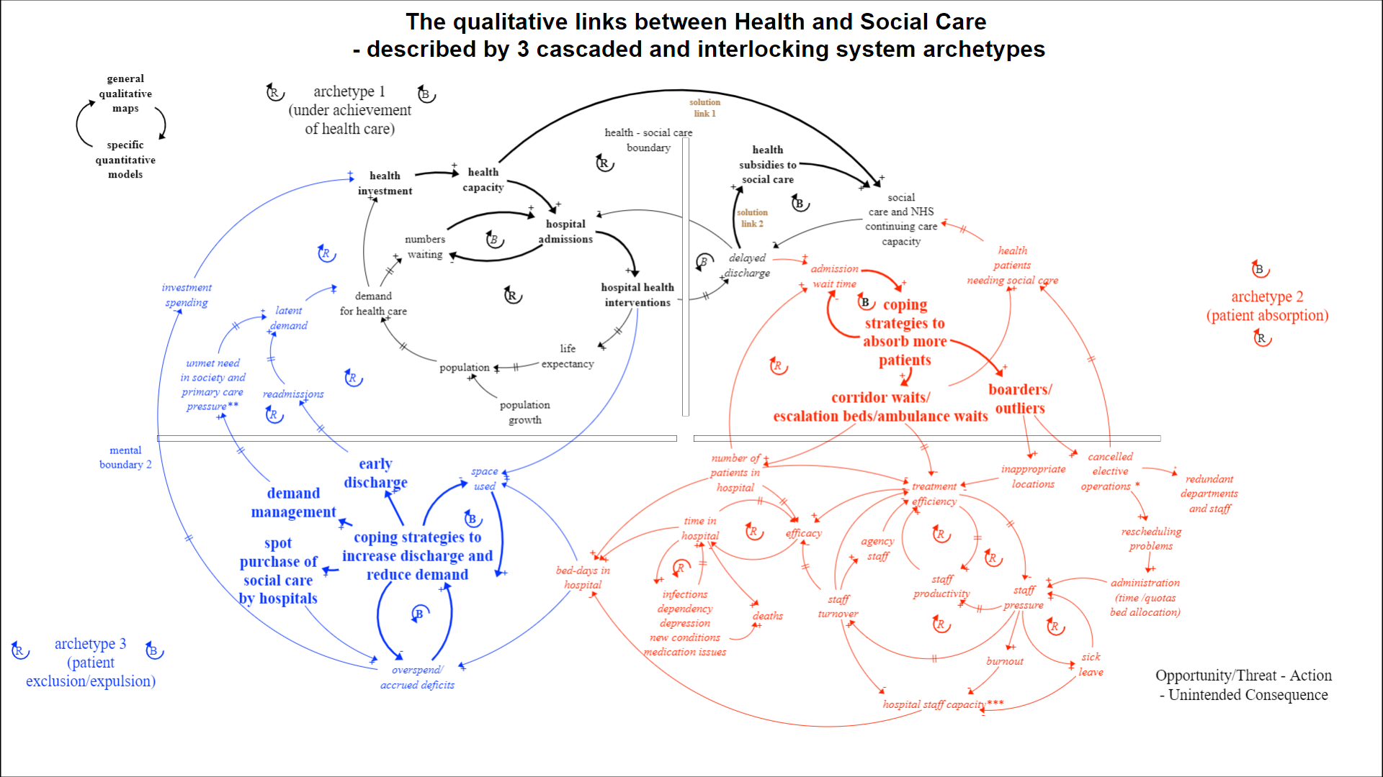
Issues covered implicitly or explicitly in the Domiciliary Care model

Slide 14
Conclusions
UK health and social care systems have serious and persistent problems
The cost of care is higher than current allocations of public funding cover
Qualitative maps explore general solutions Quantitative models explore specific solutions
System Dynamics sims can embolden stakeholders to implement necessary trade-offs
Investing in collaborative ventures can more than pay for itself in reducing delayed discharges and congestion.
A model provides a way, perhaps the only way, of integrating data (what is known) from a diverse range of sources (population health and ageing, capacity and design of service pathways, workforce and labour market dynamics, and costings)
We don’t have to model the whole system to claim a ‘whole systems approach’
The challenge remains to convince politicians to take long-term, multi-sectorial decisions within the constraints of the electoral cycle

Slide 15
Acknowledgements
Symmetric colleagues / associates: David Monk, David Todd, Steve Arnold, Sarah Nield, Donald Scott, Brian Clark
OLM Systems, especially Gill Smith, Peter O’ Hara
Many NHS Organisations, provider trusts, commissioners and Local Authorities
Strategy Unit of NHS Midlands and Lancashire CSU: Stacey Croft, Sally Chisholm, Peter Spilsbury
Association of Directors of Adult Social Services (West Midlands)
University of Birmingham Health Services Management Centre
Skills for Care (the National Sector Skills Council)
Department of Health and Social Care (England)
Public Health Scotland (formerly Information Services Division)
Northern Ireland Social Care Council, NI Department of Finance (Innovation Lab), NI Department of Health, NI Strategic Investment Board
System Dynamics Society: Health Policy SIG, UK Chapter
Isee Systems (Stella Architect software)
Springer Publishing

Slide 16
System Dynamics Society Annual Conference 2023 Tackling multi-sectoral problems with System Dynamics – exploring whole systems solutions to support health and social care Palmer House Hilton Hotel, Chicago Monday 24 July 2023
Prof Eric Wolstenholme
Douglas McKelvie
Symmetric Scenarios
Notes:
16

