Slide 1
Visualization of aging and shrinking trends in China’s population through 2060
WIP Presentation
Junlai Zhang Vienna University of Business and Economics
Jiangxi University of Finance and Economics
Mark Heffernan Western Sydney University
Dynamic Operations
University of New South Wales
0:00-0:30
@systemdynamics_
THE 41st INTERNATIONAL SYSTEM DYNAMICS CONFERENCE
Chicago, USA and Virtually
#isdc2023
Notes:
Title page: Change title to submission name. Bold the name of the presenter and display your name as you want it read by the moderator (eg Bob instead of Robert). Note the suggested timing in the bottom right. Slide timing may be adjusted, but not the number of slides. The session chair will change slide following the timing indicated, or earlier if requested.

Slide 2
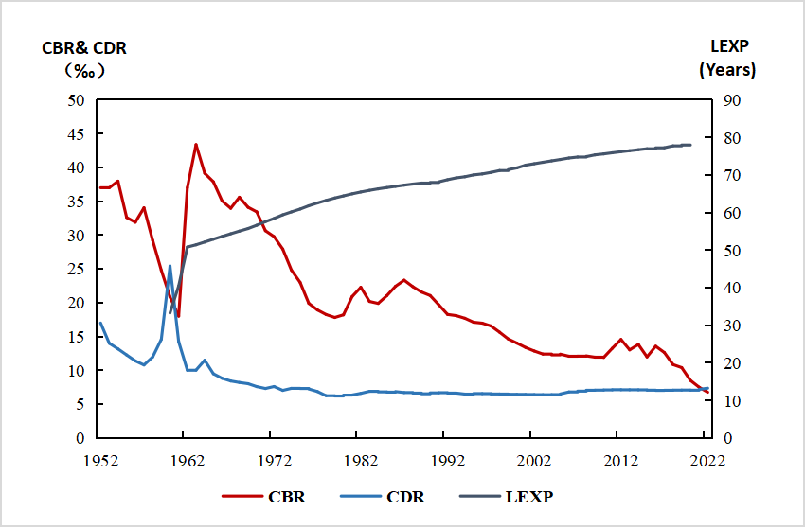
Problem Statement
China’s population faced its first decline since 1961 in 2022, as death rates surpassed birth rates.
Because of that, we wonder about the following trends 2000-2060:
1.the population of China?
2.the demographic structural changes of China?
3.the size of China’s workforce?
4.the dependency burden on the workforce?
Life expectancy
Crude birth rate
Crude death rate
0:30-2:00
@systemdynamics_
THE 41st INTERNATIONAL SYSTEM DYNAMICS CONFERENCE
Chicago, USA and Virtually
#isdc2022
THE 40TH INTERNATIONAL SYSTEM DYNAMICS CONFERENCE
Virtually everywhere!
#isdc2023
Notes:
Problem Statement: Do not change the slide title. Keep fonts big (24 pt or bigger). Indicate why the problem is important. Note the timing in the bottom right.

Slide 3
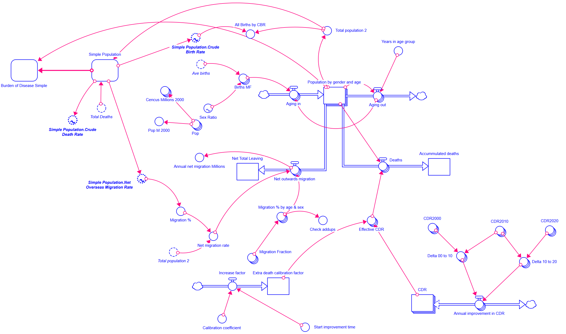
Approach or Dynamic Hypothesis
We built 3 models:
Simple population model
Array population model
(pictured here)
Workforce model
2:00-3:30
@systemdynamics_
THE 41st INTERNATIONAL SYSTEM DYNAMICS CONFERENCE
Chicago, USA and Virtually
#isdc2022
THE 40TH INTERNATIONAL SYSTEM DYNAMICS CONFERENCE
Virtually everywhere!
#isdc2023
Notes:
Approach or Dynamic Hypothesis: Do not change the slide title. Keep fonts big (24 pt or bigger). Note the timing in the bottom right.

Slide 4
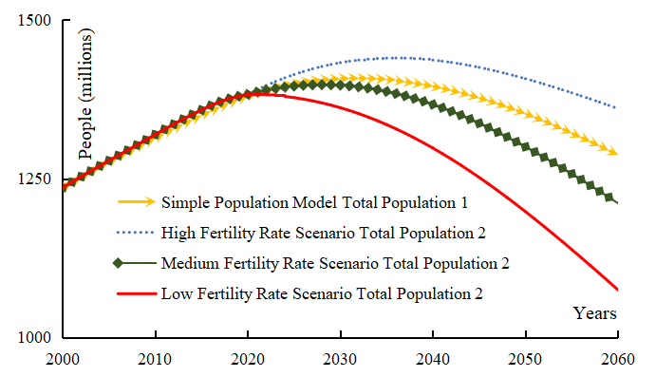
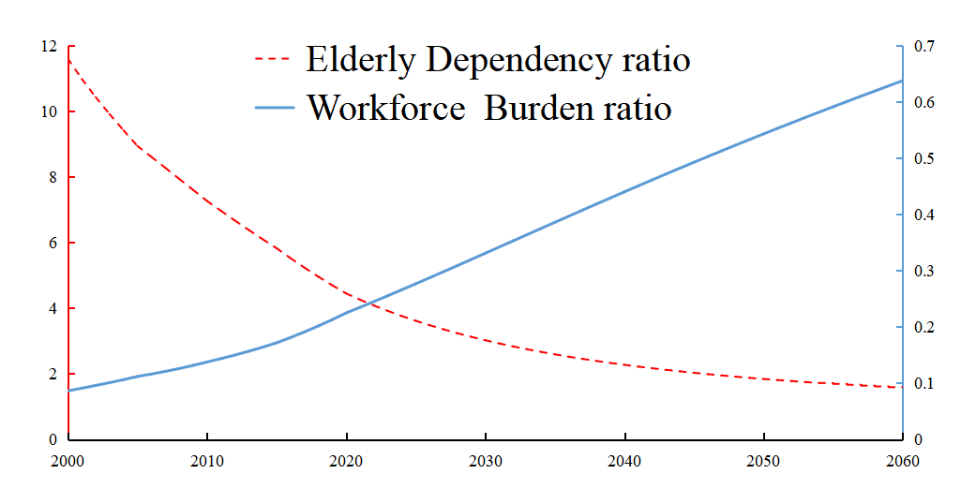
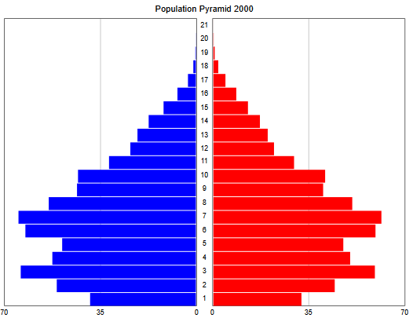
Progress, Insights, and Questions
a. Population Size.
Four different fertility
scenarios
b. Year 2000
Pyramid shape:
Broad base & Narrower top
c. Year 2060
Top heavy
d. Left axis：workforce
/Non worker 65+
Right axis: Non worker 65+/workforce
a
d
b
c
3:30-5:00
@systemdynamics_
THE 41st INTERNATIONAL SYSTEM DYNAMICS CONFERENCE
Chicago, USA and Virtually
#isdc2023
THE 40TH INTERNATIONAL SYSTEM DYNAMICS CONFERENCE
Virtually everywhere!
#isdc2022
Notes:
Progress, Insights, and Questions: Do not change the slide title. Again, keep the text short and fonts big. Show structure or behavior – may not be room for both (some flexibility on font for images). No need to conclude, there is always more to be done. Any questions you want to pose to the audience can go here. Note the timing in the bottom right.

Slide 5
THE INTERNATIONAL SYSTEM DYNAMICS CONFERENCE
Instructions: Please do this!!!
1) Prepare your Work in Progress (WIP) presentation using a copy of this template.
Change the presentation title and author information to match your submission.
Do NOT change the titles of the other slides. Do NOT change the number of slides with content.
Change the body of the slides to present your work, following the instructions in the slide notes.
2) Submit your WIP presentation slides at https://webportal.systemdynamics.org by June 2
Click on the title of your submission
Select “Upload new or updated paper files”
Upload the Powerpoint presentation file for your WIP slides
3) Follow the format and timing listed below:
You have exactly 5:00 minutes to present, followed by up to 5:00 minutes of discussion.
Keep within the time limits noted at the lower right of each slide.
The session chair will combine your slides with other presentations and will control the screen.
4) You may record your presentation in advance
If you are not able to attend the session, the recording will be used instead
If you do attend, you can ask the chair to play the recording, or present live
Add the YouTube Video ID to the Web Portal under “Review or update paper information”
5) If you make updates or change plans after June 2, send the session chair a note
Use the contact information at https://isdc.systemdynamics.org
Notes:
This slide will be hidden from presentation. You may delete this instruction slide once your slides are ready.

