Slide 1
Systems Modeling as an Approach for Eliciting the Mechanisms for Hip Fracture Recovery among Older Adults in Participatory Stakeholder Engagement Setting
By: John P. Ansah
Assistant Professor
Center for Health Integration

Slide 2
Background
With its high and increasing life expectancy, Singapore will likely see a rise in osteoporosis, accidental falls, and consequent hip fractures (Ojo et al., 2009; Office of the Surgeon General, 2004).
Osteoporosis, a condition of progressive bone loss, resulted in an estimated 1.26 million hip fractures globally in 1990; this number is projected to increase to 4.5 million by 2050 (Gullberg et al., 1997), with most of this increase coming from Asia (Doshi et al., 2014; Gullberg et al., 1997).
With a rising prevalence of osteoporosis, there are increasing concerns about hip fractures among older adults, as osteoporosis is associated with a 6 to 7-fold increase in the likelihood of hip fractures (Kanis et al., 2000).
In 2015, approximately 2,000 elderly were hospitalized locally due to hip fractures (Khor, 2016). Between 2007 and 2009, the age-standardized incidence of hip fractures in Singapore was estimated to be (per 100,000) 156 in men and 331 in women (Kanis et al., 2012).

Slide 3
Background
Hip fractures are costly and demand considerable resources from the healthcare system, accounting for a large proportion of fracture-related healthcare expenditure and mortality in men and women over 50 (Johnell & Kanis, 2006; Kanis & Johnell, 2005; Ström et al., 2011).
Considering this demographic reality, the economic burden of hip fractures on health systems is expected to increase. In Singapore, the mean cost of hospitalization due to hip fractures was approximately S$13,314 per patient in 2011, and an additional cost of S$2,690 may result from complications (Tan et al., 2017).
Furthermore, considering post-acute rehabilitation, nursing, and caregiving costs (both formal and informal), total lifetime costs are likely to be considerably higher.
In the United States, for instance, overall lifetime costs (considering lost productivity and other indirect costs) due to hip fractures were estimated to amount to more than $81,000 (in 1997 US dollars) (Braithwaite et al., 2003).

Slide 4
Overarching Goal
These issues highlight the importance of enhancing functional recovery in hip fracture patients to reduce dependency and facilitate independent living within the community.
One year after hip fracture, nearly one in four patients will die. Fewer than 50% of survivors can walk unaided, and nearly 40% can perform all activities of daily living (ADLs) independently.
To ensure that a patient and family-centered care approach is adopted, this research aims:
  To actively engage stakeholders (including doctors, physiotherapists, hip fracture patients, and caregivers) using Group Model Building (GMB) to elicit the mechanisms influencing hip fracture recovery, incorporating a feedback perspective to inform system-wide interventions.

Slide 5
Method

Slide 6
Study Context
The research team from Duke-NUS Medical School conducted two half-day workshops in Singapore on 29th August 2022 and 31st August 2022.
Twenty-five stakeholders participated in the workshop, representing:
  Singapore General Hospital,
  Changi General Hospital,
  St. Andrew’s Community Hospital,
  patients,
  caregivers, and
  researchers.
The stakeholders include three medical doctors, six physiotherapists, two nurses, eight hip fracture patients, one caregiver, and five researchers. Informed consent was obtained from all participants before the start of the workshop sessions.

Slide 7
Study Design

Slide 8
Presentation of Concept Model

Slide 9
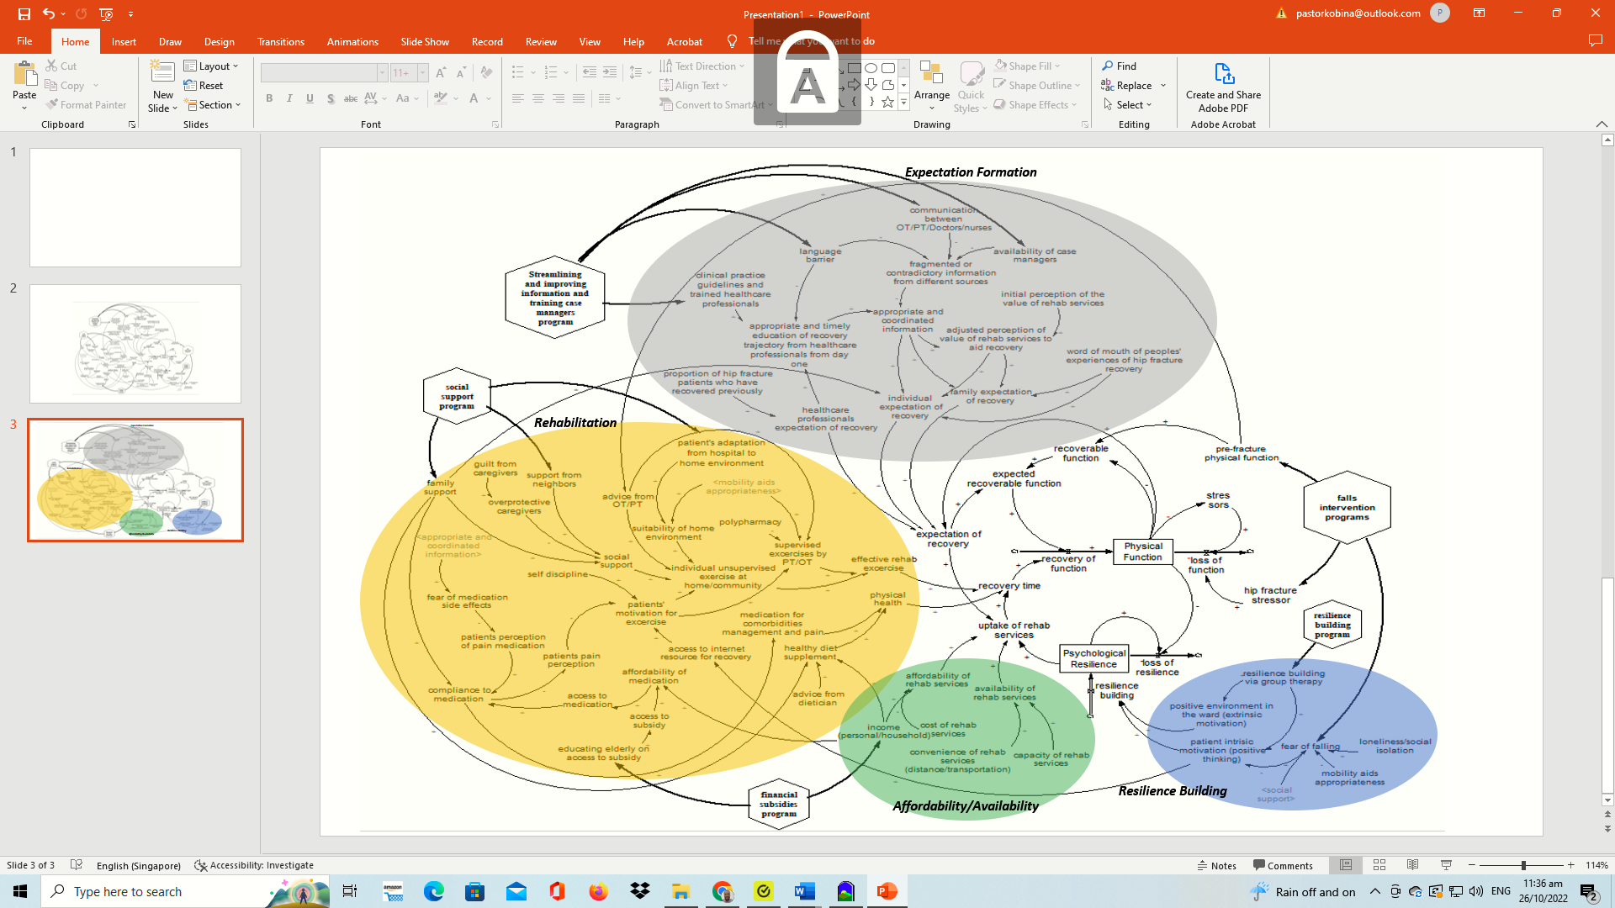
Model Developed with Stakeholders

Slide 10
Insights
The recovery of loss of function due to hip fracture is attributed to (a) the recognition of a gap between pre-fracture physical function and current physical function and (b) the marshaling of psychological resilience to respond promptly to a physical functional loss via uptake of rehabilitation services.
  The recognition of the gap and marshaling psychological resilience to close it was determined by the expectation of recovery, which is in turn influenced by the quality of the information provided to patients and their families by healthcare professionals and the appropriate and coordinated delivery of this information.
  From a policy perspective, this suggests that hip fracture care must prioritize patient education and coordinated communication to raise the expectation of recovery. A rise in the expectation of recovery will lead to increased uptake of rehabilitation services and, consequently, better recovery outcomes.

Slide 11
Insights
Support from family, caregivers, friends, and neighbors is essential for the uptake of effective rehabilitation services. This has several policy intervention implications.
  Social support refers to providing emotional support, allowing hip fracture patients to engage in prescribed exercises recommended by physiotherapists, helping patients use mobility aids to walk, creating a positive environment that encourages patients to adhere to treatment and recovery regimes, and decreasing fear of falling.

Slide 12
Insights
Hip fracture patients need financial support to subsidize the cost of medication, rehabilitation services, and mobility aids was reinforced by stakeholders’ experience of the significant cost burden of hip fracture. Stakeholders indicated that the process of recovery from hip fractures is costly and requires substantial resources.
  For most elderly individuals, the financial burden, especially if they have no external support from children, family members, and the government, is significant and can affect their ability to take up essential services and negatively impact their recovery trajectory.

Slide 13
Insights
In the wake of a stressor-induced physical function loss (such as a hip fracture), a person with high psychological resilience will respond in a way that promotes rapid recovery, while an individual with low psychological resilience will react in a way that leads to a slow recovery or deterioration.
  Based on this insight, stakeholders suggested that healthcare systems should consider implementing resilience-building programs that help older adults to build psychological resilience to prepare them for responding to life stressors over their life course.

