Slide 1
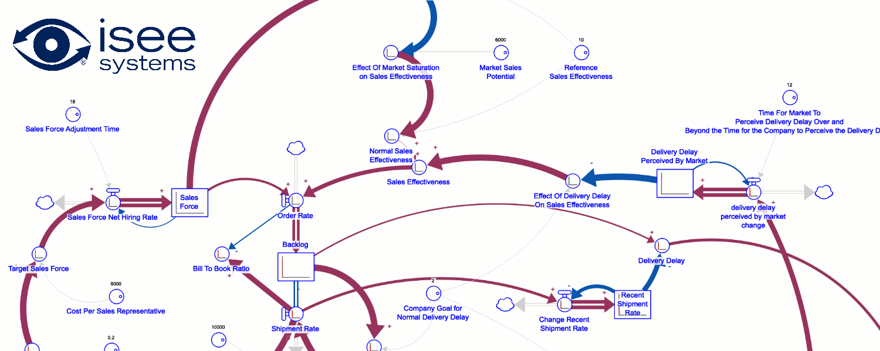
Measuring the change in behavior of a system with a single metric
By: Billy Schoenberg, Bob Eberlein, Pål Davidsen

Slide 2
A problem
LTM defines loop dominance as…
“We say that a loop (or set of loops) is dominant if the loop(s) describe at least 50% of the observed change in behavior across all stocks in the model over the selected time period.”
No clear visualization of observed change!
Much confusion on the subject of what it is!

Slide 3
Demonstrating the issue

Slide 4
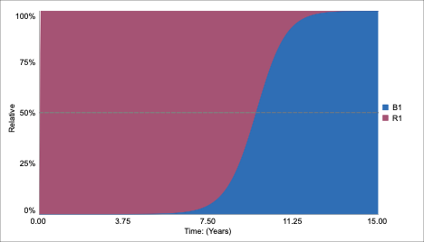
Demonstrating the issue
Loop Score Across All
Time Periods
R1 = 63.89%
B1 = 36.11%

Slide 5
A Solution…
Definition of Accumulated Stock Change for stock S
$$A_{s}=\sum_{\begin{aligned}time=start time \\ by ΔT \end{aligned}}^{stop time}{\left|\frac{dS}{dt}\right|}$$
Definition of Raw system change over time for all stocks in the model.
$$R=\sum_{all stocks S}{\frac{\left|\frac{dS}{dt}\right|}{A_{s}}}$$
Definition of System Change over time.
$$system change over time=\frac{R}{max(R)}$$

Slide 6
Visualizing System Change
Total System Change Metric
Loop Contributions to System Change

Slide 7
A more complex example…

Slide 8
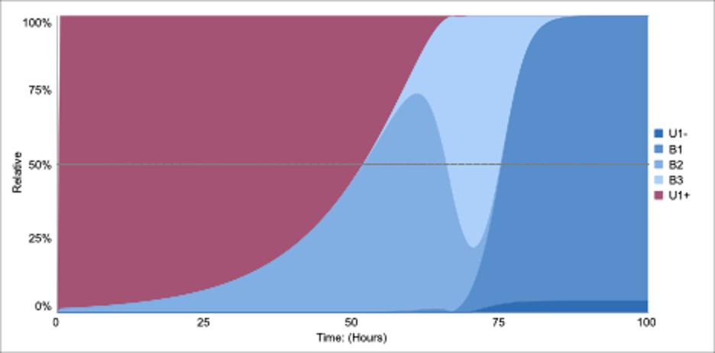
Loop dominance profile
Loop Score Across All
Time Periods
U1 = +/-49.17%
B1 = -23.72%
B2 = -17.66%
B3 = -9.46%

Slide 9
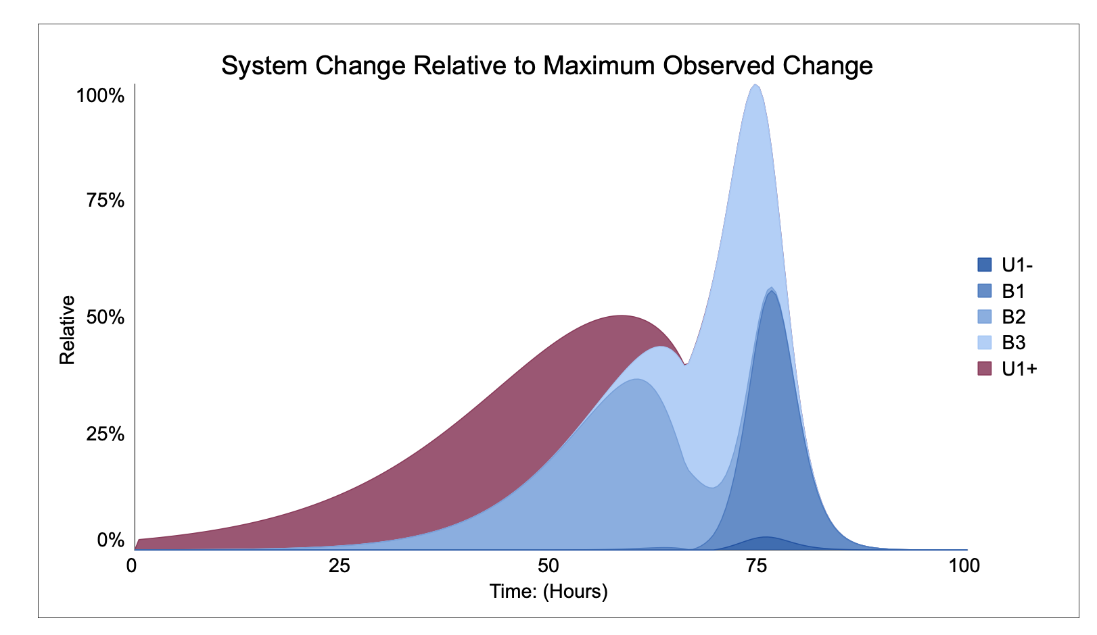
System Change
Loop Score Across All
Time Periods
U1 = +/-49.17%
B1 = -23.72%
B2 = -17.66%
B3 = -9.46%

Slide 10
Questions?
bschoenberg@iseesystems.com

