Slide 1
Online Multiplayer Experiments Raquel Buzogany and Alireza Akhavan System Dynamics Society Università dela Svizzera italiana

Slide 2
Online Multiplayer Experiments Introduction
Common-pool resource online multiplayer experiment
Benefits: smaller costs (Hawkins, 2015), need less time investment (Poteete et al., 2010), access larger subject pool (Rezlescu et al., 2020), allow for testing more factors (Almaatouq et al., 2021b)
Difficulties: lack of clear instructions (Hawkins, 2015; Mason and Suri, 2012), programming (Almaatouq et al., 2021c; Rezlescu et al., 2020), includes many actors and factors (Almaatouq et al., 2021b)
Research Objectives
Develop step-by-step instructions on connecting system dynamics tools with a crowdsourcing platform to create online multiplayer experiments and process collected data
Show how to conduct an online multiplayer experiment for common-pool resource problems

Slide 3
Online Multiplayer Experiments Experiment Structure
Qualification Test
Simulation & Interface
Qualification Test Data Handling
Data collection
Multiplayer Game
Model & Interface
Crowdsourcing
Data processing
Crowdsourcing
Game Data Handling
Data collection
Data processing
isee systems
Stata
Stella
MTurk
Stella
MTurk
isee systems
Stata

Slide 4
Online Multiplayer Experiments Experiment Structure
Simulation & Interface
HIT guideline slides
Demographic slide
Check for answers
Instruction slides
Questions slide
Multiple choice options
Unique code identifier
Crowdsourcing
Identifying info
Payment
Time for task
HIT availability time
Worker requirements
Data Collection
Clean records
Data Processing
Rename files
Stata code
Qualification Test
Qualification Test Data Handling

Slide 5
Online Multiplayer Experiments Experiment Structure
Multiplayer Game
Game Data Handling
Model & Interface
Multiplayer features
HIT guideline slides
Instruction slides
Dashboard slide
Multiple choice options
Unique code identifier
Automatic advancement
Crowdsourcing
Worker requirements
Data Collection
Clean records
Data Processing
Rename files
Stata code

Slide 6
Online Multiplayer Experiments Worker Behavior Challenges
How to Bring Workers Together Online
How to Keep Workers Engaged
How to Avoid Worker Mischievousness
?
Joining twice using other browsers/devices
Worker leaves game
1
Not all joining
Warning and blocking
Minimize instructions
Entering your ID
Simplify decision-making
Joining only if others’ IDs are visible
Asking for days and times
Skipping pages using URL
Allow communication
2
URL
Warning and blocking
Set minimum number of changes to validate player
Software update to not show pages on the URL
Bonus message with specific slots
Notes:
How to Keep Workers Engaged
Minimize instructions
Simplify decision-making
Minimum number of changes to validate player
Allow communication

Slide 7
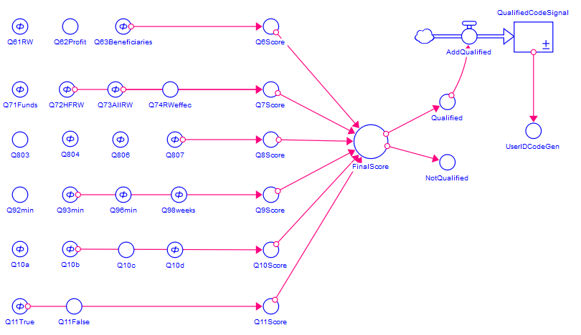
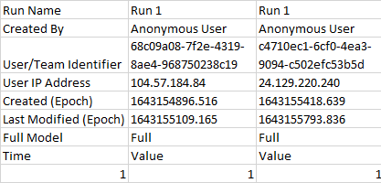
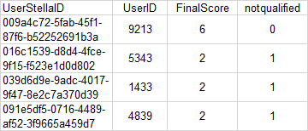
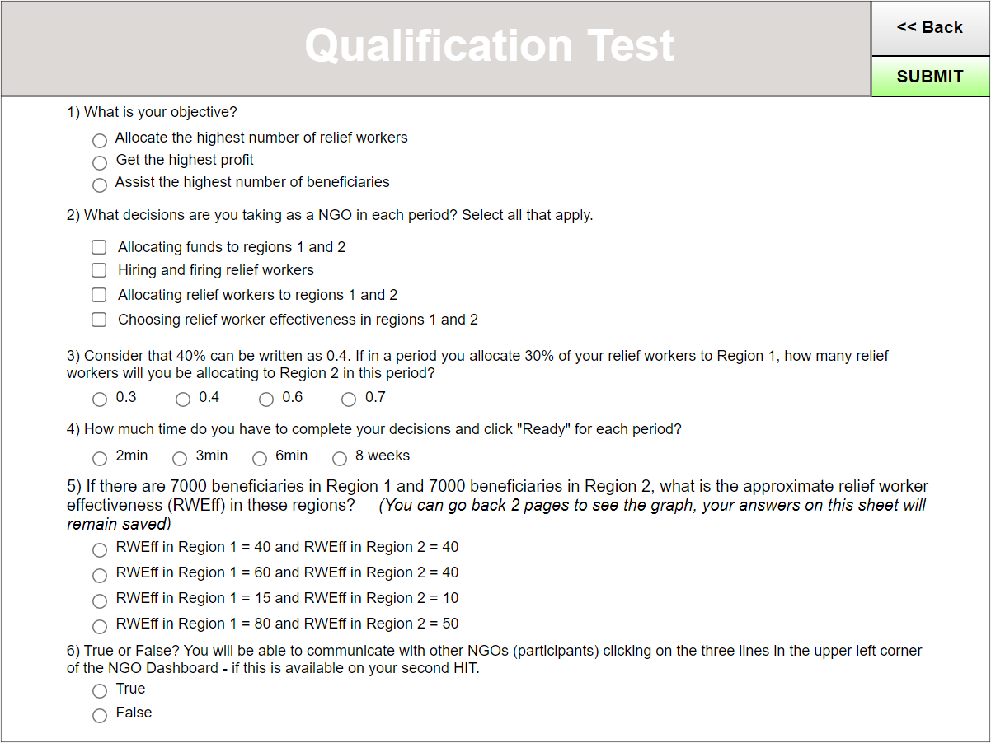
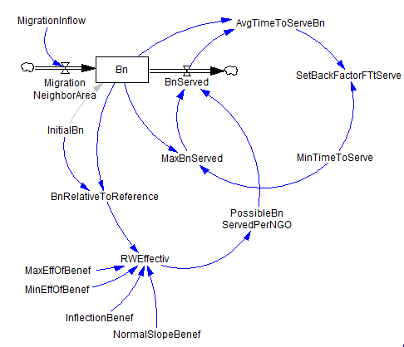
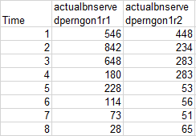
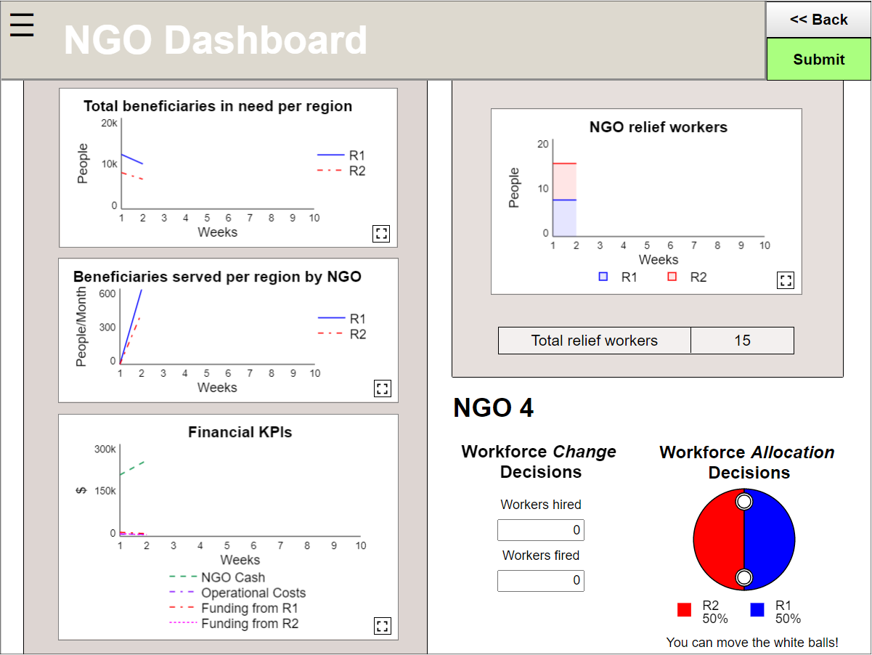
Online Multiplayer Experiments Common-pool Resource (CPR) Example
Qualification Test
Multiplayer Game

Slide 8
Online Multiplayer Experiments Conclusions
Contributions
System dynamics literature
Integrates system dynamics tools with other software for data collection
Online multiplayer experiment literature
Provides step-by-step instructions on how to set up and collect data using crowdsourcing tools for online multiplayer experiments
Identifies player challenge behaviors and how these can be addressed
Common-pool resource literature
Shows how to conduct an online multiplayer experiment for common-pool resource
Future research
Experiments with different designs
Other software
Stella development to present collected data
Adjust traditional SD games (e.g., Beer Game) to not require a facilitator

