Slide 1
Descriptive Design Structure Matrices for Qualitative Modeling of Community Interactions
International System Dynamics Conference, 2023
^{Chicago}
July 25, 2023
Rameez R Qureshi, PhD, Freese and Nichols, Inc
David N Ford, PhD, PE, Virginia Tech
Charles M Wolf, D.Eng, PE, Freese and Nichols, Inc

Slide 2
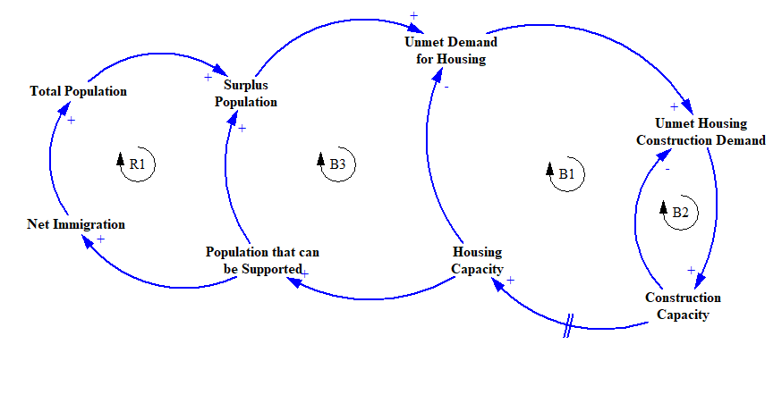
Context
Representing systems with many system components and many interactions can lead to congested CLDs
For example, consider a community recovering from natural disasters,
*For simplification purposes, CLD shows the interaction only between Housing and Construction sector
…BUT ITS NOT JUST HOUSING AND CONSTRUCTION
The Challenge
A Solution
Application
DDSM Structure
Results

Slide 3
NOT Only Housing and Construction!
Representing systems with many system components can lead to congested CLDs
For houses to be made available for occupancy, there are other sector services that need to be made available, for example, power supply.
For construction services to be made available, there need to be physical facilities required for construction (staging area, office space, etc.), social infrastructure (construction firms), and a workforce.
How can system dynamicists identify, map, and model large tightly coupled systems?
The Challenge
A Solution
Application
DDSM Structure
Results

Slide 4
Qualitative Modeling of Interactions
A qualitative tool is useful in SD to bridge the gap between the system and the modeler if it facilitates :
Modeler communication with non-technical system participants
Modeler communication with technical system participants
System Analysis, and
Formal modeling
The Challenge
A Solution
Application
DDSM Structure
Results

Slide 5
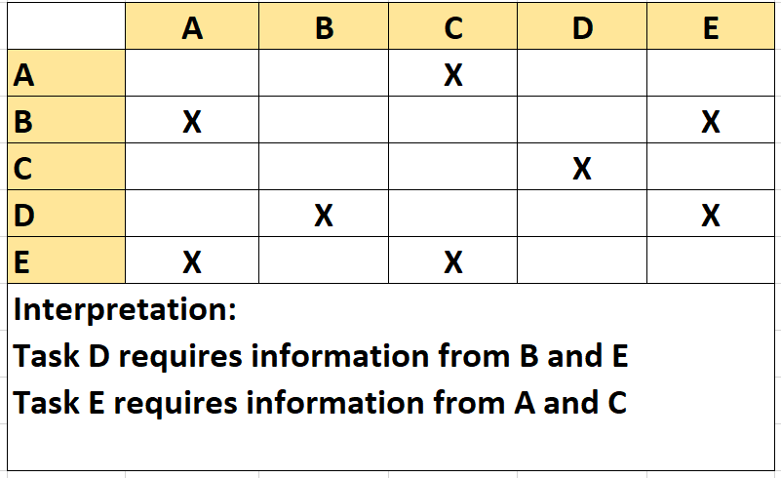
Background: Design Structure Matrix (DSM)
Clear
Practical
Scalable
Proven
The Challenge
A Solution
Application
DDSM Structure
Results

Slide 6
Descriptive DSM Conceptualization
4 parallel 2-dimensional DSMs were developed to allow information representation in multiple forms
Binary/Traditional DSM – “How would you visualize components and interactions for system overview?”
Non-Technical DSM – “How would you describe interactions to non-technical people?”
Technical DSM – “How would you describe the interactions to the city department heads?”
Source DSM – “What is the source that supports the reported interactions?”
The Challenge
A Solution
Application
DDSM Structure
Results

Slide 7
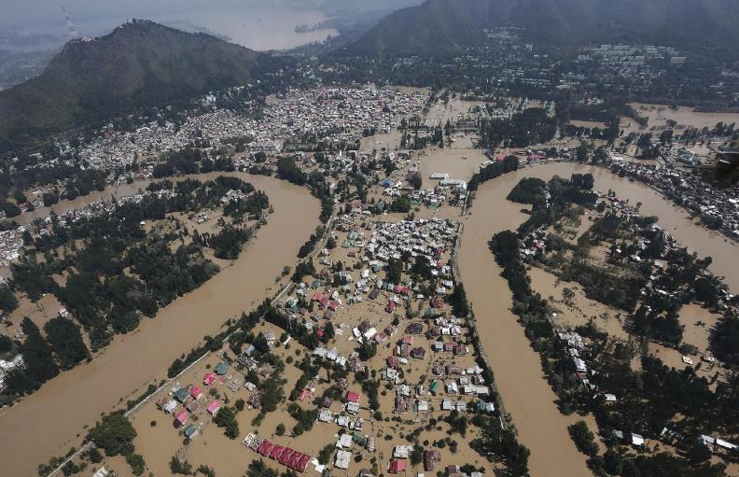
DDSM in Action: Case-Study Background
The Challenge
A Solution
Application
DDSM Structure
Results
Notes:
“So, how did we prove the effectiveness of this tool? Well, we performed a case study of the 2014 Jammu and Kashmir flood response.” Then, I would have everything else memorized. No text (the photo is too powerful to be obscured by all the text). If you forget one of these things, it isn’t that big a deal.
“Jammu Tawi Flood Recovery Project (JTFRP)” was commissioned by the World Bank in Jammu and Kashmir in 2015.
Project Objective - Support the recovery of damaged infrastructures and build resilience in the community.
4 major sectors were identified by state disaster management body for the recovery of Jammu and Kashmir – Education, Public Health, Transportation, Business (Commerce).
As of beginning of 2019, less than 10% of the total estimated expenditure had been achieved with many of the project components still under bidding stage.
Project Steering Committee of JTFRP requested an extension of project deadline from June 2020 to December 2021.

Slide 8
Identify System Components
What built-infrastructure is required for the recovery of Kashmir?
Community Recovery is defined as the restoration of normal patterns of community activities as they existed in the pre-disaster period.
(Lindell 2006)
Identified 16 Community Infrastructure Systems relevant to recovery in Kashmir used as inputs for rows and columns in the DDSM
The Challenge
A Solution
Application
DDSM Structure
Results

Slide 9
Identify System Component Interactions
Use system information to identify which system components interact
The Challenge
A Solution
Application
DDSM Structure
Results

Slide 10
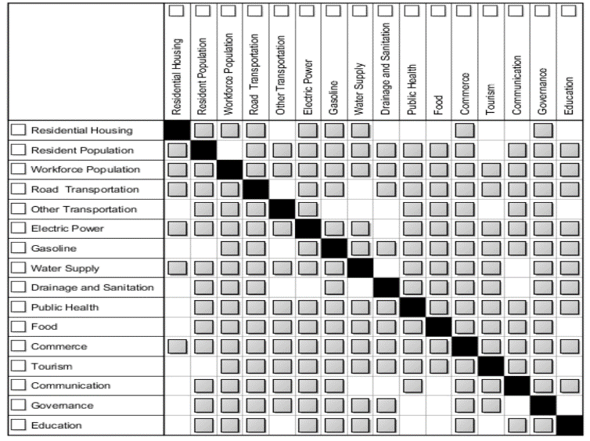
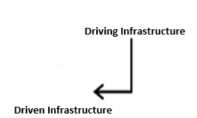
Binary Community Recovery DDSM
Clear
Practical
Scalable
The Challenge
A Solution
Application
DDSM Structure
Results
Notes:
"so what does one of these DDSM solutions look like?“
DDSM describes 16 community-level sectors and their interactions that are important for recovery. Includes built-infrastructure and their related social infrastructures.

Slide 11
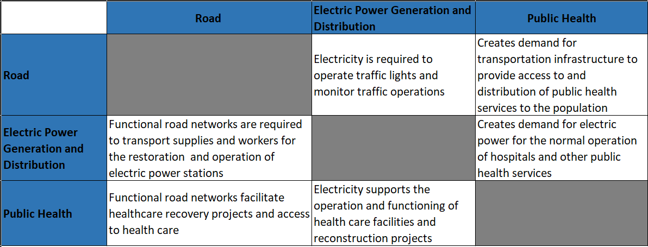
System Description Using DDSM
Non-Technical DDSM – “How would you describe interactions to non-technical people?”
Practical
Scalable
Level 1 Community Recovery DDSM for non-technical managers (*Representative image)
The Challenge
A Solution
Application
DDSM Structure
Results
Notes:
We developed parallel matrices to qualitatively describe the interactions to non-technical and technical leaders. As an example Level 1 DSM provides an answer to How would you describe interactions to non-technical people (e.g. the Mayor)?

Slide 12
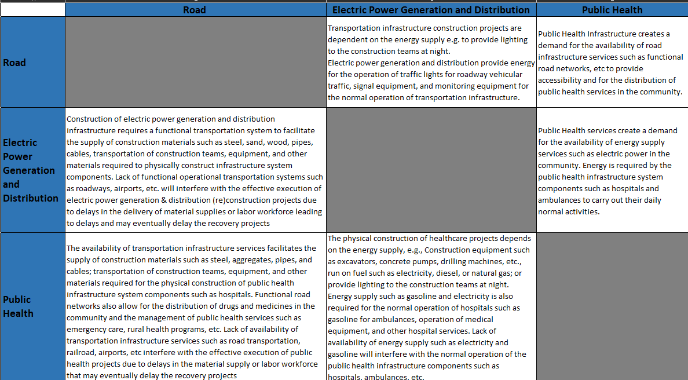
System Description Using DDSM
Technical DDSM - “How would you describe the interactions to the domain experts?”
Practical
Scalable
Level 2 Community Recovery DDSM for technical managers (*Representative image)
The Challenge
A Solution
Application
DDSM Structure
Results
Notes:
- Similarly, Level 2 DSM provides an answer to How would you describe interactions to city department heads (e.g. heads of DOTs)?

Slide 13
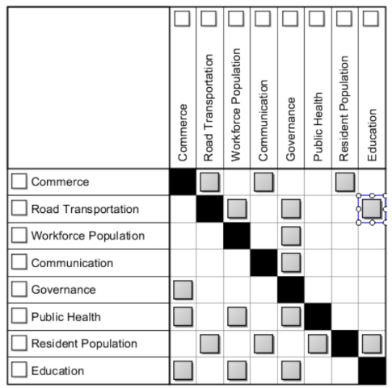
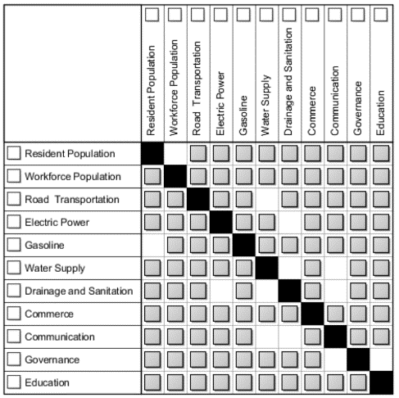
DDSM in Action: Case-Study Analysis
Clear
Practical
Scalable
Proven
Recovery Manager’s Mental Model
Actual Recovery Matrix
The Challenge
A Solution
Application
DDSM Structure
Results
Notes:
“Semi-Structured interviews were conducted with the officials from JTFRP to understand the constraints in timely execution of the project.
The figure on your left shows the project design approach used by the recovery managers, whereas the figure on your right shows the actual recovery model developed as a part of this research.
While the managers were on the right track in identifying the important sectors for recovery, they were not accounting for the interdependency of infrastructures.

Slide 14
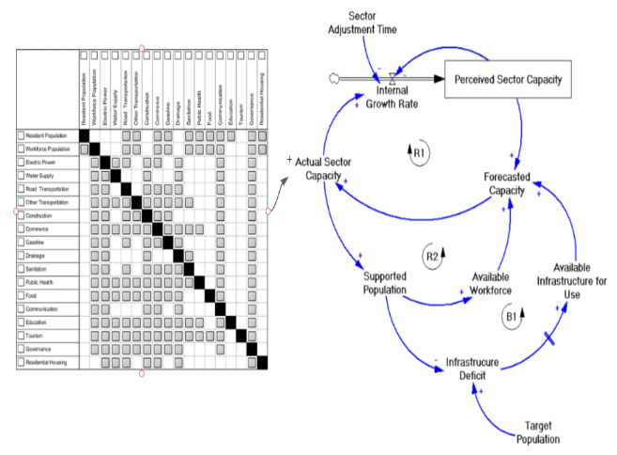
Example Integration of DDSM and SD Models
Capacity of an infrastructure at any time is a function of
Dependencies among infrastructure systems (Loop R1)
Available workforce (Loop R2)
Available physical infrastructure (Loop B1)
Legend of Loops: R1: Sector Operations Growth Loop R2: Workforce Growth Loop B1: Population Goal Seeking Loop
Feedback Structure of Community Growth
The Challenge
A Solution
Application
DDSM Structure
Results

Slide 15
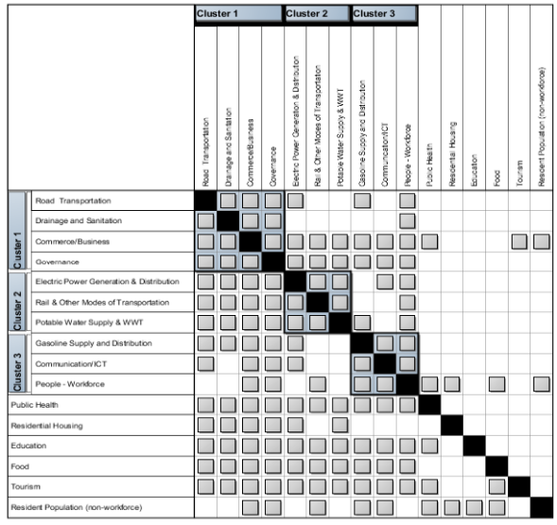
Example Identification of Feedback Loops
Scalable
Practical
The Challenge
A Solution
Application
DDSM Structure
Results

Slide 16
Contributions
Improves qualitative system dynamics modeling of large tightly coupled systems by helping modelers to:
Identify and structure system information
Collect and use rich system structure information in modeling
Identify feedback loops
Qualitatively identify and explain system interactions and their impacts on system behavior and performance
Bridge gaps between the system being modeled and the formal simulation model
The Challenge
A Solution
Application
DDSM Structure
Results

Slide 17
Modeling Community Interactions Using Descriptive Design Structure Matrix (DDSM)
Clear
Practical
Scalable
Proven
The Challenge
A Solution
Application
DDSM Structure
Results

Slide 18
THANK YOU!
"In the midst of chaos, there is also opportunity."
- Sun Tzu

