Slide 1
PhD Research Class Work In Progress Update

Slide 2
Objective for Today
Describe the problem
Describe the hypothesis
Peer discussion

Slide 3
Abstract
The rare earth element group of minerals (REM) are classified as critical minerals, which are defined as mineral commodities essential to economic and national security. REM are essential to the manufacture of renewable energy products as well as electric vehicles, mobile communications, defense technology and other strategically important goods. Due to the pervasive risk of REM supply chain disruption, they are receiving significant global attention and commensurate funding. Domestically, U.S. policy focuses on creating a “comprehensive strategy to increase the resilience of strategic and critical material supply chains that both expands sustainable production and processing capacity and works with allies and partners to ensure secure global supply” (White House, 2021). While resilient supply chains are necessary, robust value chains are needed to protect economic stability and national security for the long-term. This work develops agent-based dynamic simulation models to examine innovative policy scenarios for building robust REM value chains supported by resilient supply chains.

Slide 4
1. Introduction

Slide 5
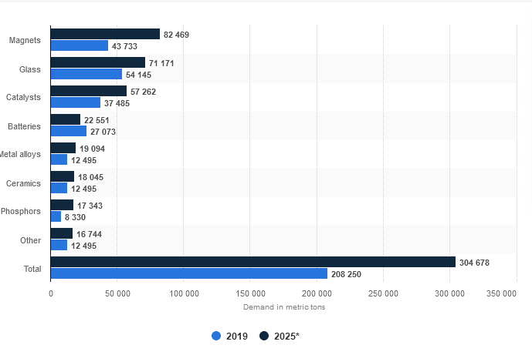
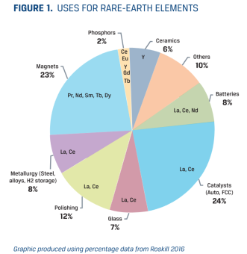
REE Uses & 2025 Forecast
Statista. (2020). Rare earth demand worldwide by application 2019 and 2025. Statista. https://www.statista.com/statistics/449722/rare-earth-estimated-demand-globally-by-application/
Goode, J. (2018). Provenance and Traceability of Rare Earth Products (p. 27). CSA Group.

Slide 6
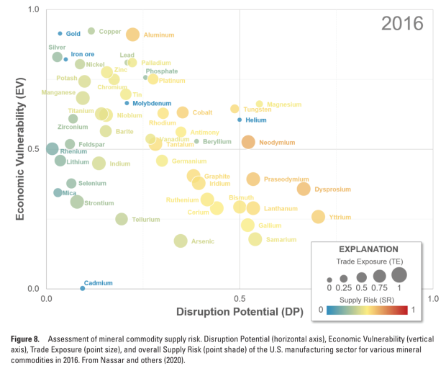
REEs: Critical and Strategic
*REE are critical minerals essential for US$20T of GDP in strategic industries*
*The White House. (2021). Building Resilient Supply Chains, Revitalizing American Manufacturing, and Fostering Broad-based Growth 100-Day Reviews Under Executive Order 14017. The White House.
Nassar, N. T., Alonso, E., & Brainard, J. L. (2020). Investigation of U.S. Foreign Reliance on Critical Minerals—U.S. Geological Survey Technical Input Document in Response to Executive Order No. 13953 Signed September 30, 2020 (Open-File Report Open-File Report 2020–1127; Mineral Resources Program, p. 50). U.S. Geological Survey. https://doi.org/ 10.3133/ ofr2020112

Slide 7
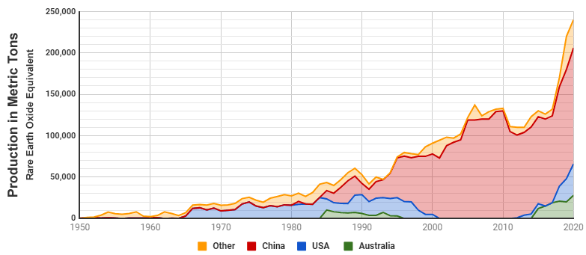
It all started in the mid-80s …
Mid-80s: REE dominance shifted from US to China when DoE classified REE as a radioactive source material
Most REE processing has radioactive (Thorium, Radium) waste
Rare Earth Element Production 1950 - 2020. Source: King, H. M. (2021). REE - Rare Earth Elements—Metals, Minerals, Mining, Uses. Geology.Com. https://geology.com/articles/rare-earth-elements/

Slide 8
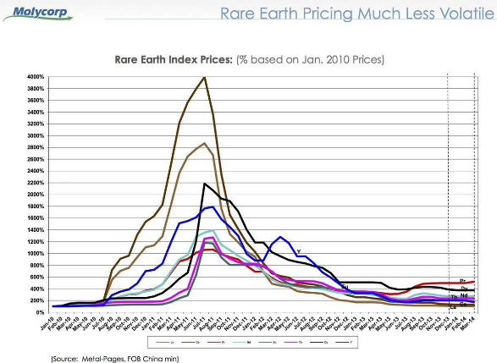
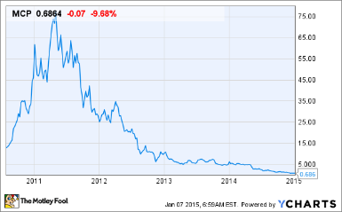
… and hit home in 2010.
2010: China supply chain disruption triggered pricing instability, setting in motion the classification of REE as critical minerals

Slide 9
Current State of the REE Industry
REE industry continues to be dominated by a single actor – China
Post-2010: Australia, US, EU, Canada, Japan implement policies to re-establish stable global REE supply chains from new & recycled sources
Chinese REE policy is a roadblock to using recycled material
2015: REE added to Critical & Strategic Minerals
2019 & Ongoing: Gov’t policies (& money) to re-establish REE industry outside of China

Slide 10
2. Rare Earth Value Chain –Mining-to-Manufacturing

Slide 11
REE Supply Chain
Forrester, J. W. (1961). Industrial Dynamics. Pegasus Communications, Inc. (based on R. W. Ballmer)
Mines
Concentrators
Smelters
Refiners
Fabricators
Manufacturing
Exploration
Mining
Processing
Separation & Purification
Metals Processing/ Making
Alloying
Manufacturing
Extract Ore, Coal
Crushing
Leaching
Electrolysis
End Use Alloy Making
OR
Milling
Impurity Removal
Metallothermic Reduction
Processing
Separation
“Super Alloys” or Permanent Magnet Alloys
REE Concentrate
REO (RE Oxide)
Metals
adapted from: NETL. (2021). Critical Minerals Sustainability Program. Netl.Doe.Gov. https://www.netl.doe.gov/coal/rare-earth-elements/program-overview/background
Renewable Energy, Consumer and Defense Industry Products

Slide 12
Recycling Roadblock

Slide 13
Supply Chain (SC) vs. Value Chain (VC)
 | Supply Chain Thinking | Value Chain Thinking
Objectives | Reduce costs, increase margins and increase market share | Add value and segment the market with differentiated products designed to increase profitability at all stages in the chain
Material Flow | Focus on efficiency, market access and increased distribution | Focus on quality, service and agility with distribution determined by consumer demand rather than capacity utilization
Information | Protected and perceived as a source of arbitrage. Exchange restricted to transactional data | Shared and perceived as a source of competitive advantage; strategic information shared with trusted partners
Relationships | Arm’s length, focus on supply chain efficiency, leveraging scale and market power to secure favourable terms of trade | Collaborative focus on supply chain resilience and shared resource allocation – shared risk and shared benefits
adapted from Fearne, A., Garcia Martinez, M., & Dent, B. (2012). Dimensions of sustainable value chains: Implications for value chain analysis. Supply Chain Management: An International Journal, 17(6), 575–581. https://doi.org/10.1108/13598541211269193

Slide 14
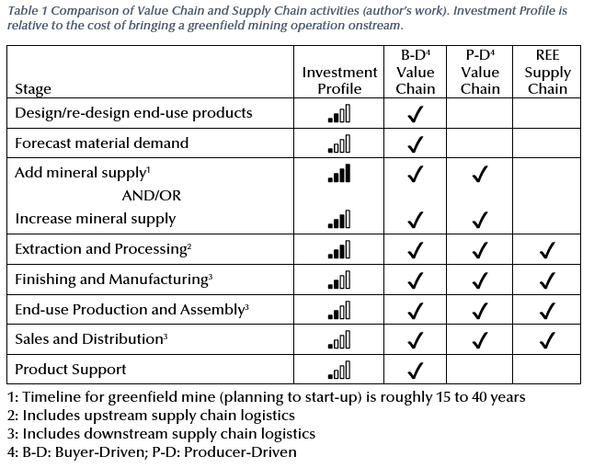
VC/SC Comparison

Slide 15
VC provides critical SC feedback
“…there is a limit to how much cost savings and business growth «business executives» can derive from the traditional supply chain…”⁽¹⁾
“Months into a $3 billion U.S. effort to manufacture tens of thousands of ventilators to stave off coronavirus deaths, the government stockpile is facing a glut.” … “The scenario that actually ended up happening was substantially lower...”⁽²⁾
Simchi-Levi, D. (2010). Operations Rules: Delivering Customer Value through Flexible Operations. MIT Press.
Siddiqui, F. (2020 August 18). Ventilators built in a hurry now sit unused. Washington Post.

Slide 16
VC/SC with Feedback
Buyer-Driven Value Chain
Product-Driven Value Chain
Feedback
Supply Chain
R&D/ Innovation
Demand Forecast
Product
Support
adapted from Laudal, D. A. (2017). Evaluation of Rare Earth Element Extraction From North Dakota Coal-Related Feed Stocks [Dissertation]. UND.

Slide 17
Shift to Buyer-Driven VC (1)

Slide 18
Shift to Buyer-Driven VC (2)

Slide 19
3. Transformational Change Framework

Slide 20
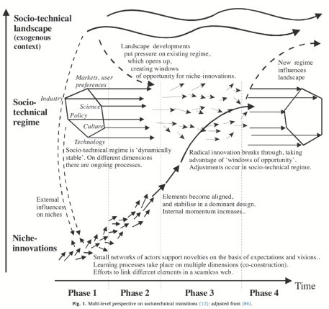
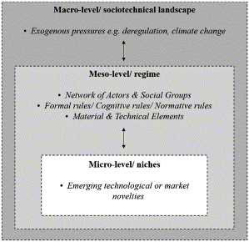
VC Transformation Framework
“One theoretical approach that has been extensively applied to the study of transitions, especially that of energy systems, and is well-established in the transitions research community, is the multi-level perspective, or MLP.” (emphasis added)
Hansen, P., Liu, X., & Morrison, G. M. (2019). Agent-based modelling and socio-technical energy transitions: A systematic literature review. Energy Research & Social Science, 49, 41–52. https://doi.org/10.1016/j.erss.2018.10.021
Geels, F. W., Sovacool, B. K., Schwanen, T., & Sorrell, S. (2017).
The Socio-Technical Dynamics of Low-Carbon Transitions. Joule, 1(3), 463–479. https://doi.org/10.1016/j.joule.2017.09.018
Fig. 1. from Hansen et al

Slide 21
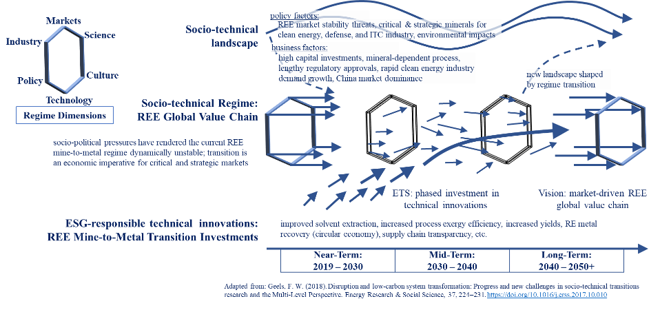
REE VC Multi-Level Perspective

Slide 22
4. Dynamic Simulation of the REE Value Chain

Slide 23
Dynamic Hypothesis
Rare earth element (REE) supply chain and value chain behaviour models are required to optimize for long-term REE stability and sustainability
Stability means:
supply chain: frictionless movement of goods (mine to manufacturing)
value chain: frictionless payments for “real” value-add (excludes economic rent)
“real” value-add requires feedback
no government transfers (subsidies) in long (> 10yr) term
Sustainability means:
operations are exergy efficient (exergy efficiency objectives TBD)

Slide 24
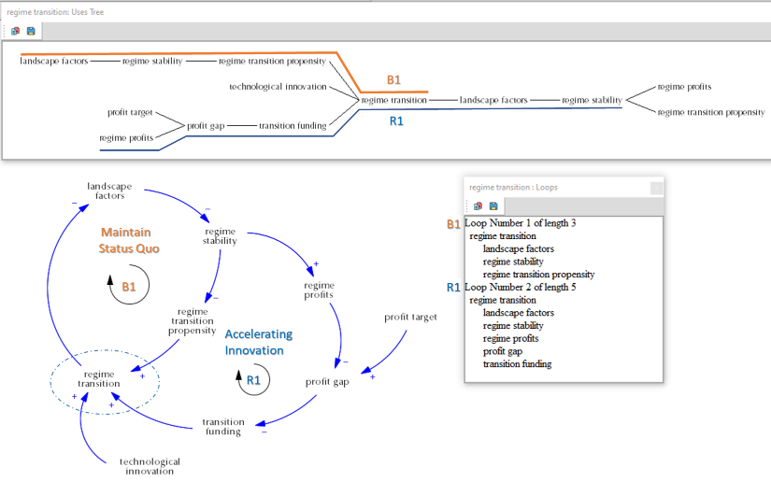
MLP Causal Loop Diagram

Slide 25
Model Sector Map*
* with inspiration from Dr. D. Wheat and Macrodynamics: see Cavana, R. Y., Dangerfield, B. C., Pavlov, O. V., Radzicki, M. J., & Wheat, I. D. (Eds.). (2021). Feedback Economics: Economic Modeling with System Dynamics. Springer International Publishing. https://doi.org/10.1007/978-3-030-67190-7
Domestic
Government
Supply
Demand
Consumer
Alloying
Policy: Regulation
Extract & Concentrate
Renewable Energy
Inventories
Manu-facturing
Policy: Stimulation
Separate & Purify
Defense Industry
Foreign
Regulated
Supply
Non-Regulated Supply

Slide 26
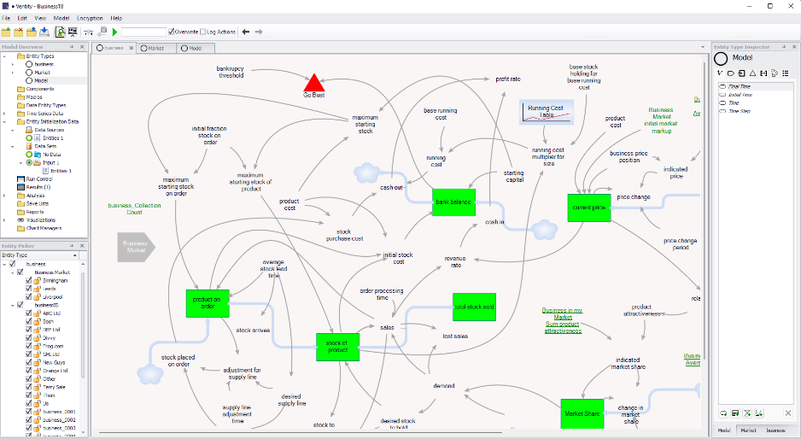
Ventity: Agent-based modeling
Jones, L. (2021) Business18.vmdl Ventity sample model . Ventana Systems Inc.

Slide 27
5. Scenario-Based Model Testing

Slide 28
Scenario Tests V0.000001
Domestic
Government
Supply
Demand
Consumer
Policy: Regulation
Extract & Concentrate
Alloying
Renewable Energy
Inventories
Policy: Funding
Separate & Purify
Manu-facturing
Defense Industry
Technical Innovation
Foreign
Business Innovation
Regulated
Supply
Non-Regulated Supply
Policy Innovation

Slide 29
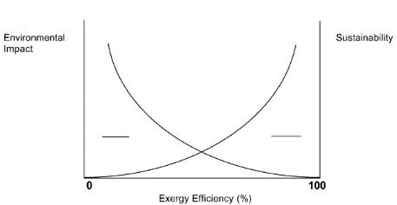
TBD: Exergy Analysis
Technical Innovation Scenarios
Exploration
Mining
Processing
Separation & Purification
Metals Processing/ Making
Alloying
Manufacturing
Exergy Analysis
Exergy analysis will follow the concepts outlined in Ayres, R. U. (2010). Energy Intensity, Efficiency and Economics. INSEAD.
“• Energy available to do useful work is exergy. • Exergy is a factor of production.”
Exergy analysis will be used to determine the sustainability of a given scenario.
Dincer, I., & Rosen, M. A. (2005). Thermodynamic aspects of renewables and sustainable development. Renewable and Sustainable Energy Reviews, 9(2), 169–189. https://doi.org/10.1016/j.rser.2004.02.002

Slide 30
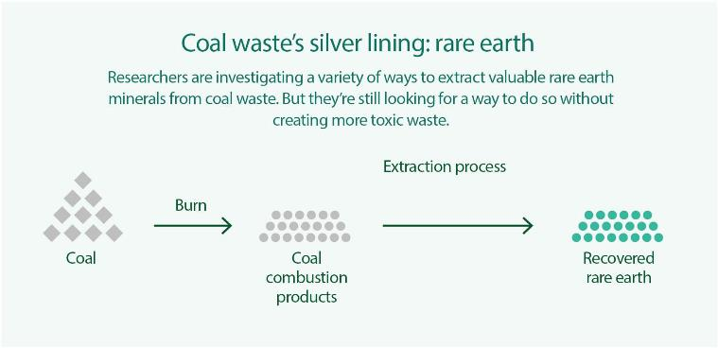
Exergy analysis - comparison
Separation & Purification
Metals Processing/ Making
Exergy: fuel to metal
Exploration
Mining
Processing
Separation & Purification
Metals Processing/ Making
Alloying
Manufacturing
Exergy: mine to metal

Slide 31
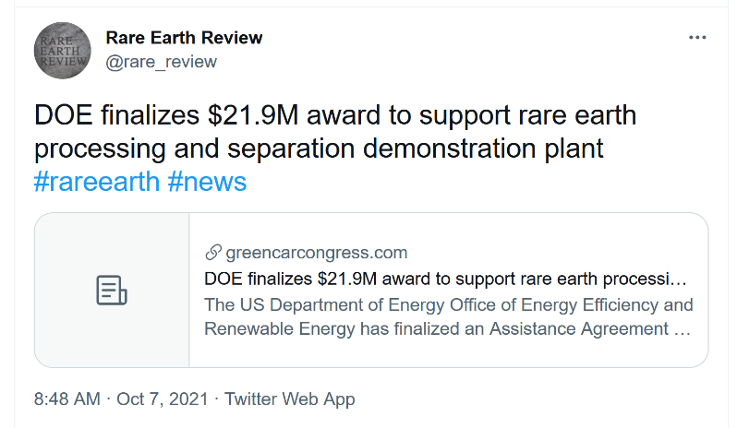
Evolving in Real Time
50% funding
40 months
Nd/Pr for magnets

