Slide 1
Causal loop modelling of Rebound Effects Mechanisms in product-service systems The case of clothing rental
Online Poster Presentation
Julija Metic, Technical University of Denmark
Daniel Guzzo, Technical University of Denmark
Daniela Pigosso, Technical University of Denmark
0:00-0:22
@S_D_Society
THE 40TH INTERNATIONAL SYSTEM DYNAMICS CONFERENCE
Frankfurt, Germany and Virtually
#isdc2022
Notes:
Title page: Change title to submission name. Bold the name of the presenter and display your name as you want it read by the moderator (eg Bob instead of Robert). Note the suggested timing in the bottom right. Slide timing may be adjusted, but not the number of slides. The session chair will change slide following the timing indicated, or earlier if requested.

Slide 2
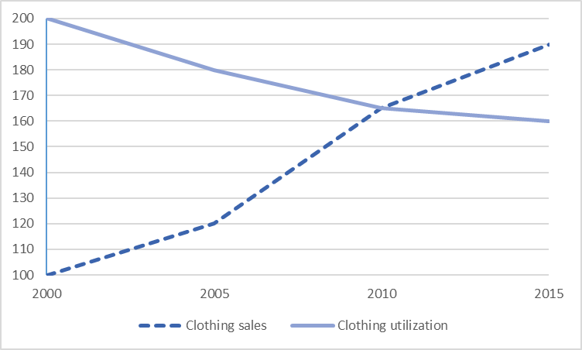
Problem Statement
Higher clothes production
Fast Fashion
Increasing clothing underutilization
Product-service system (PSS)
Access to a product or a service in exchange for a fee while retaining the product’s ownership
Seen as possible solutions to linear models
Example of renting clothes - increases utilization across several users
0:22-1:03
@S_D_Society
THE 40TH INTERNATIONAL SYSTEM DYNAMICS CONFERENCE
Frankfurt, Germany and Virtually
#isdc2022
THE 40TH INTERNATIONAL SYSTEM DYNAMICS CONFERENCE
Virtually everywhere!
#isdc2022
Notes:
Problem Statement: Do not change the slide title. Keep fonts big (24 pt or bigger). Indicate why the problem is important. Note the timing in the bottom right.

Slide 3
Approach or Dynamic Hypothesis
Rebound effect (RE)
Due to systematic and behavioral responses
Across different levels and actors
RE Mechanisms
Trigging and driving total RE across the system
Different types - direct and indirect
Actors – consumers and producers
Levels – single/several actors or societal networks
1:03-2:11
@S_D_Society
THE 40TH INTERNATIONAL SYSTEM DYNAMICS CONFERENCE
Frankfurt, Germany and Virtually
#isdc2022
THE 40TH INTERNATIONAL SYSTEM DYNAMICS CONFERENCE
Virtually everywhere!
#isdc2022
Notes:
Approach or Dynamic Hypothesis: Do not change the slide title. Keep fonts big (24 pt or bigger). Note the timing in the bottom right.

Slide 4
Results
PSS implementation leading to RE
Promotion and enabling to higher level of consumption
Identified RE mechanisms
Lower costs, increase in disposable income, perception of doing good
Total of 7 direct and indirect mechanism for RE were identified
RE early identification is essential – to help companies and policies to address them better
2:11-4:50
@S_D_Society
THE 40TH INTERNATIONAL SYSTEM DYNAMICS CONFERENCE
Frankfurt, Germany and Virtually
#isdc2022
THE 40TH INTERNATIONAL SYSTEM DYNAMICS CONFERENCE
Virtually everywhere!
#isdc2022
Notes:
Results: Do not change the slide title. Again, keep the text short and fonts big. Show structure or behavior – may not be room for both (some flexibility on font for images). Any questions you want to pose to the audience can go here. Note the timing in the bottom right.

