Slide 1
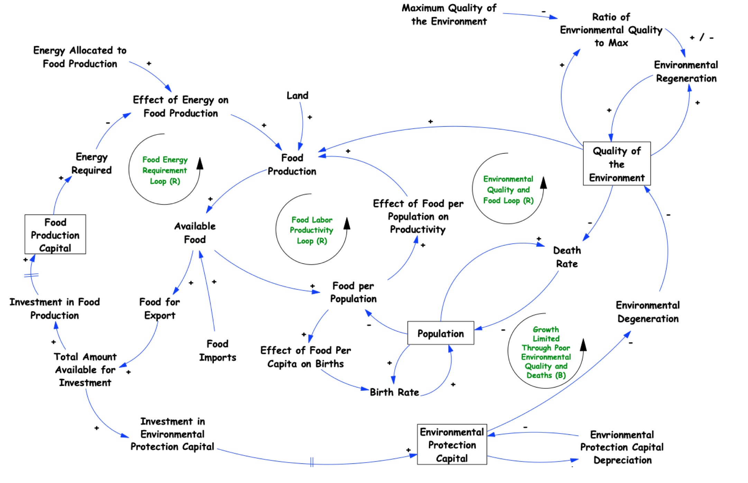
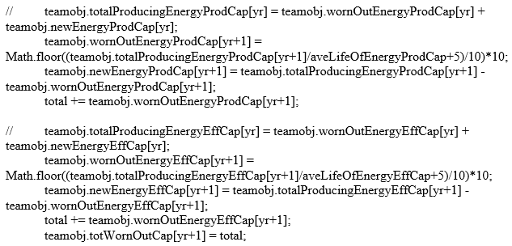
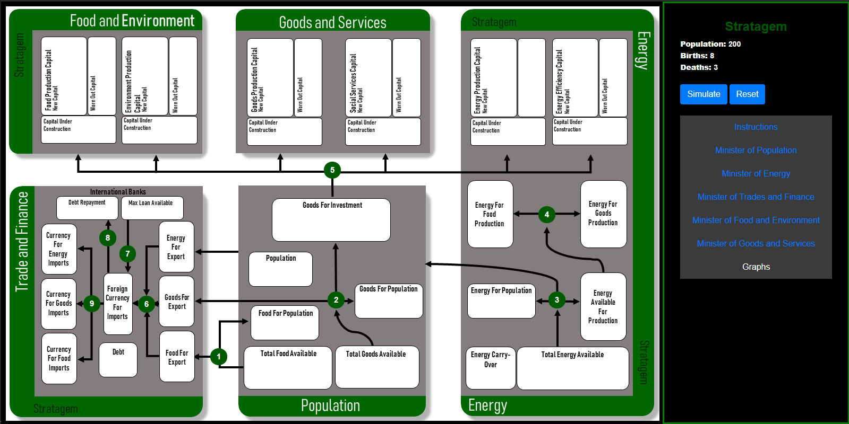
Stratagem Revised
Antoine Edelman, Anthony Foretich, Sean Grier, Joe Ziegler
Advisor: Rod MacDonald
Objectives
Update Stratagem using a Forio interface and Vensim model to be made available through the System Dynamics Society
Learn about human decision making and improve it
Methods
Extracted equations from the old code to help develop Vensim model
Created a website with Javascript, HTML, and Forio packages to display decisions and visualized data
Flow.js - Connects the Vensim model to the User Interface to access desired variables
Contour.js - Graphed the data Flow.js provided
Communication and support from Forio allowed inquiries and errors to be solved easily
Practiced a finished model to gain familiarity with the FORIO packages while the Stratagem Vensim model was in development and for error testing
Changes from Original Game
Smoother, more automated game requires less time
Game board and pieces eliminated.
The game’s user interface resides entirely online and is managed through the Forio website.
Education
Used to train and educate decision makers as well as students about:
Conclusions
Stratagem has been transformed into an entirely virtual simulation game no longer requiring a game board or pieces and has been made available through the Systems Dynamics Society.
Dynamic behavior
Feedback
Time Delays
Nonlinearities
Accumulations
Sustainable Development
Acknowledgements
(1)Dennis Meadows (2) Forio (3) James Madison University

Slide 2
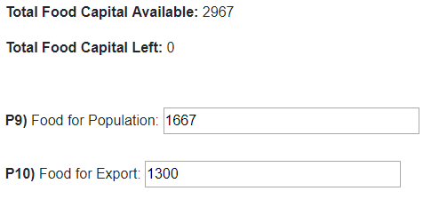
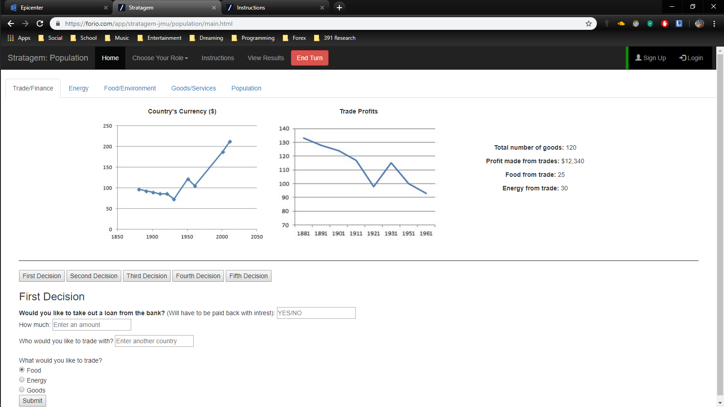
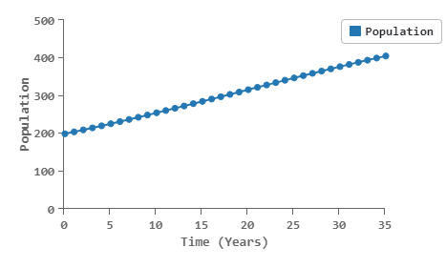
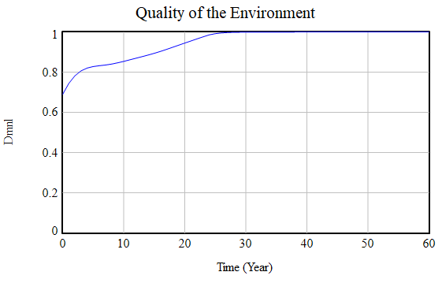
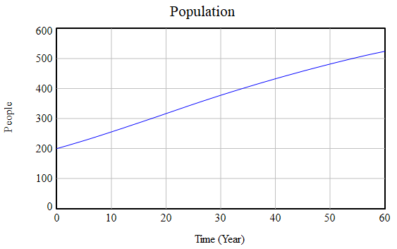
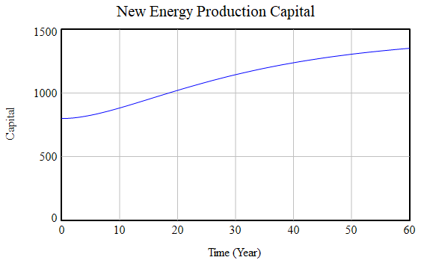
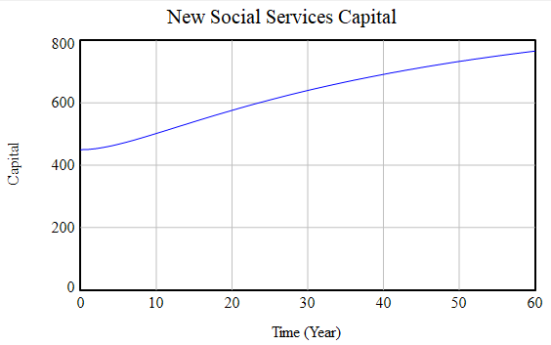
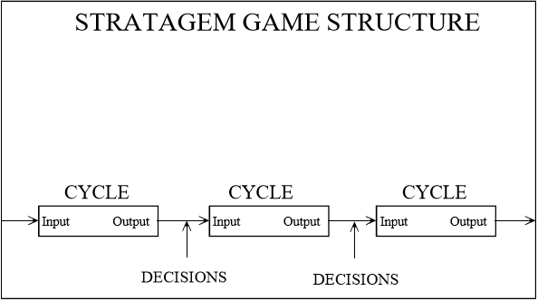
“After you have played Stratagem, you will know more about how to achieve sustainable development than 99.9% of the public officials running countries today” (Meadows, 2000 p.1”.)

