Slide 1
Effect of online interactive learning environments on students’ complex dynamic problem solving skills
Aklilu Tadesse & Pål Davidsen
System Dynamics Group, University of Bergen
ISDC2019, July 21-25
Albuquerque, NM, USA

Slide 2
Presentation highlight
Context – Mr. Wang case study
Why OILE?
The Mr. Wang OILE
Results
Discussion
Conclusion

Slide 3
Context: Mr. Wang Case Study
Mr. Wang is a reputable bicycle repair shop in Shanghai established by Mr. Wang’s great grandfather in 1912.
It delivers your bike in top shape after one day.
Shanghai is a dynamic city with lots of events and bicycle rental is booming there.
After each event, Mr. Wang experiences lots of bicycles coming in and oscillations (major disturbances) in the business

Slide 4
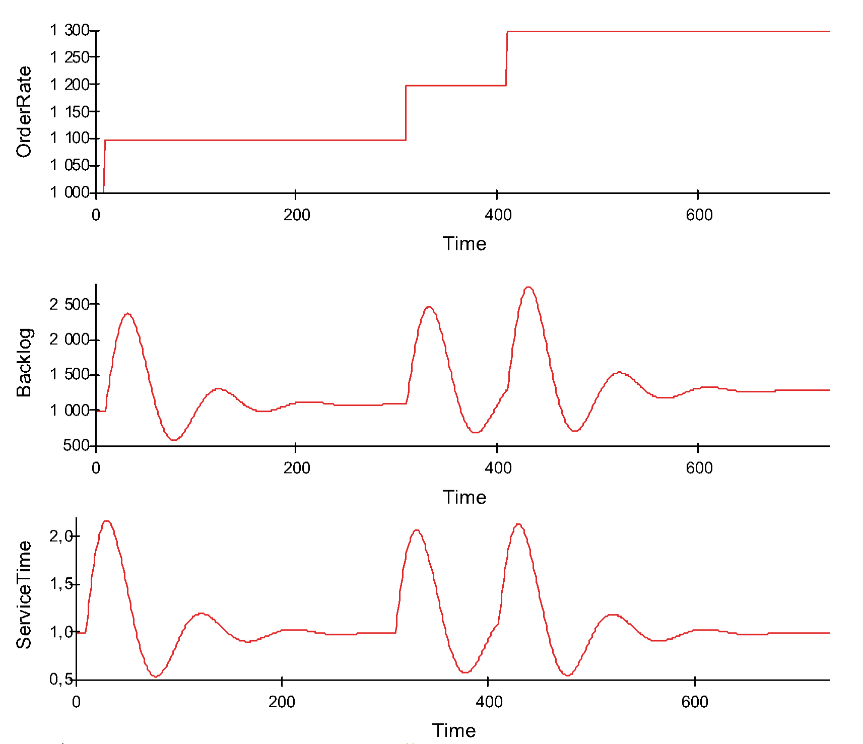
Mr. Wang’s Problem
?
?
?
?
?
?
In the short run, the company is not able to tackle the increase in demand very well. In the very long run, there are signs that indicate it works to the satisfaction of Mr. Wang, - stabilizing the Backlog and the Service Time

Slide 5
Why OILE?
Numerous studies document that people have difficulties comprehending Complex Dynamic Systems (CDS) and managing these systems effectively
The difficulty in understanding arises from lack of:
Cognitive capability to comprehend structural complexity
Skills to infer dynamic behavior of a system from its underlying structures.
Effectiveness of methods, techniques and tools that are available to analyze systems

Slide 6
The Mr. Wang OILE
An asynchronous, personalized and adaptive OILE with the following characteristics:
It presents a complex, dynamic problem that learners should address in its entirety. It then allows learners to progress through a sequence of learning tasks from easy to complex
After completion of each learning task, the OILE provides learners with supportive information based on their individual performance. The support fades away as learners gain expertise.
The OILE tracks and collects information on learners’ progress and generates learning analytics.

Slide 7
The OILE …
Sample welcome page

Slide 8
The OILE: Templet for item description
Navigation Buttons
Task and item number | Stimulus material (Feed-up)
 | Question
Multiple Choice
Alternatives

Slide 9
The OILE: Templet for Feedback
Navigation Buttons
Feedback: gives the reason why the student’s response is not correct and supports the student to re-correct its response
Feed-forward: gives the right reason why the student’s answer is correct and why the other alternatives are not

Slide 10
Results: learning path – unique
1. Does scaffolding help students perform better in subsequent tasks?
Problem identification
Model Building 1
Model Building 2

Slide 11
Results: Exp’t Vs Control group
2. Will exp’tal group students have significantly higher gains in their problem solving than students in a comparable control group?
Independent sample t-test results from two studies: Study 1 &2
Study 1 | Number of Students | Mean | SD | df | T | Sig. (2-tailed) | Effect Size (Cohen's d)
Experimental | 33 | 8.95 | 1.58 | 58 | 3.21 | 0.002 | 0.8
Control | 27 | 7.17 | 2.68
Study 2 | Number of Students | Mean | SD | df | t | Sig. (2-tailed) | Effect Size (Cohen's d)
Experimental | 24 | 8.60 | 2.12 | 49 | 2.10 | 0.040 | 0.59
Control | 27 | 7.17 | 2.68

Slide 12
Discussion: Feedback from the OILE
To teachers/mentors - Information about:
Performance of the students
How the students have utilized the material
The amount of time the students have spent on the tasks and feedback they received
Content that needs more or less discussion during class time
Content that needs to be presented differently next time

Slide 13
Discussion: Feedback from the OILE
To students – information about:
Their own performance/ progress
How to learn from their mistakes - chance to redo tasks or branch to less difficult questions)
The right reason why their answers were correct

Slide 14
Conclusion
In light of the supportive evidence, we conclude that the use of personalized and adaptive OILE to support learning about CDS is promising

Slide 15
Thank You! Questions? Contact: Aklilu Tadesse Email: aklilutt@gmail.com Aklilu.Tadesse@uib.no

