Slide 1
Wetland City Planning for the Controversy Surrounding Water levels
THE 36TH INTERNATIONAL CONFERENCE OF THE SYSTEM DYNAMICS SOCIETY
REYKJAVÍK, ICELAND
Min Kim, Jinhyung Chon
Department of Ecological Engineering and Environmental Science, Korea University, Seoul, Republic of Korea
0:00-0:30
Notes:
Title page: Bold the name of the presenter and display your name as you want it read by the moderator (eg Bob instead of Robert). Do not include contact information. Timing in the bottom right. Moderator will change slide following that schedule, or earlier if requested. Change if needed.

Slide 2
Problem Statement
“Wetland City” initiative (IUCN, 2015)
New wetland management from a social-ecological system(SES) perspective
Wetland and water is a key natural resource in the SES of Wetland City
Controversy among Stakeholders with different mental models
Stakeholders in Chanyeong-gun, one of the Wetland City candidates, managing wetland with each mental models
No considering social system as wetland city
No alternative to frequent flood leading to local residents who fail to manage water level
0:30-2:00
Notes:
Problem Statement: Do not change this title. Keep fonts big (24 pt or bigger). Indicate why the problem is important.

Slide 3
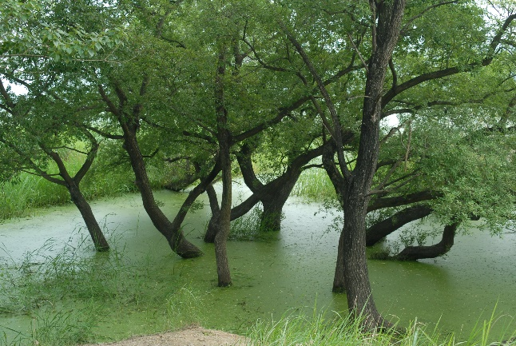
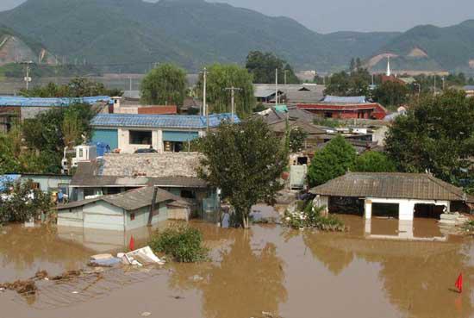
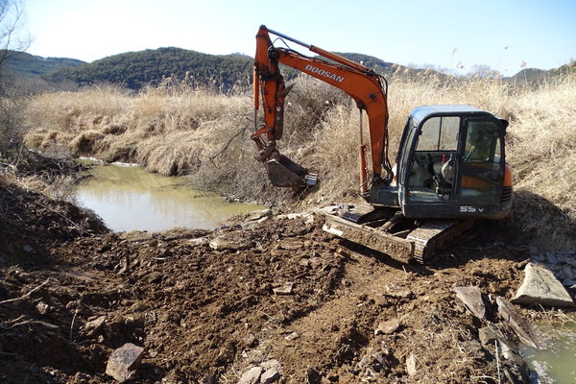
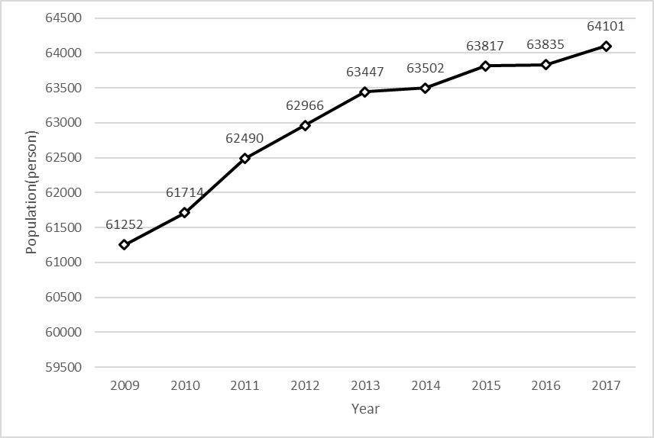
Approach or Dynamic Hypothesis
Discovery of dynamic problems in the study site
Willow growth
Drain-pump competition
Fishery structure
Water demand
To suggest strategies for Wetland City planning through analyzing social and ecological problem structure by system dynamics analysis in Chanyong-gun with Upo Wetland(Ramsar site).
2:00-3:30
Notes:
Again big fonts, do not alter title

Slide 4
Progress and Insights to Share
Around water volume, there are four(4) social-ecological problems interrelated.
- Willow Thinning
- Drain -pump competition
- Fishery structure
- Water demand
3:30-5:00
Notes:
Again short. Show structure or behavior – may not be room for both (some flexibility on font for these). No need to conclude, there is always more to be done. Note the timing in the bottom right.

