Slide 1
Simulation for Evaluating a Proposed Systems Architecture for Enabling Supply Chain Coordination in Disaster Relief
THE 36TH INTERNATIONAL CONFERENCE OF THE SYSTEM DYNAMICS SOCIETY
REYKJAVÍK, ICELAND
Cameron Chi Sum Taylor,
The University of Auckland
Tiru Arthanari,
The University of Auckland
0:00-0:30
Notes:
Title page: Bold the name of the presenter and display your name as you want it read by the moderator (eg Bob instead of Robert). Do not include contact information. Timing in the bottom right. Moderator will change slide following that schedule, or earlier if requested. Change if needed.

Slide 2
Problem Statement
Information sharing in disaster relief
Critical to supply chain coordination
No one has enough resources to operate alone
Information sharing along a supply chain is impossible
Prototype system in development for sharing between the end of supply chains
Hypothetical value of sharing between NGOs?
Should prototype system development continue?
No existing supply chain models for information sharing at the downstream level only
0:30-2:00
Notes:
Problem Statement: Do not change this title. Keep fonts big (24 pt or bigger). Indicate why the problem is important.

Slide 3
Approach or Dynamic Hypothesis
Disaster relief environment
Use backlogs as proxy for deprivation costs
Initial demand spike with limited existing inventory
Hypotheses
‘Vertical’ Information sharing between retailers across supply chains delivers most of the benefits of ‘Horizontal’ information sharing along individual supply chains
2:00-3:30
Notes:
Again big fonts, do not alter title

Slide 4
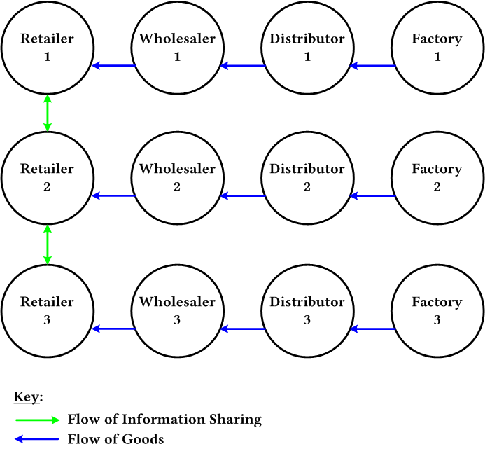
Progress and Insights to Share
Downstream supply chain information sharing
Delivers most of the benefits in backlog reduction
From literature review is the most practicable option
Figure 1. Vertical (Downstream)
Information Sharing
3:30-5:00
Notes:
Again short. Show structure or behavior – may not be room for both (some flexibility on font for these). No need to conclude, there is always more to be done. Note the timing in the bottom right.

