Slide 1
ISDC 2018
Malware dynamics: how to develop a successful anti-malware defense reference architecture policy
Speaker: Sander Zeijlemaker, PhD Student
Authors: Sander Zeijlemaker RA RE MSc CSF, Jorge Daniel Uriega Silva MSc, Dr. Guzay Pasaoglu

Slide 2
Difficulties in cyber security investment decision making
Past raised concern (Tongia and Kanika 2003, Su 2006, Rue et al 2007, Graves et al 2016)
Incomplete Data
Inaccurate Data
Tackle the essence of the case
Fear, Uncertainty and Doubt, FUD (Tongia and Kanika 2003)
Willingness to spend (Anderson et al 2013)
‘Cover my ass security’ (Schneier 2007)
Our malware dynamics model is an attempt to address these past raised concerns

Slide 3
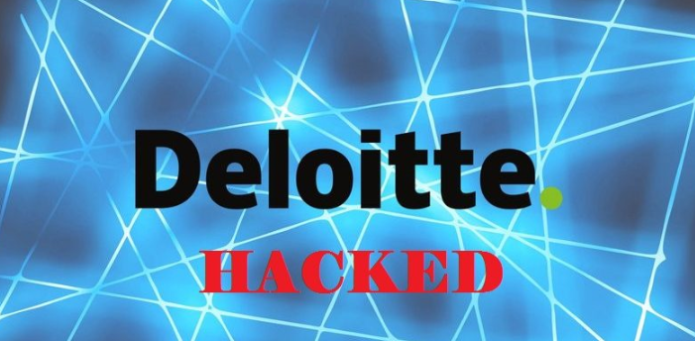
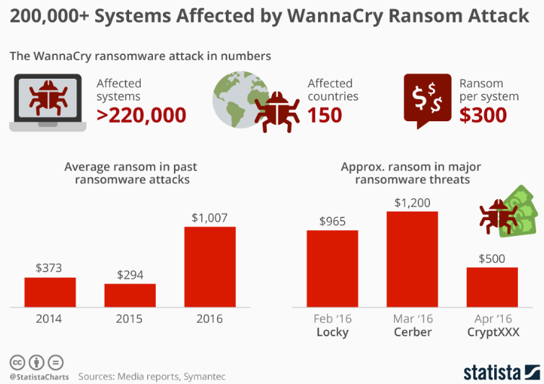
Some real-life examples in 2017*
*sources: semantic, hack facts and NBC news
Notes:
These examples are cyber attacks with their results known in the media while preventing these attacks were relatively easy (patching, update, strong passwords). However, it did not happen.

Slide 4
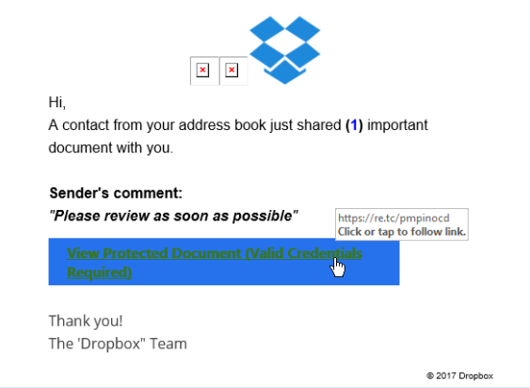
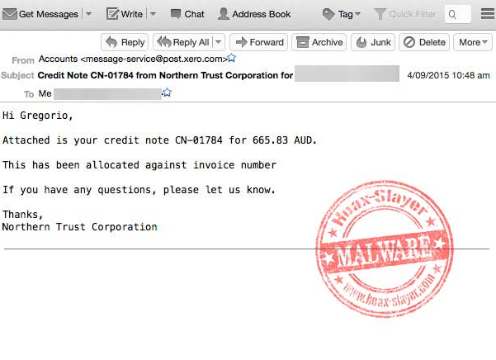
Sometimes people receive suspicious emails; maybe you recognize them

Slide 5
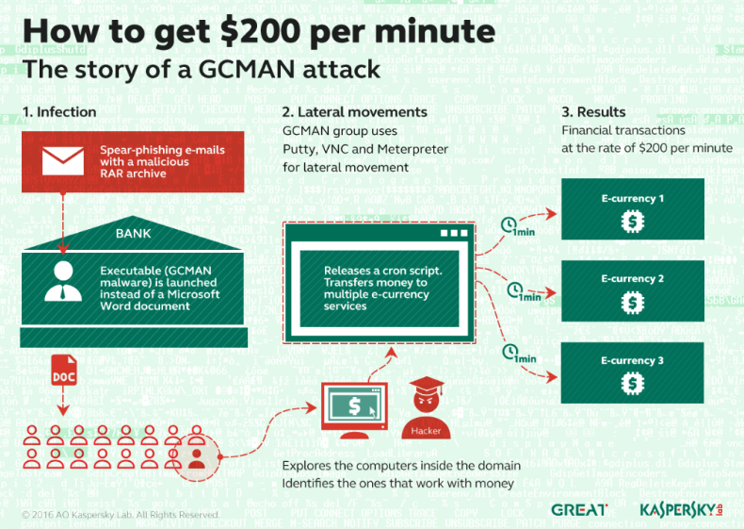
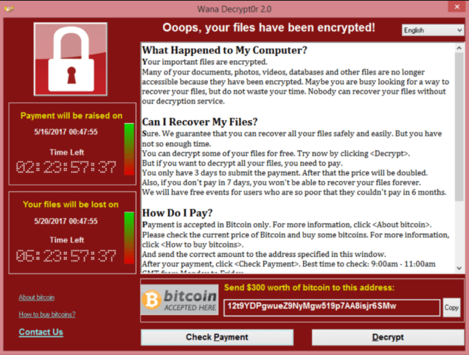
In case you open files or click on links you, your device or even your employer may be under attack by a threat actor

Slide 6
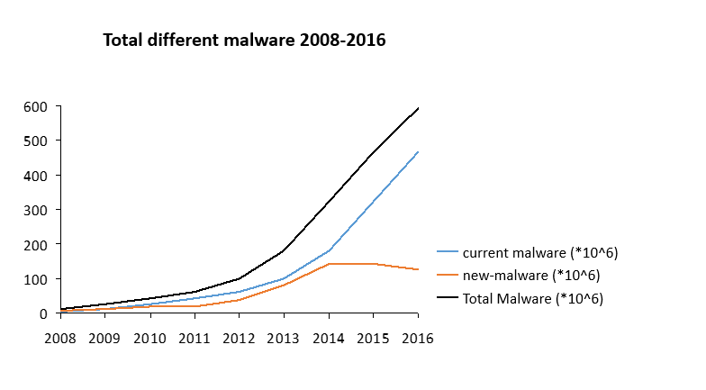
Susceptibility for malware attacks is a relevant security (research) question
Kill chain
Malware usage

Slide 7
Our malware dynamics model recognizes: attacker – defender interactions, employee awareness and asset susceptibility
Assets
successful malware attack
Employees
Learn from infections
Activate malware attack
Click on links / open files
Security function
Inform / train
Targeted attack
Mitigate malware attack
Threat actor
Learn from threat actors
Launch malware attack

Slide 8
Our model combines expert participation, calibration to actual data, fairly rigorous testing, and extensive policy analysis
Other Assets
successful malware attack
Assets
Response to infection
Resolved devices
Known infected devices
Employees
Learn from infections
Cleaned asset
Detect / observe infectivity
Share experiences
Susceptible devices
Unknown infected devices
Unaware employees
Aware employees
Not stopped malware attack
Click on links / open files
forget
Activate malware attack
Security function
Inform / train
Patching
Targeted attack
Anomaly detection
Mitigate malware attack
Threat actor
Network segmentation
Learn from threat actors
Anti Malware scanners
Innovate by failure
Black listing
Launch malware attack
Known malware
Unknown malware
Proxy server
Observed by defenders
Spam Filters
= in this area the attacker can evoke damages without notice of the defender. Especially when crown jewels or high privilege accounts are compromised.

Slide 9
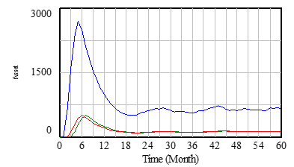
We simulated several different policy settings
Organisation
Organization A
500 employees
2.500 assets
Organization B
2.500 employees
10.000 assets
1
Organization A and B
Anomaly detection in place?
Foothold defender and attackers behaviour, awareness employees, layers of defence
Foothold defender
2
General malware attacks
3
Organization A
Increase to infection of 16% of assets follow by small decline (low defence)
Small peak up to 0,04% of assets infected (high defence)
Organization B
Increase to infection of 9% of assets follow by small decline (low defence)
Small peak up to 0,06% of assets infected (high defence)
Specific malware campaigns

Slide 10
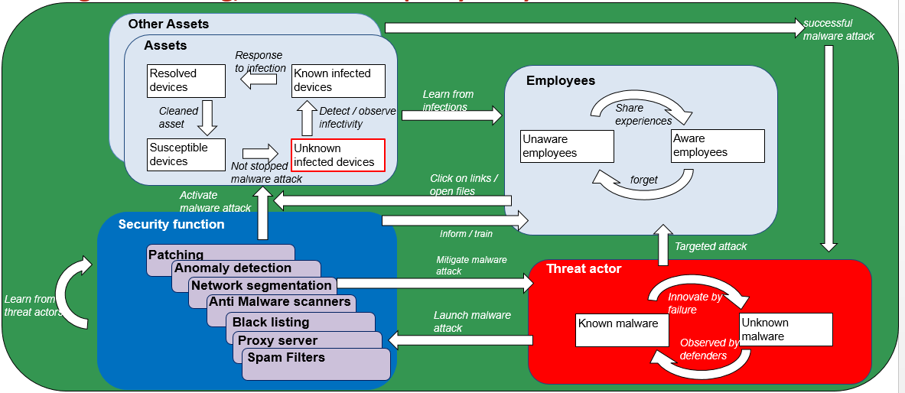
Possible Future Research
By building this malware dynamics model we were able to quantify.
Further research should provide us rational quantified evaluation means (not FUD, e.d.) by:
Including dynamics for defender financial decision making
Focus on end-point and servers
Focus on the attacker dynamics within the “unknown infected devices
Include dynamics from an attacker perspective
€

Slide 11
Contact information
Sander Zeijlemaker
PhD research student Radboud University
E: s.zeijlemaker@ru.nl
Notes:
Contact information

