Slide 1
A system dynamics funding model for universities
THE 36TH INTERNATIONAL CONFERENCE OF THE SYSTEM DYNAMICS SOCIETY
REYKJAVÍK, ICELAND
Malcolm Brady
Dublin City University
ID#2025
0:00-0:30
Notes:
Title page: Bold the name of the presenter and display your name as you want it read by the moderator (eg Bob instead of Robert). Do not include contact information. Timing in the bottom right. Moderator will change slide following that schedule, or earlier if requested. Change if needed.

Slide 2
Problem Statement
A fundamental shift in nature of funding for European universities is taking place
A move from largely tuition based funding
A move to other funding sources
Research grants
Philanthropy
The question is: what are the implications for universities of this funding shift over time?
0:30-2:00
Notes:
Problem Statement: Do not change this title. Keep fonts big (24 pt or bigger). Indicate why the problem is important.

Slide 3
Approach or Dynamic Hypothesis
The paper considers a causal loop/ influence approach to the university funding issue
In essence it creates a dynamic business model of university activity and funding
The anchor constructs of the model are
Resources
Reputation
Assumption: that different sources of funding generate reputation over different time scales
2:00-3:30
Notes:
Again big fonts, do not alter title

Slide 4
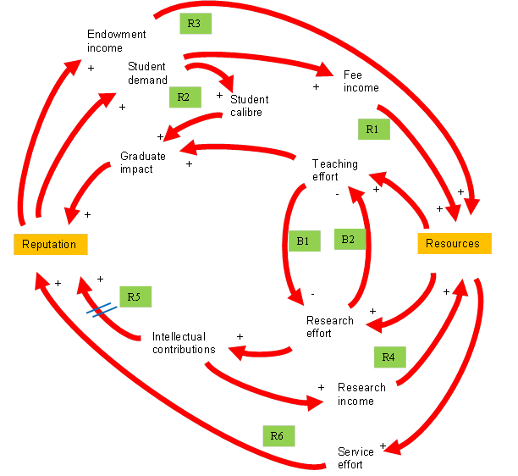
Progress and Insights to Share
Several reinforcing loops
One balancing loop
Several university business models
Teaching only
Research only
Mixed mode (teaching and research)
3:30-5:00
Notes:
Again short. Show structure or behavior – may not be room for both (some flexibility on font for these). No need to conclude, there is always more to be done. Note the timing in the bottom right.

