Slide 1
P2015 Research Project Workshop B www.pbs.plymouth.ac.uk/P2015
David Carter
15:00-17:00
14 November 2014
Plymouth University
Mast House, Room 004a and b, PL4 0HJ
Notes:
UPON ENTRY TO ROOM TALK STARTS
Switch-on workshop audio recordings
Check sound levels on video clips
Confirm all presentation elements on desktop

Slide 2
Purpose of today’s P2015 Workshop
Support aim of explaining impact of competing for secondary places on children with objective of quantifying the problem with applicable agents by:-
Testing intervention opportunities;
Collating views on problem linkages;
Assessing progress and improvements with methods.
Notes:
13:30-13:45 (15 minutes)
Start audio recording
Three bullets and 2 more slides

Slide 3
Agenda – Group Model Building
Introductions and problem 15:00 (slide)
Nominal Group Technique 15:10 (paper forms)
Causal Model Map 15:50 (whiteboard)
Debriefing Survey 16:45 (clicker responses)
Parking and refreshments available
Notes:
Workbook has aim for today and case-specific, real world problem on your desk based on what is available online. Also glossary of terms at the end otherwise just ask.
Will be using sketch models within workbook to record connections when discussing component parts

Slide 4
Introductions & Project Problem
Primary schools currently experiencing population bulge but 17% more children a year putting pressure on 95% first choice Plymouth secondary school expectations not yet a major concern for multi-agent modellers from council, health and education;
Parents and children relationship when deciding secondary school of greater value to participants;
How might parents and children select schools best matched to their needs in an uncertain future?
Notes:
TIMING - 13:45 complete this slide
Run through list
Check everyone OK with recording audio
Ask everyone to complete their card facing outward and take it in turns to explain their education, health or local government backgrounds
No names will be mentioned; only views and demographics sampled

Slide 5
Recap Hopes and Fears from Workshop A
Modeller | Hope | Fear
1 | Genuine multi-agency working | Time commitment too high
2 | Systemic perspective | Negative impact on individuals
3 | Meaningful change for family/child | Reductionist perspective
4 | Positive support for explaining available choices | Not broad enough group
5 | Practical change benefits | Whether it will make a difference
Notes:
13:45
TIMING - 1 minutes (5 writing, 1 minute each explaining)
LOGISTICS – handout each paper copy, using pencils and rubbers write responses, collect once complete
PROCESS –
Explain last workshop results from exercise
B. Top hopes
Genuine multi-agency working; responses to question 11.2.7 suggest that your own contributing agency values do related to their views while question 17.2.13 answers indicate that each organisations culture was being accurately reflected. Very positive views were also expressed in response to question 25.3.8 about contributors working well together in teams (see your percentage answers in attachment);
Practical change benefits have completely neutral views at present since we have only looked to understand more around parental and child anxieties when changing schools for those aged eleven without the opportunity to check for where changes might improve the situation; question 15.2.11 refers (see your percentage answers in attachment);
A systemic perspective addressing all key influences is offered through this approach by building quantified system dynamic models so the answers to question 10.2.6 is naturally divided between the majority who are neutral and others who are/or have yet to be convinced as it is only start of the development cycle (see your percentage answers in attachment);
Meaningful change for family/child/young person is informed by the spread of answers to understanding the ethics around transferring schools and the admissions system whether appreciating or not according to your responses to question 13.2.9 (see your percentage answers in attachment);
Positive support for explaining available choices is informed by responses to listening to other people’s views in question 24.3.7. Here only one participant remained neutral on whether or not they had been heard while the remainder all accepted that they had expressed themselves within the group and therefore provided early indications on whether this research could help explain choices facing those making secondary school decisions (see your percentage answers in attachment).
Top fears
Time commitment too high may be smaller than anticipated, based on the first of three workshops each lasting no more than three hours. However it is noted that even greater facilitation would help keep time answering scripts to a minimum and allow the agenda to be completed.
Negative impact on individuals was not surveyed but all signatories agreed not to disclose details of the conversations by naming individuals involved, so that the group could have confidence to express their views without fear of negative management feedback. The lead researcher also accepted that any quotes would be anonymised for reporting purposes using the participants alphanumeric allocation rather than a name and organisation; it was confirmed that no manager subordinate pairs were present in the group.
Reinforces reductionist perspective is countered by the range of agency views incorporated through representation across all three groups including local authority, health and education in question 2. System dynamics allows different scaling and supports incorporation of wide-ranging influences within models that more event-based, mathematical techniques might not (see your percentage answers in attachment)
Not broad enough group is answered by group demographics which suggests approximately 40 years combined experience (averaging question 4) in the area alongside everyone being over the age of 25 according to your question 3 responses (see your percentage answers in attachment). A recognised weakness of small group modelling is the number in a small group however, aspects of these views will widen by obtaining the voice of children through teaching assistants together with surveying parents about the weight of their views on what constitutes a good decision.
Unsure whether it will make a difference is answered in question 15.2.11 as before and it is noted that this is a very reasonable uncertainty that comes from developing insights that can be shared in a complex and dynamic environment (see your percentage answers in attachment)
C. CLOSE – next topic.

Slide 6
Nominal Group Technique for potential applicant wellbeing policy interventions
 | Policy A | Policy B | Policy C
Originator 1 |  |  |  | 10 mins
Reviewer 2 |  |  |  | 5 m
Reviewer 3 |  |  |  | 5 m
Reviewer 4 |  |  |  | 5 m
Review update |  |  |  | 5 m
Best policy | Y/N | Y/N | Y/N
APPLICANT ADMISSIONS
Notes:
15:20 (35 minutes)
LOGISTICS – handout punched paper forms, ask originator to suggest a policy decision rule applied to their own or another’s organisation before passing it on. SUGGEST WRITING IN SMALL CAPITALS FOR EASE OF READING AND KEEPING IT SHORT
PROCESS -
Introduce policy options for intervening to reduce complaints, appeals and anxieties in the Plymouth system as demand rises over next four years
A policy intervention example might be to encourage applications to other admission authorities but this might not be a good option for reducing anxiety
Originators indicate their policy intervention options in boxes provided (writing in small capitals may be best for quality reviews) in 5 minutes
Timer then goes and papers pass to neighbour to provide a succinct review of good and bad aspects of adopting the policy. This repeats until originator receives their fully commented, policy interventions back.
Last workshop consider all the commentary from reviewers, now indicate preferred option i.e. which two policies might not work in a multi-agency context (5 minutes).
When invited present policy option for best intervention along with typical benefits for different agencies (a minute per person).
Now vote to decide top three (scored 3-2-1) presented policies best able to meet anticipated system demands, given the impending population rise of primary school children transferring into secondary education.
CLOSE by making copies then placing punched papers in workbook for next workshop.

Slide 7
Sketching a Causally Mapped Model
Cause
e.g. smoke
-
+
Effect
e.g. disease
Balanced Loop
Control Example;
more smoke more
disease, more
diseased fewer
smoke.
Notes:
14:50
TIMING - 40 minutes
LOGISTICS – flip chart, variables listed on sticky notes with blue tack, marker pens
PROCESS –
Ask for variables that affect wellbeing of those making secondary school choice decisions; those variables either adding to taking away from this stock should be written on individual sticky notes and parked on flipchart.
Concentrating on anxiety, link to wellbeing reduction impact explanations (physical MHNL1, mental MHNL2 and sociological MHNL3) before drawing/representing primary loops and asking for polarities using graph.
C. CLOSE – collect papers at end of the day. next want to collect views on first workshop.

Slide 8
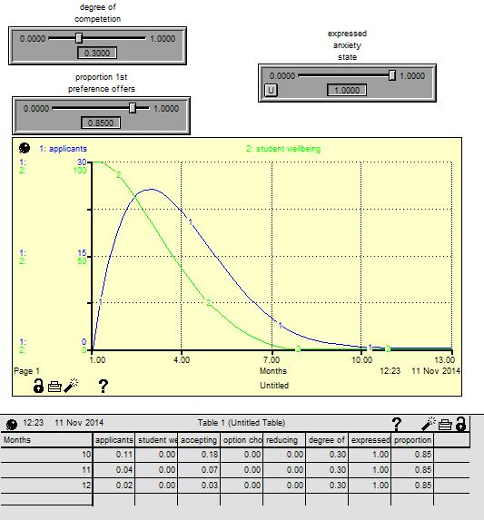
In-year admission dynamics example
LEVERS
STRUCTURE
RESPONSE
Notes:
16:30
demonstrate levers in action if not already used during the break

Slide 9
Electronic methods debrief; use clicker
Notes:
15:55
TIMING - 15 minutes (5 minutes explaining clicker technology, 5*2 for each set of questions)
LOGISTICS – handout clickers at start of session, using power up button and then selecting numbers from 1 to 5 when green shows on screen
PROCESS –
A. Start turning point, switch to questionnaire powerpoint on desktop
B. Ask questions, check 9 or 7 responses, plot results, move on
C. CLOSE – save details to file, export reports to Excel and as CSV, clear questions
Stop audio recordings
Thank those who have attended hoping they have enjoyed the workshop and obtain potential dates for next meeting (July)

