Slide 1
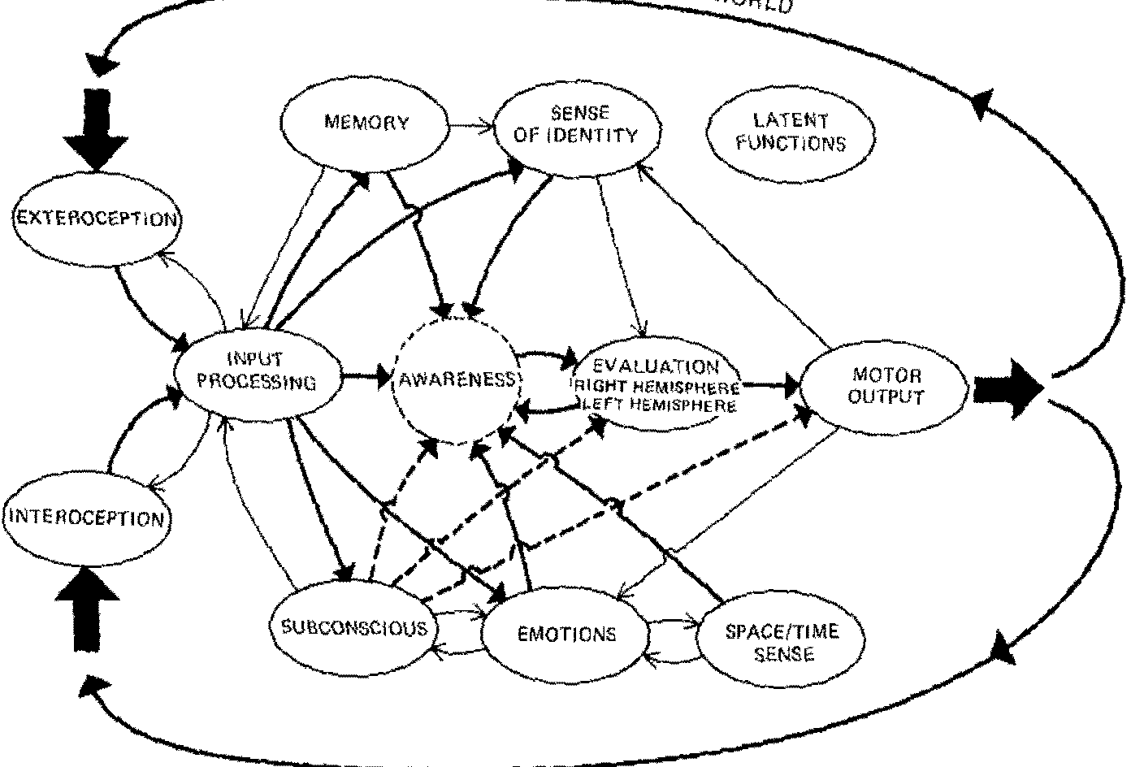
Figure 1

Slide 2
Figure 2

Slide 3
Figure 3

Slide 4
Figure 4

