Slide 1
­Applying System dynamics to simulate Iran’s engineering post graduates’ employment status
A.Moslemini, MS.Owlia, K. Gholami
Yazd University, Yazd, Iran
+98(935)8379062
moslemini@yahoo.com

Slide 2
Introduction
during recent decades, students’ admission in Iran’s universities had not been in line with country’s market’s needs for academic hum­an resources [1]; a fact which has led to problems such as lack of experts in some fields and excess of them in many others. Graduates unemployment and under employment are the most vivid results stemming from this problem.
In this research, we simulated Iran’s market’s future capacity for engineering post graduates from one side and the number of engineering PhD graduates, PhD students and master graduates from the other side to make it possible to predict post graduates’ employment status in country’s near future.

Slide 3
SD’s application in modeling educational systems
advantages for using SD to model higher educational systems:
Model feedbacks or interactive views in dynamic systems like higher education
Incorporate non-linear relationships inherent in higher educational quality issues
Address complexity situations while experimenting their behavior over time
Accommodate soft factors that underpin higher education quality issues

Slide 4
Reference modes
PhD engineering graduates vs. university and industry’s capacity

Slide 5
Reference modes
Fig3. Master engineering graduates vs university and industry’s capacity

Slide 6
Engineering students’ admission and graduation sub system

Slide 7
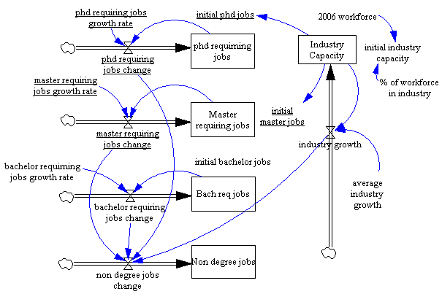
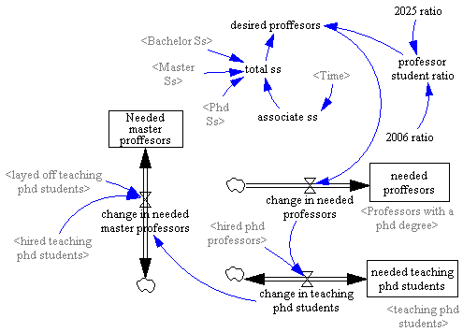
Capacity for engineering post graduates
Market
University

Slide 8
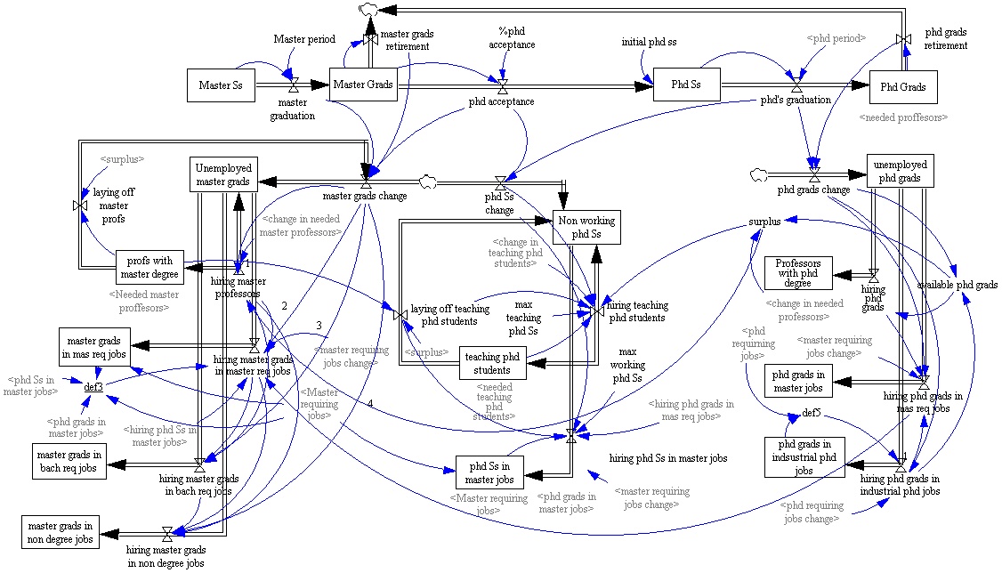
Post graduates employment status sub system

Slide 9
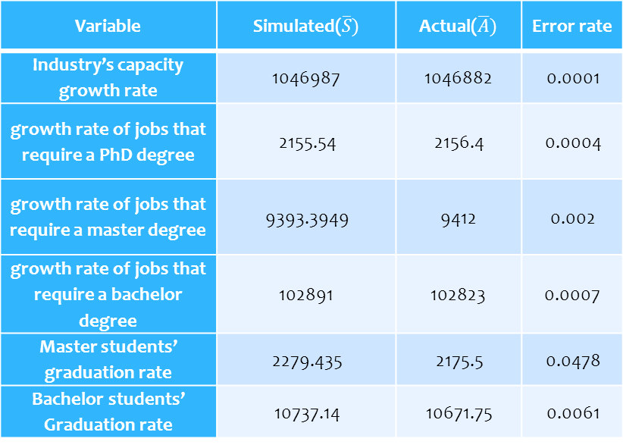

Model Validation
Model’s Error rate
$$Errorrate= \frac{\left|\overline{S}−\overline{A}\right|}{\overline{A}}$$
Variable | Simulated($\overline{S})$ | Actual($\overline{A})$ | Error rate
Industry’s capacity growth rate | 1046987 | 1046882 | 0.0001
growth rate of jobs that require a PhD degree | 2155.54 | 2156.4 | 0.0004
growth rate of jobs that require a master degree | 9393.3949 | 9412 | 0.002
growth rate of jobs that require a bachelor degree | 102891 | 102823 | 0.0007
Master students’ graduation rate | 2279.435 | 2175.5 | 0.0478
Bachelor students’ Graduation rate | 10737.14 | 10671.75 | 0.0061

Slide 10
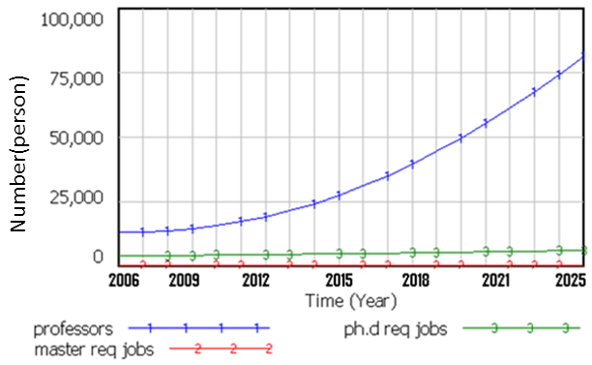
Results
Fig8. PhD graduates’ employment status

Slide 11
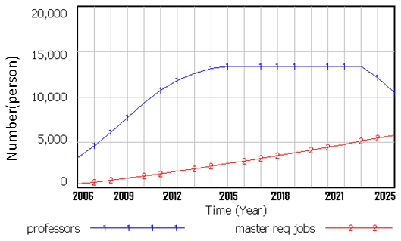
Results
Fig9. Phd students’ employment status

Slide 12
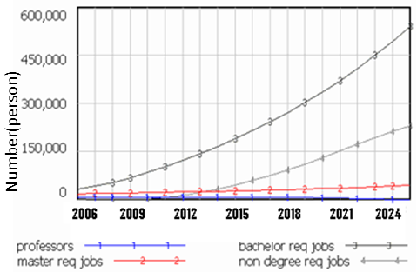
Results
Fig10. Master graduates’ employment status

Slide 13
Discussion
there will be enough job opportunities for engineering PhD graduates in both university and industry preventing them from jobs with lower academic degrees or becoming unemployed in onward years.
there will always be enough job offerings from universities to let a considerable percent of engineering PhD graduates to be employed as professors.
most engineering master graduates should be relegated to jobs requiring less knowledgeable workers (under employment).
Recommendations to improve Master graduates’ future:
Increase the growth rate of knowledge intensive jobs in country’s industry.
Decrease admission rate of higher education in master’s degree; to adapt number of Master graduates to existing master degree requiring job opportunities in Iran’s industry.

