Slide 1

System Dynamics Society
27th International Conference
São Paulo University
Renewable Energy: A Framework to Model a Brazilian Case of Success (Part I)

Slide 2
Joaquim Rocha dos Santos (M.Eng.) – EPUSP
Marcelo Ramos Martins (PhD) – EPUSP
Abraham Sin Oih Yu (PhD) – FEA-USP
Paulo Tromboni Nascimento (PhD) – FEA-USP

Slide 3
Agenda
Tell the story
Graph the Variables
Making the System Visible
  Subsystem Diagram
  Causal Loops Diagrams
Identify the lessons

Slide 4
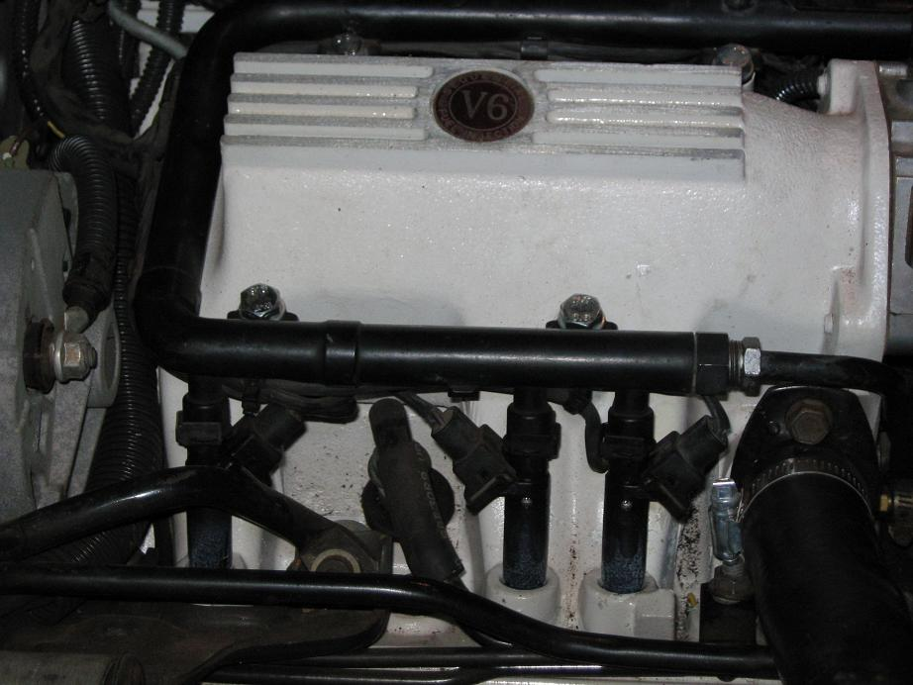
Tell the Story
What is this?

Slide 5
Tell the Story
What is this?
A flex-fuel engine with its flex-fuel
electronic injection system

Slide 6
Tell the Story
What is this?
WHY IS IT IMPORTANT?
A flex-fuel engine with its flex-fuel
electronic injection system

Slide 7
Tell the Story
What is this?
Sugar Cane Industry
Petroleum Industry
A flex-fuel engine with its flex-fuel
electronic injection system

Slide 8
Tell the Story
Environment
Sugar Cane Industry
Petroleum Industry
Land Avaliability
Food Industry

Slide 9
Tell the Story
Environment
Our Focus
(Today)
Sugar Cane Industry
Petroleum Industry
Land Avaliable
Food Industry

Slide 10
Tell the story
1970
1980
1990
2000
2010
Time

Slide 11
Tell the story
From 1950 to 1973
World oil demand increased steadily at a rate of 9.5%/year
Petroleum Costs stable around 2.5 US dollars per barrel
1970
1980
1990
2000
2010
Time

Slide 12
Tell the story
First Oil Crisis (1973)
The Organization of the Petroleum Exporting Countries (OPEC), established a new production level and costs policy
Barrel price increased to 11.65 US dollars.
1970
1980
1990
2000
2010
Time

Slide 13
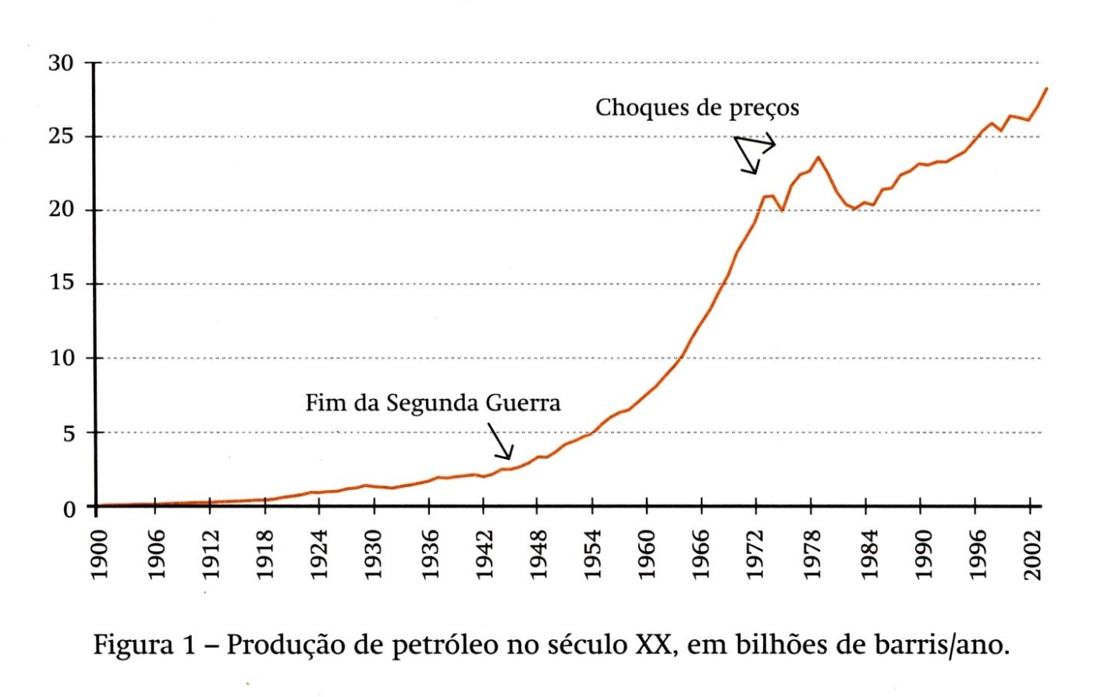
Tell the story
First Oil Crisis (1973)
The Organization of the Petroleum Exporting Countries (OPEC), established a new production level and costs policy
Barrel price increased to 11.65 US dollars.
1970
1980
1990
2000
2010
Time

Slide 14
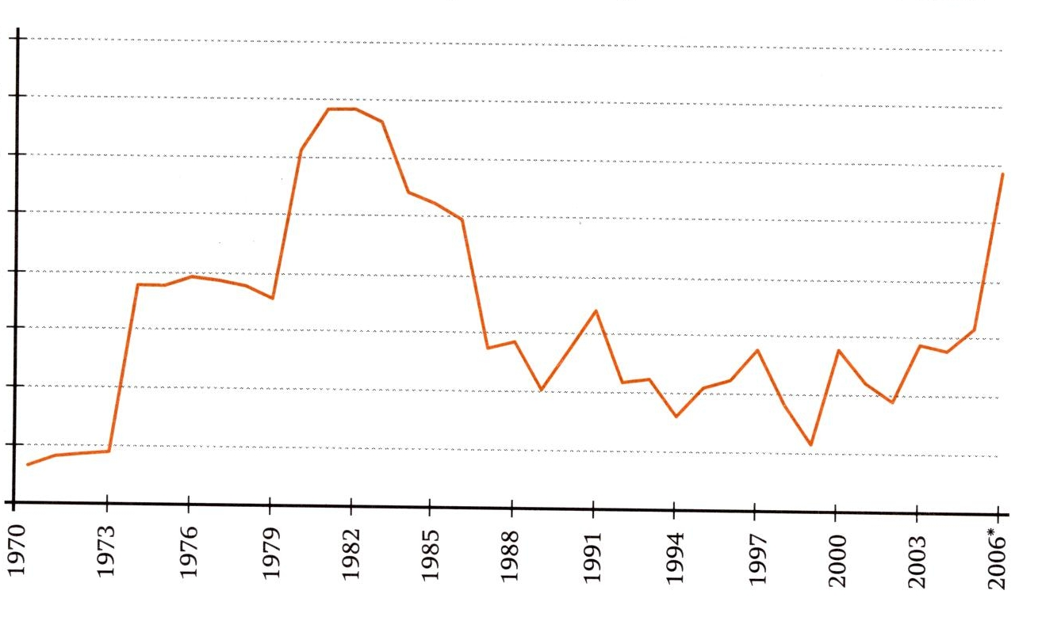
Tell the story
First Oil Crisis (1973)
The Organization of the Petroleum Exporting Countries (OPEC), established a new production level and costs policy
Barrel price increased to 11.65 US dollars.
1970
1980
1990
2000
2010
Time

Slide 15
Tell the story
Effects of First Oil Crisis (1973)
Relative short term demand inelasticity
Many countries faced a serious economic situation
Decreased discretionary oil consumption, reducing its relative importance in their energy matrix
Changes in macroeconomic policies, both fiscal and monetary
1970
1980
1990
2000
2010
Time

Slide 16
Tell the story
Effects of First Oil Crisis (1973) – Brazil
Systematic use of sugarcane ethanol as an alternative fuel started in 1934.
From 1934 to 1975 anhydrous ethanol was added to petrol.
In 1975, Brazil started its Alcohol Program, so called Proalcool.
At the beginning, the aim of the program was a modest replacement of petrol with anhydrous ethanol.
In 1980 the goal became more ambitious. This new policy achieved a relevant percentage of petrol replacement: from 1% in 1971 to 41% in 1985. (Leite, 2007).
Investment in Petrobras (Brazilian Petroleum Company)
1970
1980
1990
2000
2010
Time

Slide 17
Tell the story
Late 1970’s – Proalcool Program
1970
1980
1990
2000
2010
Time

Slide 18
Tell the story
Late 1970’s – Proalcool Program
In country development of E-100 cars.
In 1978, an agreement between the Brazilian Government and the National Association of Motor Vehicle Manufactures (Anfavea) established the beginning of E-100 development.
In 1979 the E-100 was in the streets.
1970
1980
1990
2000
2010
Time

Slide 19
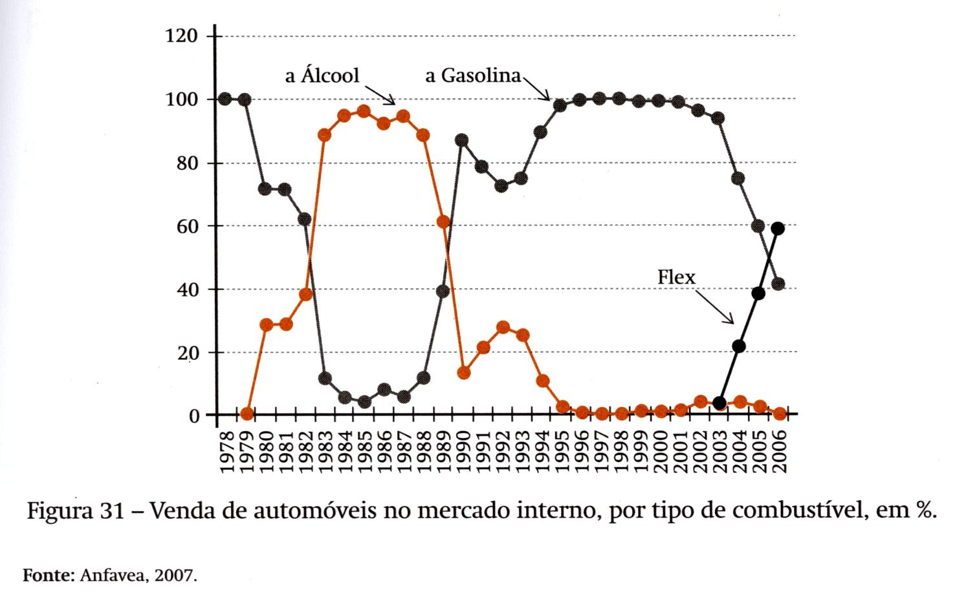
Tell the story
Late 1970’s – Proalcool Program
1970
1980
1990
2000
2010
Time

Slide 20
Tell the story
1985 – 1990 – Economic Crisis
1970
1980
1990
2000
2010
Time

Slide 21
Tell the story
1985 – 1990 – Economic Crisis
Political changes
Economic pressures:
  High inflation
  Low GDP for more than fifteen years.
Cut of subsidies
The total ethanol fractional usage reduced from 50% (1988) to 40% (1994).
During the 1980’s 70% of vehicles sold in Brazil where E-100. The ethanol fleet was relevant and it would take a decade to be deactivated.
1970
1980
1990
2000
2010
Time

Slide 22
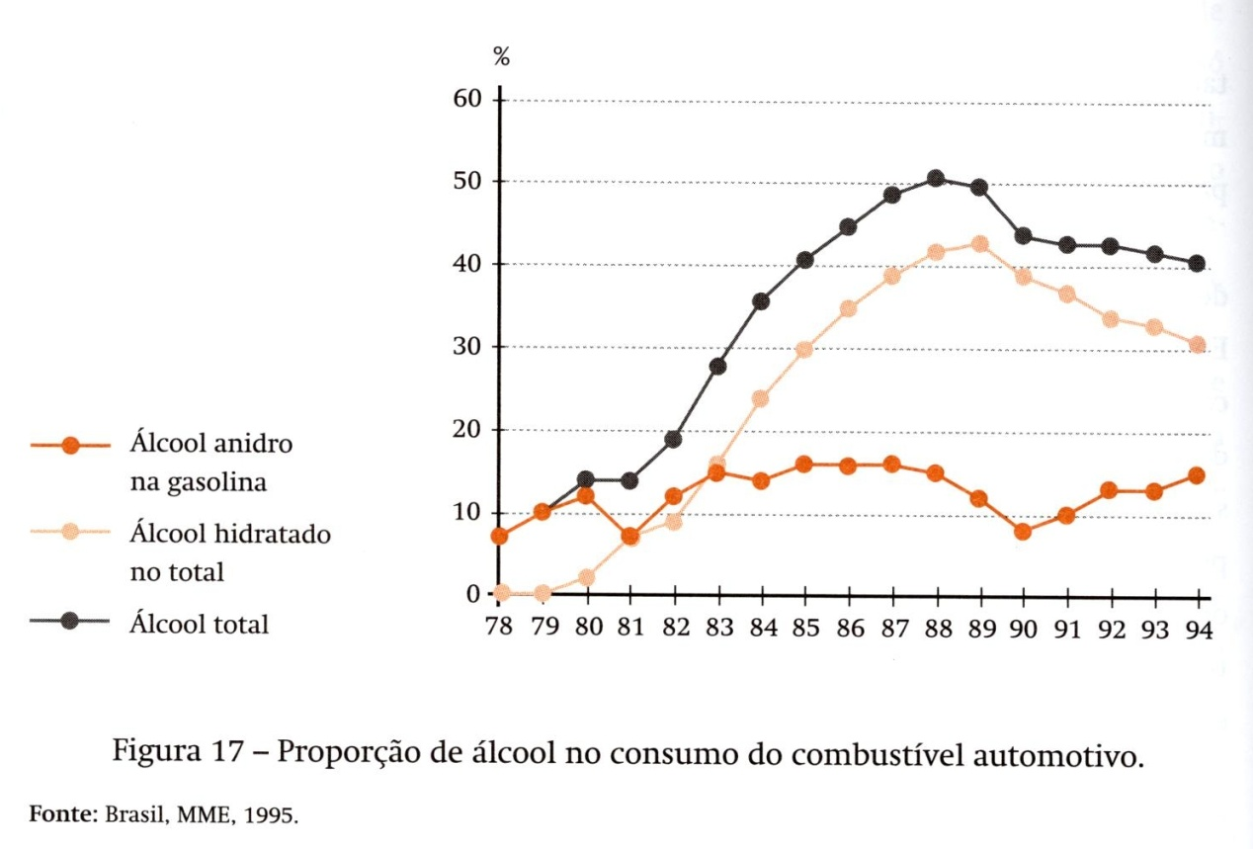
Tell the story
1985 – 1990 – Economic Crisis
Political changes
Economic pressures:
  High inflation
  Low GDP for more than fifteen years.
Cut of subsidies
The total ethanol fractional usage reduced from 50% (1988) to 40% (1994).
During the 1980’s 70% of vehicles sold in Brazil where E-100. The ethanol fleet was relevant and it would take a decade to be deactivated.
1970
1980
1990
2000
2010
Time

Slide 23
Tell the story
1985 – 1990 – Economic Crisis
Political changes
Economic pressures:
  High inflation
  Low GDP for more than fifteen years.
Cut of subsidies
The total ethanol fractional usage reduced from 50% (1988) to 40% (1994).
During the 1980’s 70% of vehicles sold in Brazil where E-100. The ethanol fleet was relevant and it would take a decade to be deactivated.
1970
1980
1990
2000
2010
Time

Slide 24
Tell the story
Early 1990’s
1970
1980
1990
2000
2010
Time

Slide 25
Tell the story
Early 1990’s
End of Proalcool
Rise in international raw sugar cane prices
SHORTAGE OF ETHANOL.
1970
1980
1990
2000
2010
Time

Slide 26
Tell the story
Early 1990’s
End of Proalcool
Rise in international raw sugar cane prices
SHORTAGE OF ETHANOL.
1970
1980
1990
2000
2010
Time
Lost of consumer confidence
This would charge its price later.
From 1986 to 2003, consumers no longer bought ethanol E-100 cars.
The remainder ethanol cars still sold were results of the sugarcane sector pressure for government incentives and the so called “green fleet”, part of the Government cars fleets should be E-100.

Slide 27
Tell the story
Early 1990’s
1970
1980
1990
2000
2010
Time

Slide 28
Tell the story
Early 1990’s
1970
1980
1990
2000
2010
Time

Slide 29
Tell the story
2003 – Flex Fuel Electronic Injection
Technological Inovation
1970
1980
1990
2000
2010
Time

Slide 30
Tell the story
2003 – Flex Fuel Electronic Injection
A technological innovation, the flex fuel electronic injection, was already available in the US. Bosch started to study this solution in 1988, in California, USA.
Due to the technology adopted, Bosch solution was expensive for Brazilian patterns costs and Brazilian motor vehicle manufactures refused to use it.
Moreover, dual sensor technology was not suitable for Brazil due to the presence of hydrated ethanol.
1970
1980
1990
2000
2010
Time

Slide 31
Tell the story
2003 – Flex Fuel Electronic Injection
A technological innovation, the flex fuel electronic injection, was already available in the US. Bosch started to study this solution in 1988, in California, USA.
Due to the technology adopted, Bosch solution was expensive for Brazilian patterns costs and Brazilian motor vehicle manufactures refused to use it.
Moreover, dual sensor technology was not suitable for Brazil due to the presence of hydrated ethanol.
1970
1980
1990
2000
2010
Time
Magnetti Mareli launched the flex fuel electronic injection system with only one sensor.
Volkswagen do Brasil launches its first flex car in 2003

Slide 32
Graph the Variables
Cars sold in Brazil

Slide 33
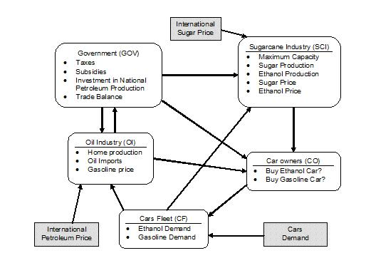
Making the System Visible
Subsytem Diagram

Slide 34
Making the System Visible
Causal loop Diagram

Slide 35
Making the System Visible
Causal loop Diagram

Slide 36
Identify the Lessons
This paper is 35 years late!!!
With this preliminary analysis, it is possible to understand the shift in loops dominance and why they happened
Flex fuel technology became a dominant design and changed the consumer behavior
Pro-alcohol program is now self sufficient and its long term effects must be studied in advance.

Slide 37
Next Step
Build a simulation model to explore some scenarios
Expand the model so as to include other relevant issues (land, food and environmental aspects)

Slide 38
Thank you very much!
Questions ...?

